Slide 1
Moller SC Magnet Status

Slide 2
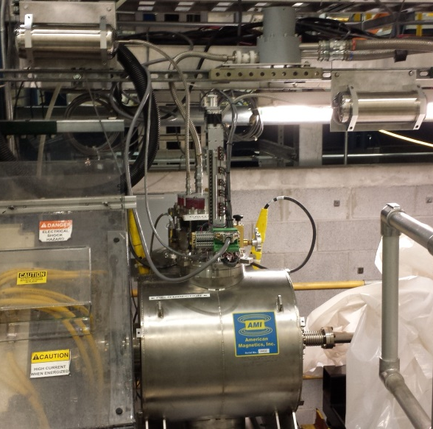
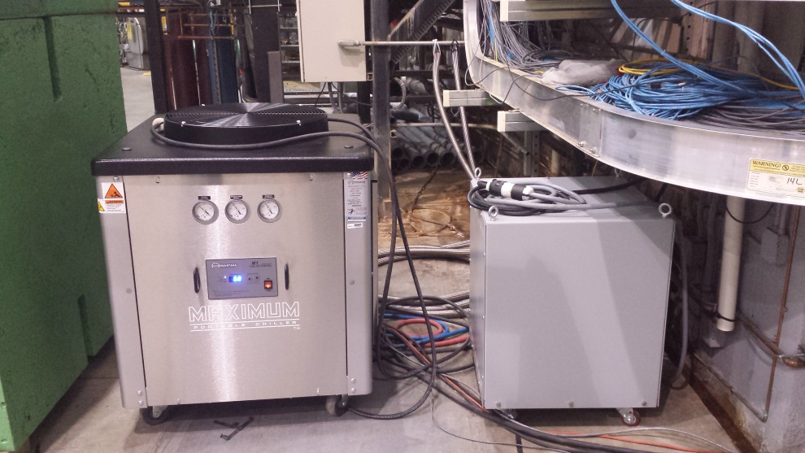
Installed
Magnet is installed and cooled down
EPICS controls tested and working
Magnet has been ramped several times in its current location
Insulating vacuum was pumped down to 1.40 x 10⁻⁷ mbar
Magnet Inductance=39.8 H, Stored Energy(@80 A)=127,360 J
Magnet on Beamline
Water Chiller and Compressor

Slide 3
Survey
Method – Laser scanner generating point cloud
Error of laser scanner is ~80 um
All surveying was done outside of vacuum and magnetic field
Measurements were all taken with motors moving in a consistent direction
Repeatability
Translational – Repeatable within 80 um
Rotational – Repeatable within .1º
Magnetic Coupling for Rotation
Gives us ~.5º of uncertainty due to play in coupling

Slide 4
Survey(cont’d)
Magnet is in place and surveyed
Pitch: .001º
Yaw: .003º
Roll : .010º
Individual foil survey
Measurements are compared to average foil position
Offsets are all less than .2 mm
 | Foil 1 | Foil 2 | Foil 3 | Foil 4
Pitch | .006º | -.025º | .092º | -.072º
Yaw | -.123º | .082º | -.078º | .119º

Slide 5
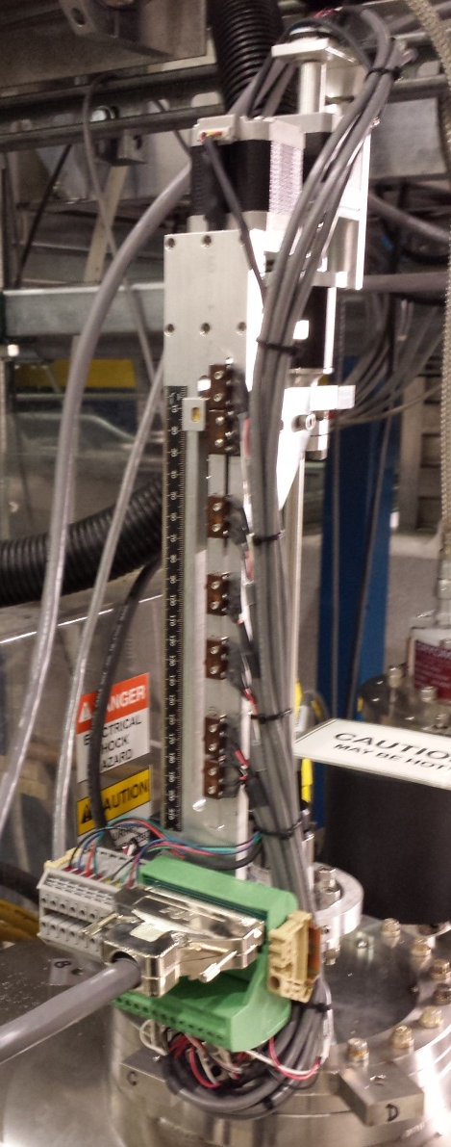
Foils
Installed Foils:
1 um – First foil position – Torn/unusable
4 um – Second foil position – 99.99%
12.5 um – Third foil position – 99.99%
25 um – Fourth foil position – 99.99%
All foils are made by Goodfellow
Target Foils in Holder
Target Arm in Magnet

Slide 6
Controls (Target)
Target motion can be done with a jog or preset positions
Preset positions
Translational: Centers of the foils and retracted
Rotational: 0º and limits
Position is determined by the encoders
Encoder Resolution:
Translational: ~15 mV/mm
Rotational: ~50 mV/degree
Target always moves in the same direction to destination, will use backlash correction if necessary

Slide 7
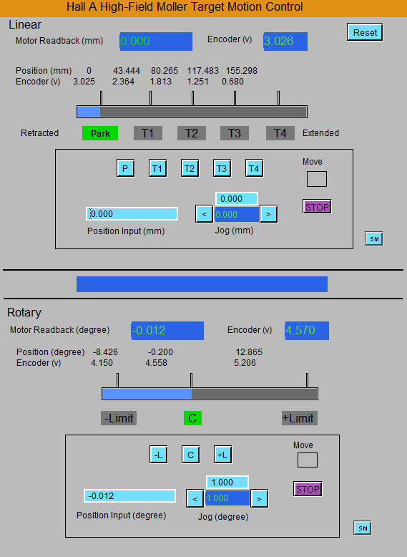
Controls (Target)

Slide 8
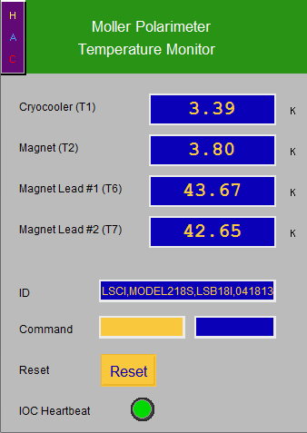
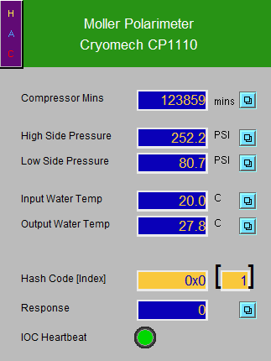
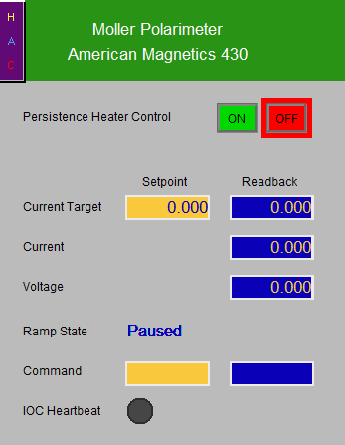
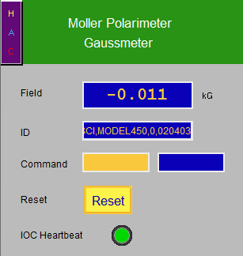
Controls (Magnet)

Slide 9
Measurement Goals
No Field, Target retracted
Does beam affect magnet temperatures?
Field at target, Target retracted
Any unaccounted for fields affecting beam steering?
Field at target, Target in place
Does beam hitting the target cause heating?
Moller measurement and compare with Injector group

