Slide 1

Hall A GEM Gas Distribution Rack
George Jacobs
Detector Support Group
09/04/2019

Slide 2
Hall A GEM Gas Distribution System Details
Single Rack Layout
  Front Panel Location For all Pressure and Flow Controls
  Rear Panel Location For all Gas Line Connections
  Layout Minimizes Tubing and Cable Lengths ( Minimizes Cost)
Provides 58 Total Gas Supply Channels
  10 High Flow (100-1000sccm) Channels
  48 Standard Flow (50-500sccm) Channels
  All 58 Channels Can be Routed as Desired

Slide 3
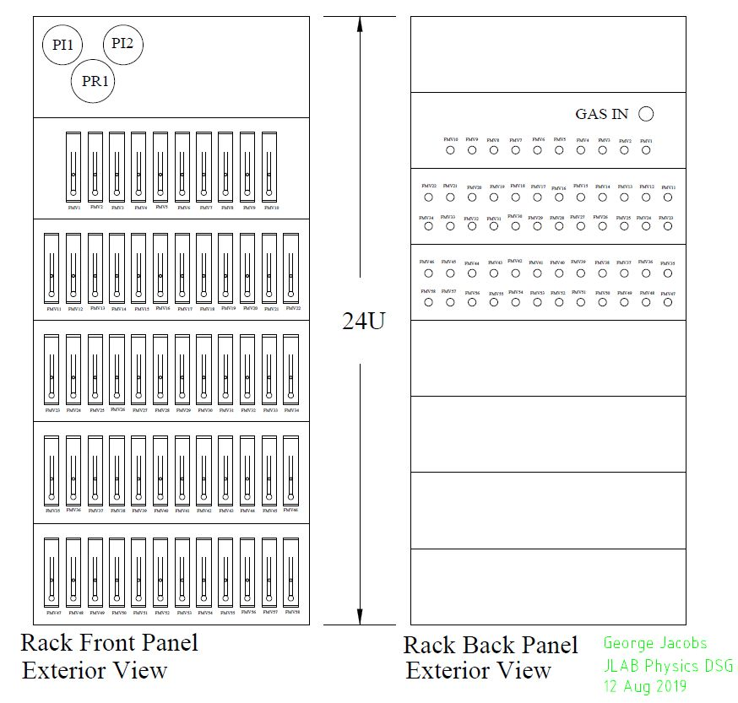
GEM Gas Distro Rack External View

Slide 4
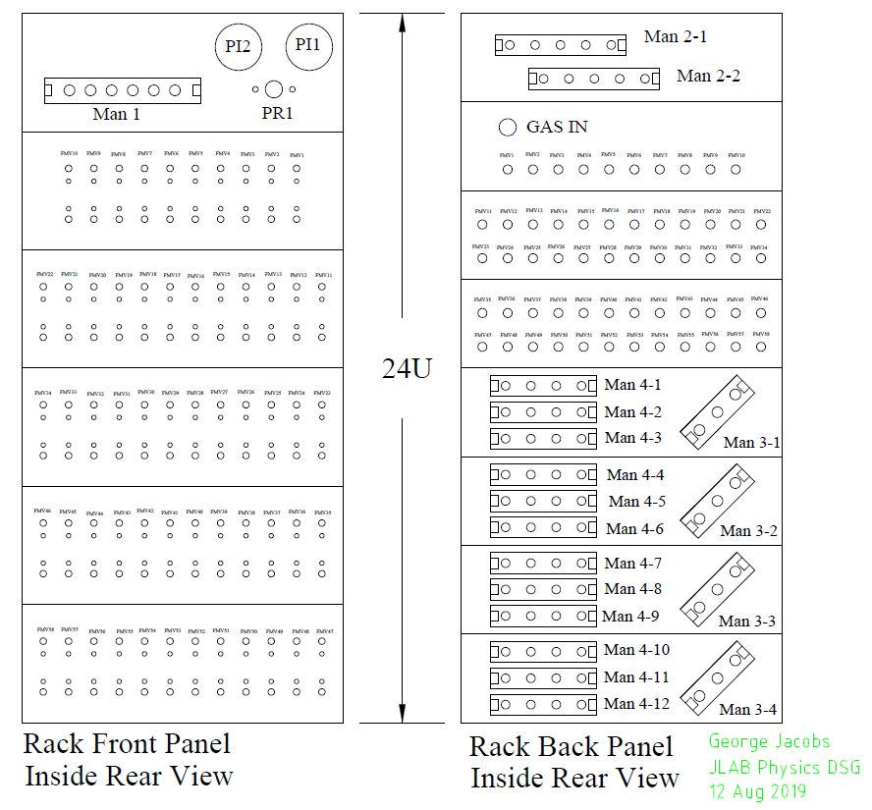
GEM Gas Distro Rack Internal View

Slide 5
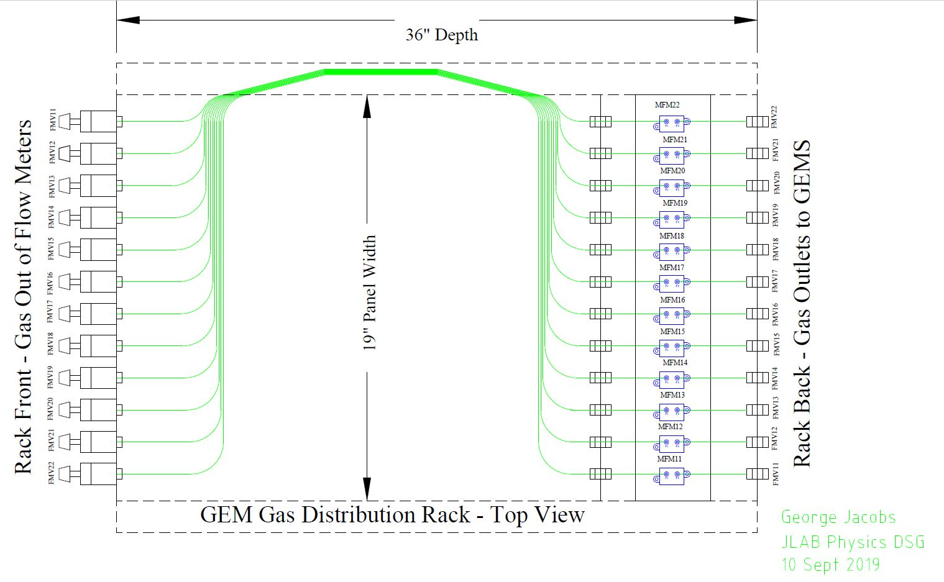
GEM Gas Distro Rack Internal Tubing Runs

Slide 6
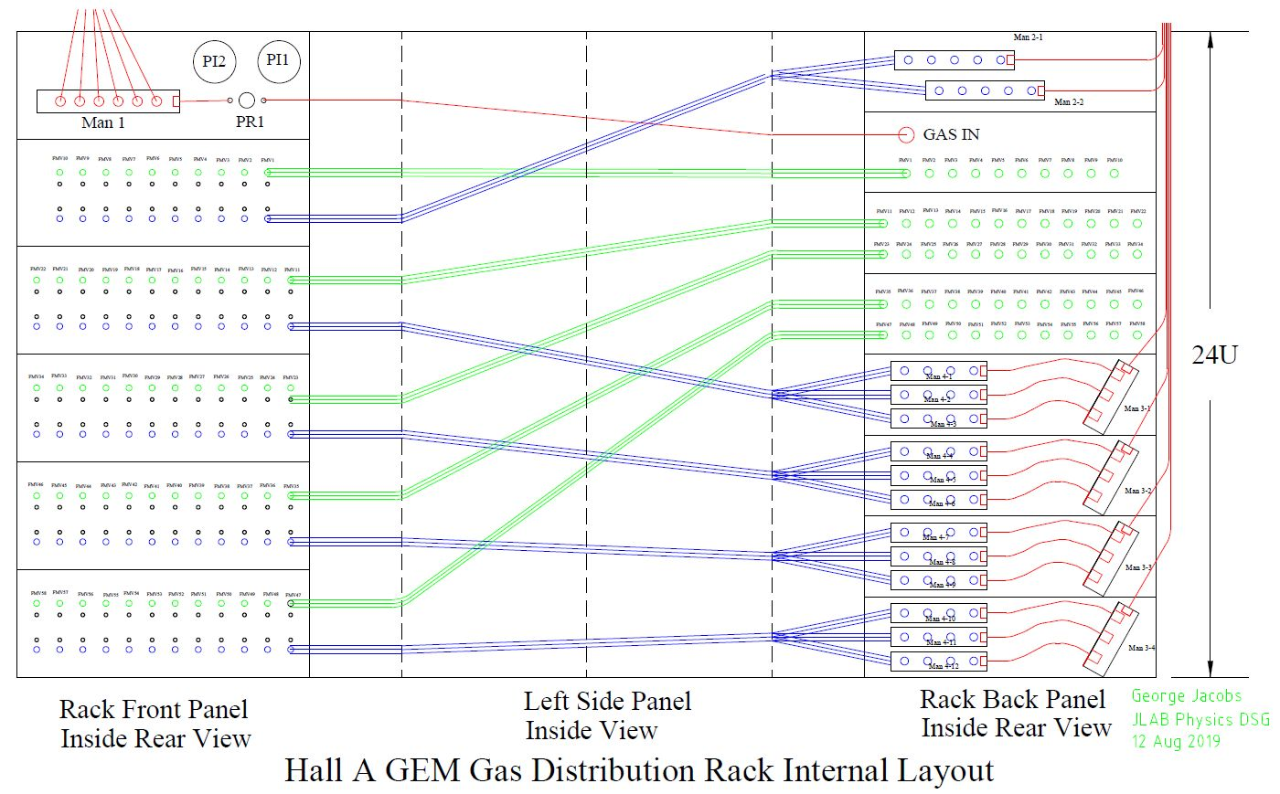
GEM Gas Distro Rack Internals Unfolded

Slide 7
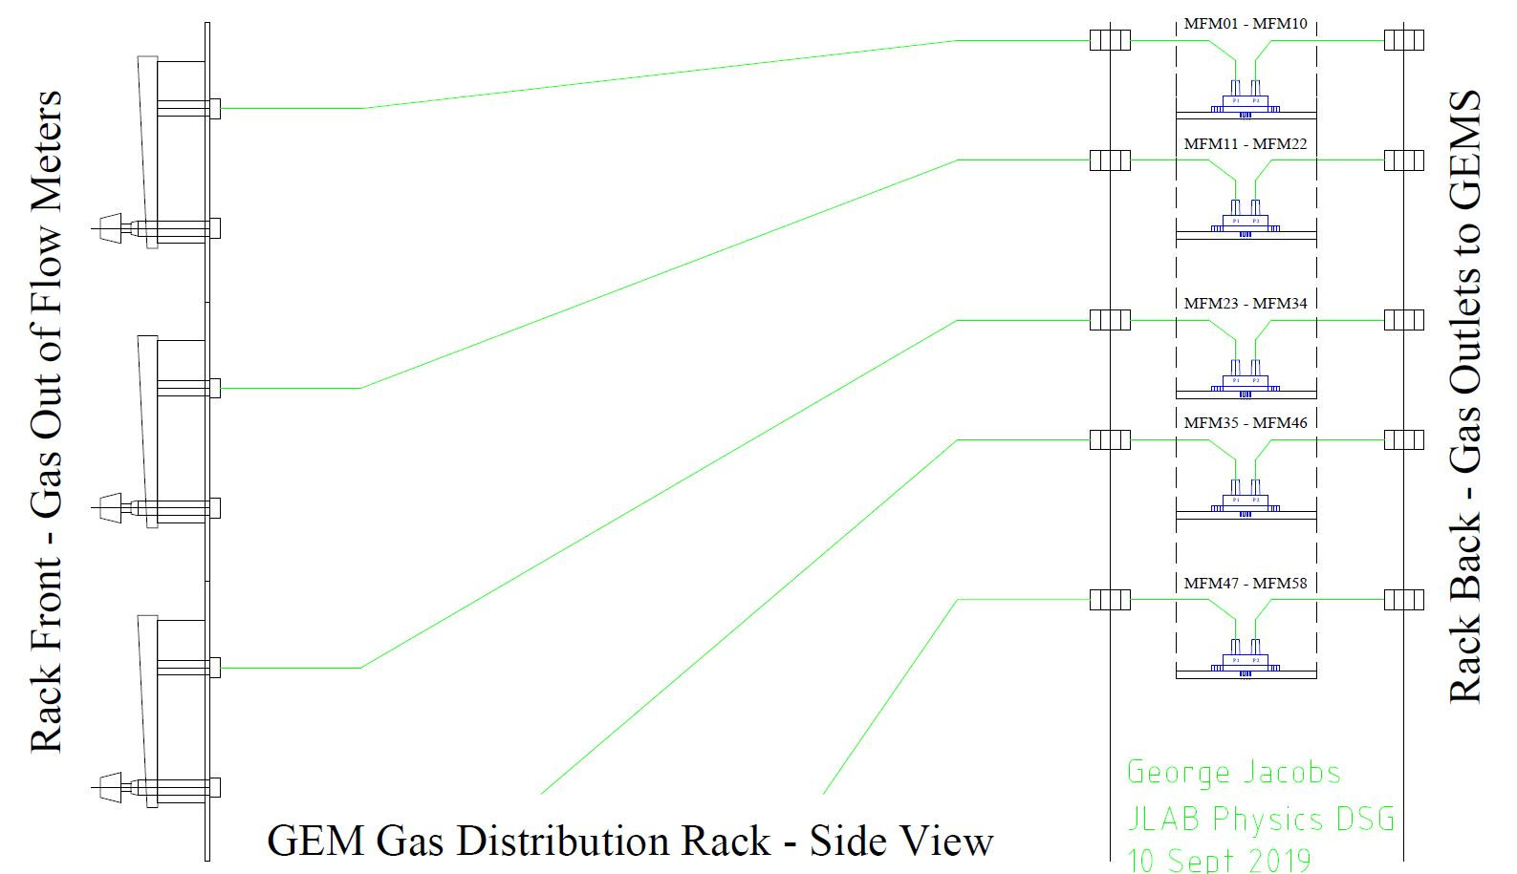
GEM Gas Distro Rack Transducer Plumbing

Slide 8
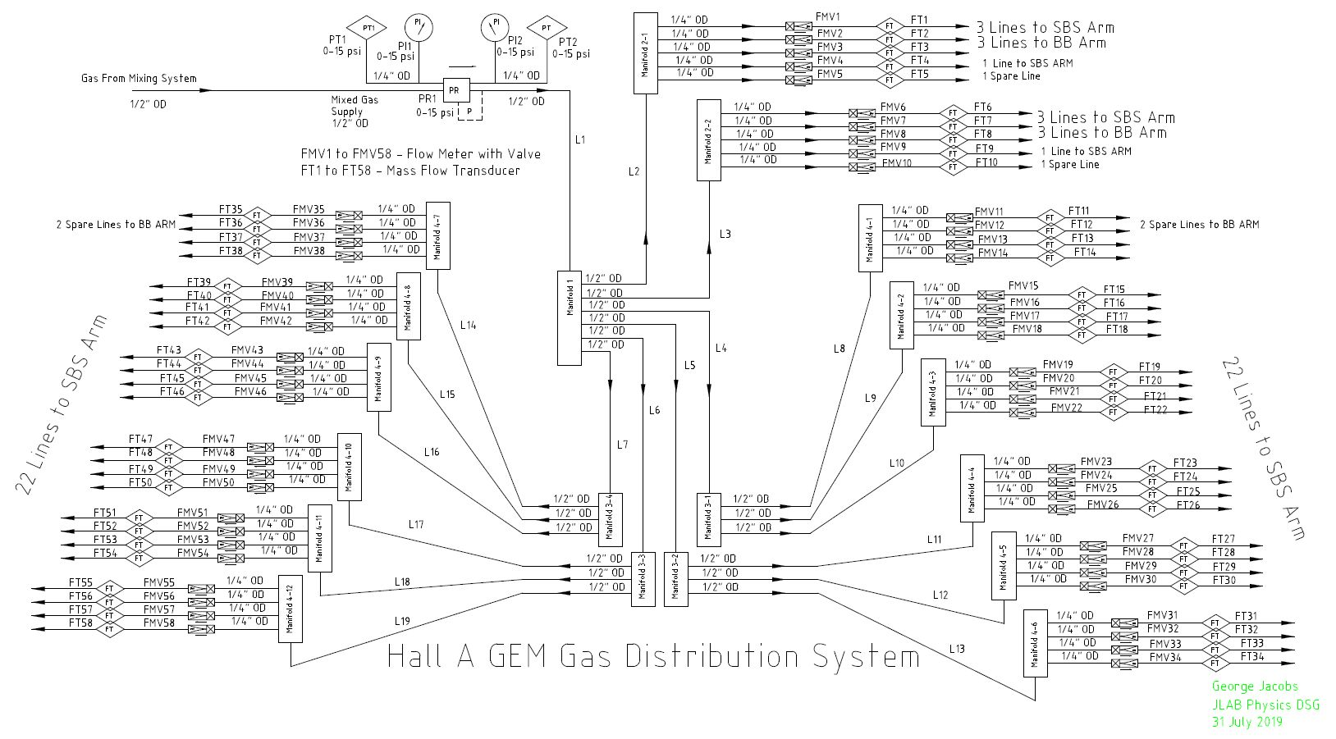
GEM Gas Distro System P&I Diagram

Slide 9
Conclusion
Portable High Density Single Rack Layout
  Front Panel Location For all Pressure and Flow Controls
  Rear Panel Location For all Gas Line Connections
  High Density Layout Minimizes Cost
Provides 58 Total Gas Supply Channels
  10 High Flow (100-1000sccm) Channels
  48 Standard Flow (50-500sccm) Channels
  All 58 Channels Can be Routed as Desired to Meet Current and Future Requirements

Slide 10
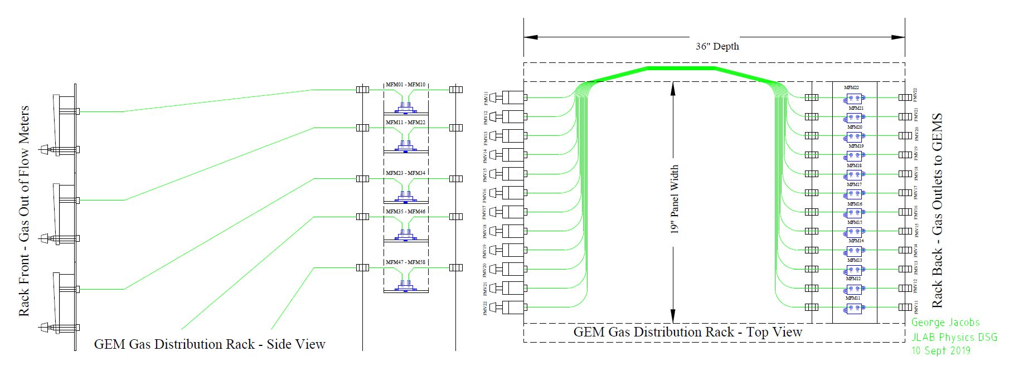
Mass Flow Transducer Installation

Slide 11
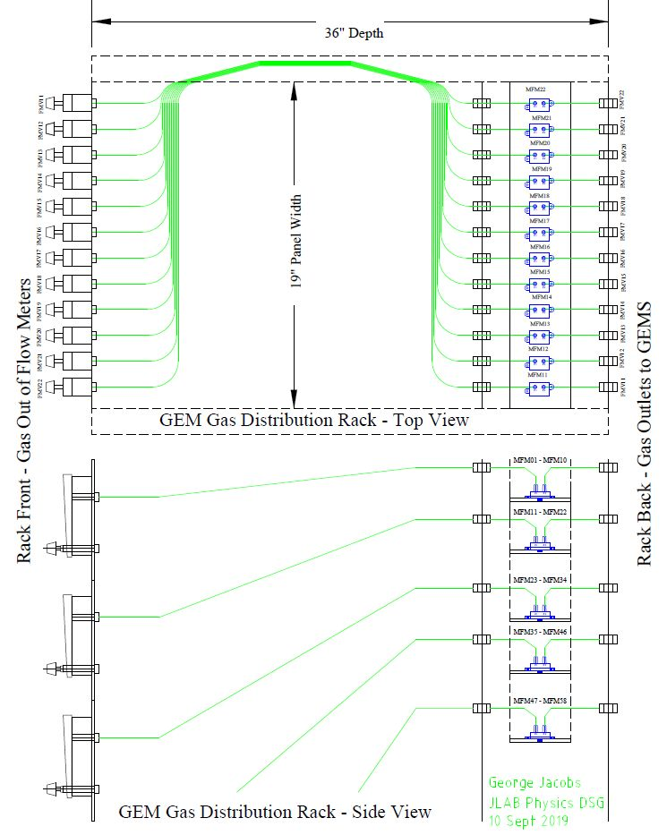
Mass Flow Transducer Installation

Slide 12
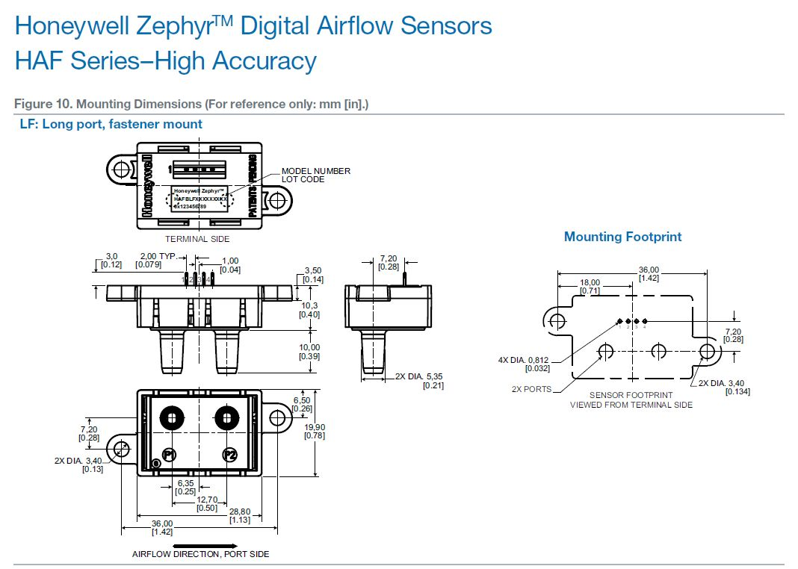
Honeywell Zephyr Digital Air Flow Sensors

Slide 13
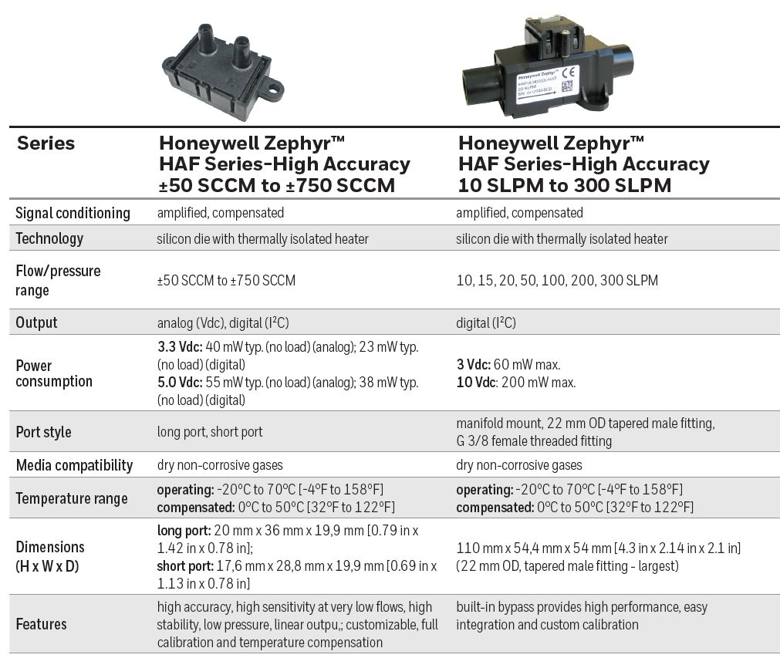
Digital Air Flow Sensors Specifications

