Slide 1
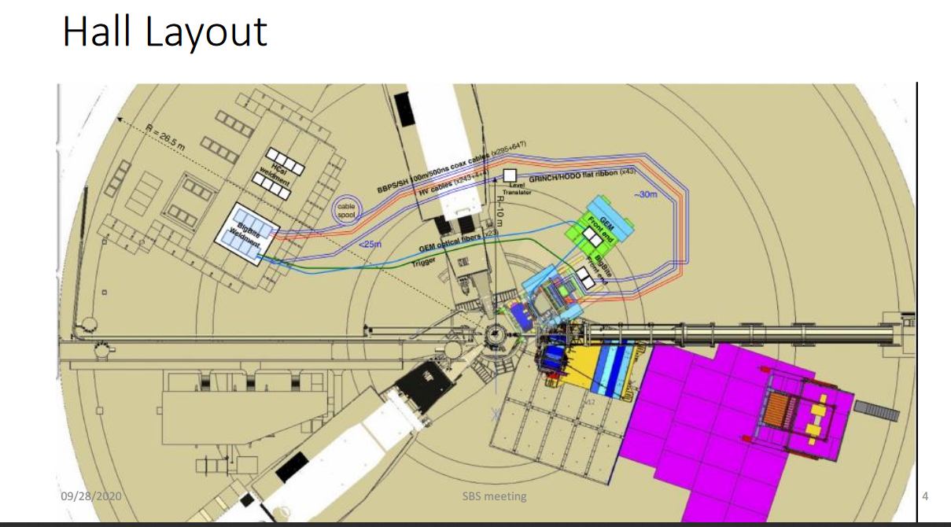
Alexandre showed this as what he expects for cable routing from BB detectors in GMn

Slide 2
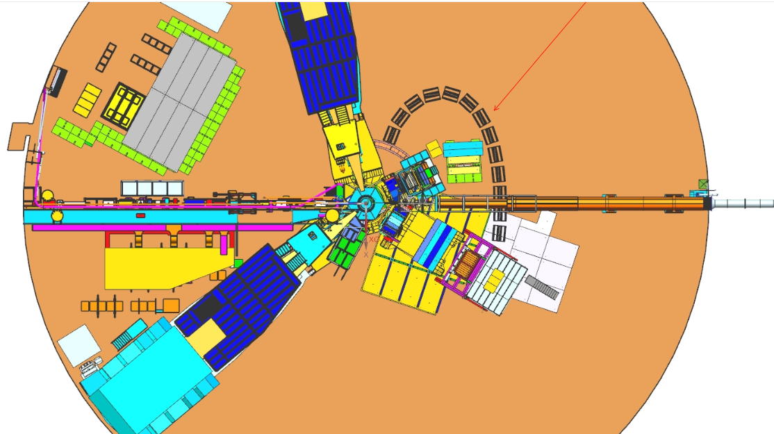
Hcal cables
Hcal cables

