Slide 1
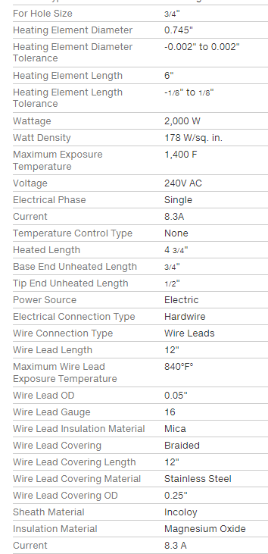
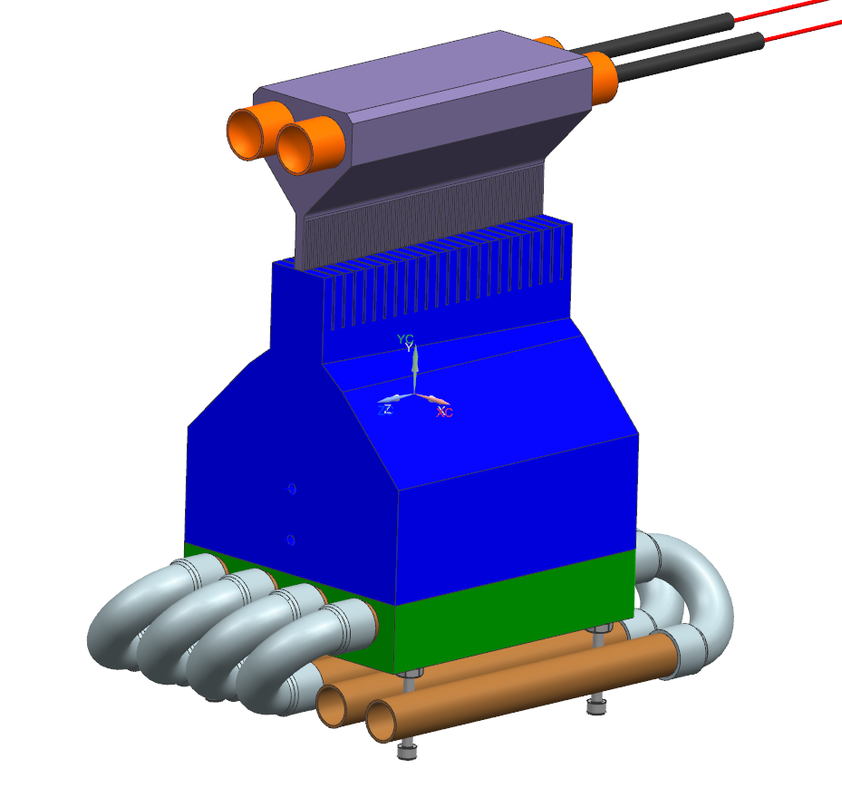
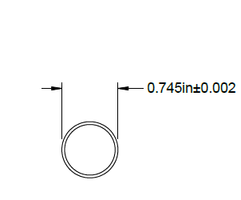
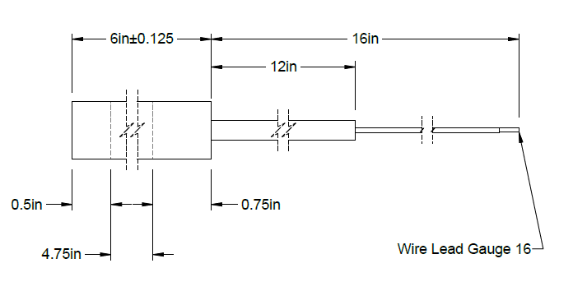
CPS TEST SECTION
COOLING INLET
OUTLET
4X FEET

Slide 2
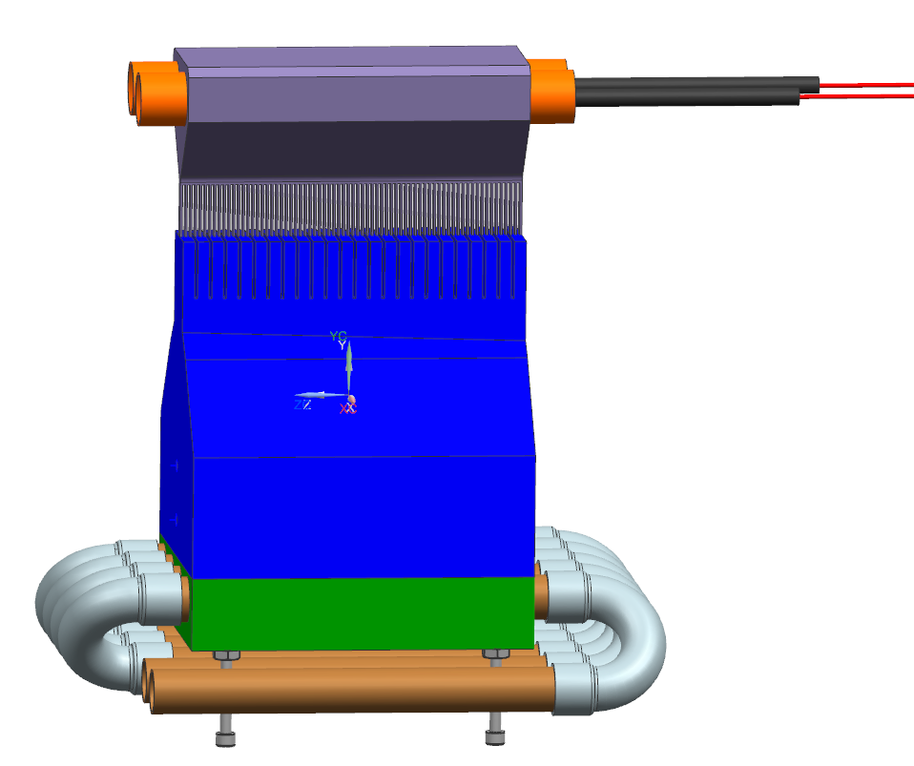
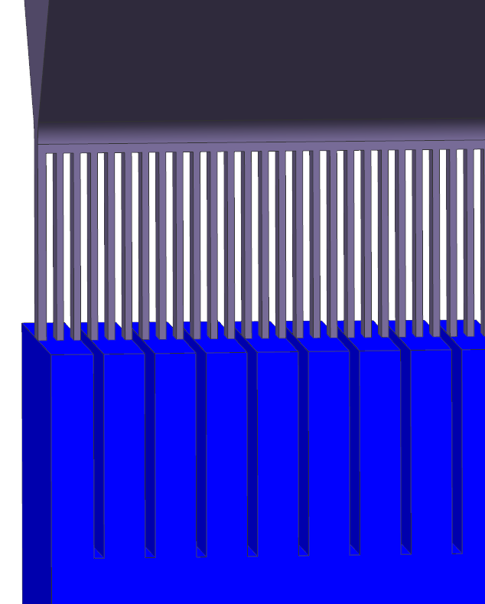
CPS TEST SECTION
CUTOUTS (WIRE EDM)
AFTER BRAZE
10”
FIXTURE WHILE TESTING

Slide 3
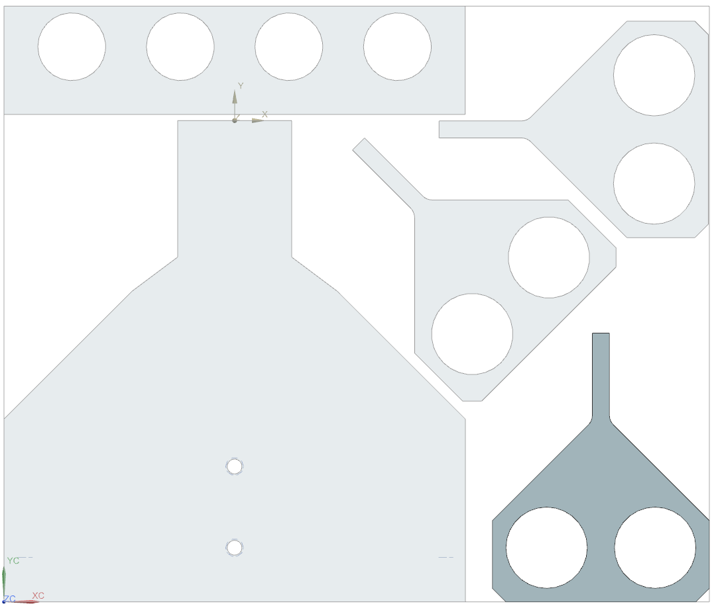
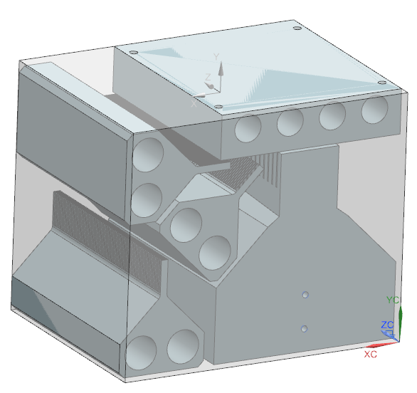
CPS TEST SECTION
COPPER DIMENSIONS 6.5” X 5.5” X 5.0”

Slide 4
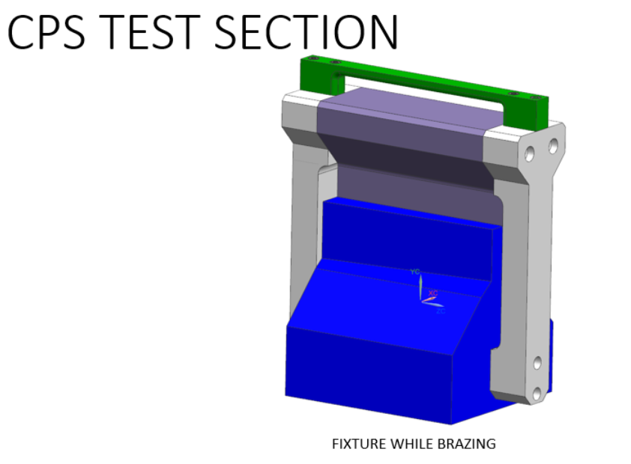

Slide 5
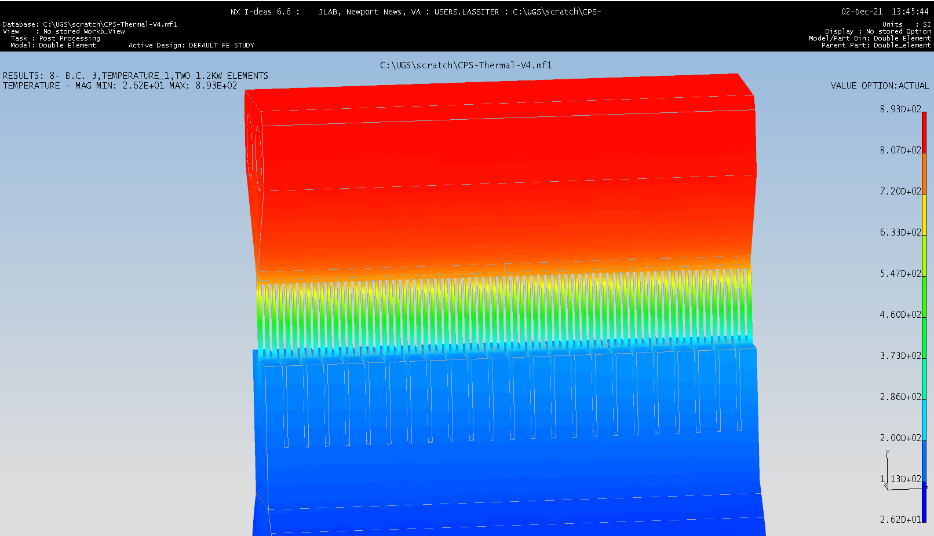
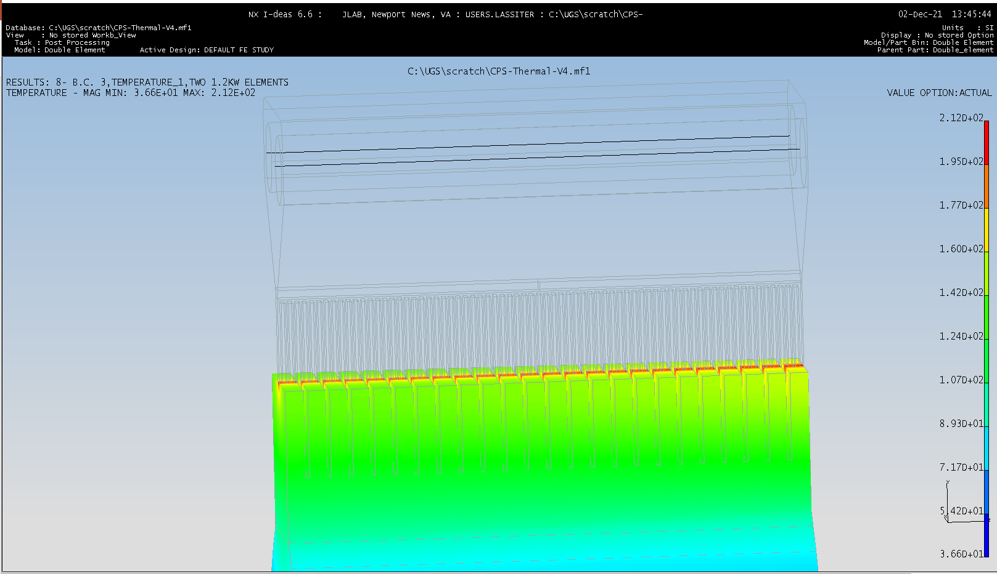
Temperature Profile with two 1.2kW heaters
Tmax=893C
T(absorber)=212C

Slide 6
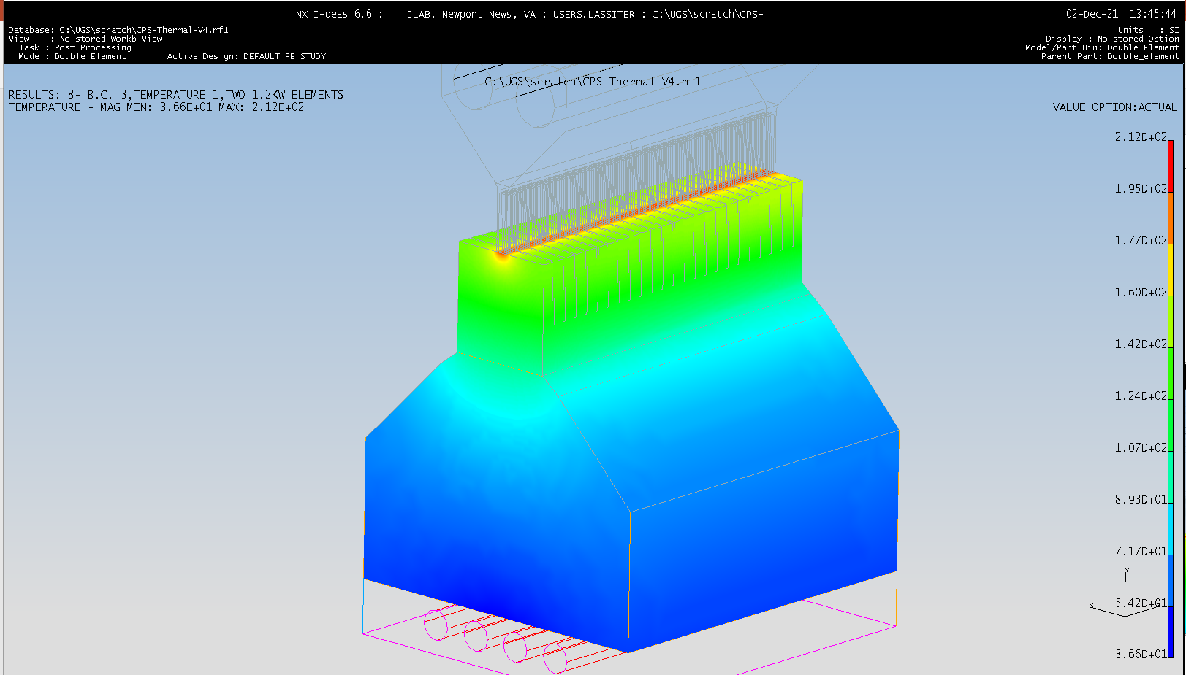
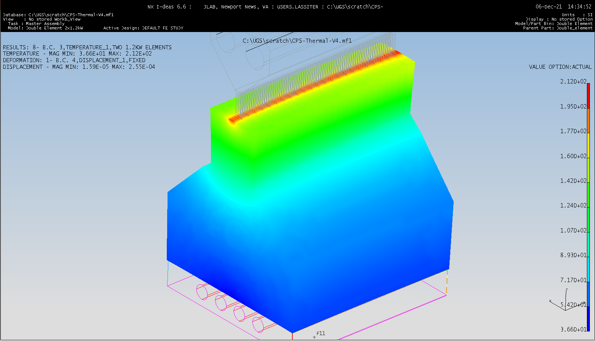
Top Surface of the Prototype Absorber
Temperature 212C for two 1.2kW heaters

Slide 7
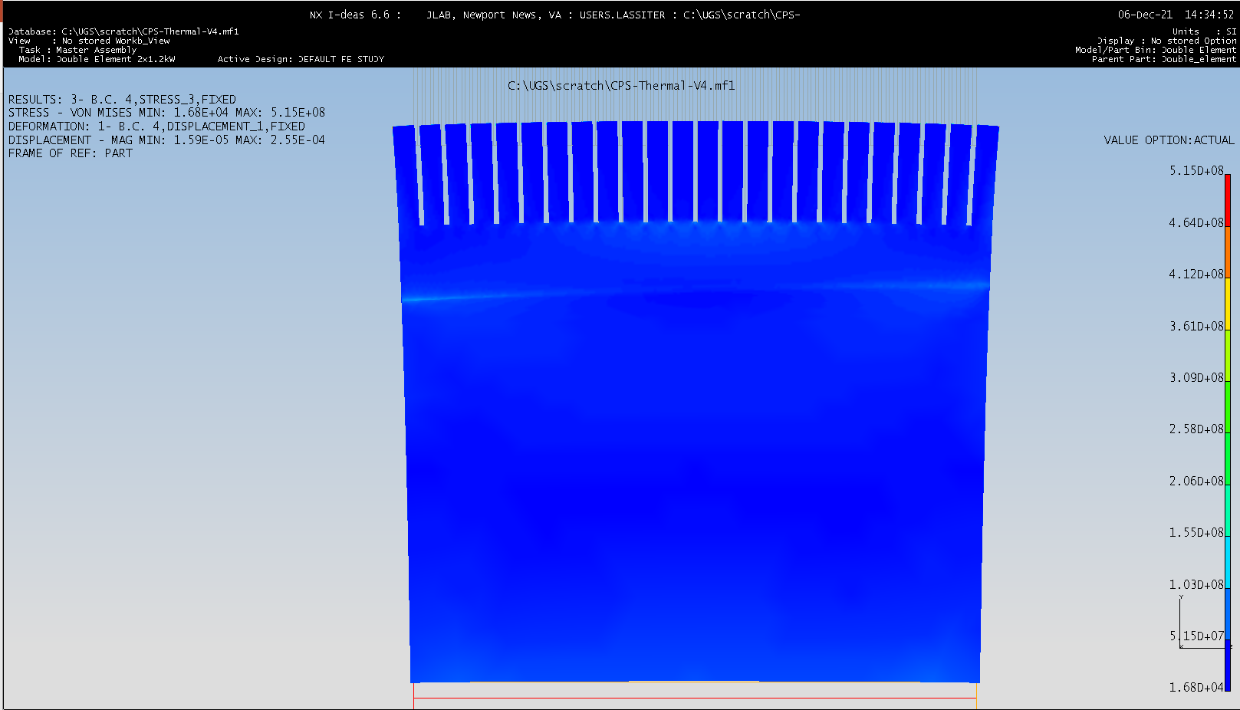
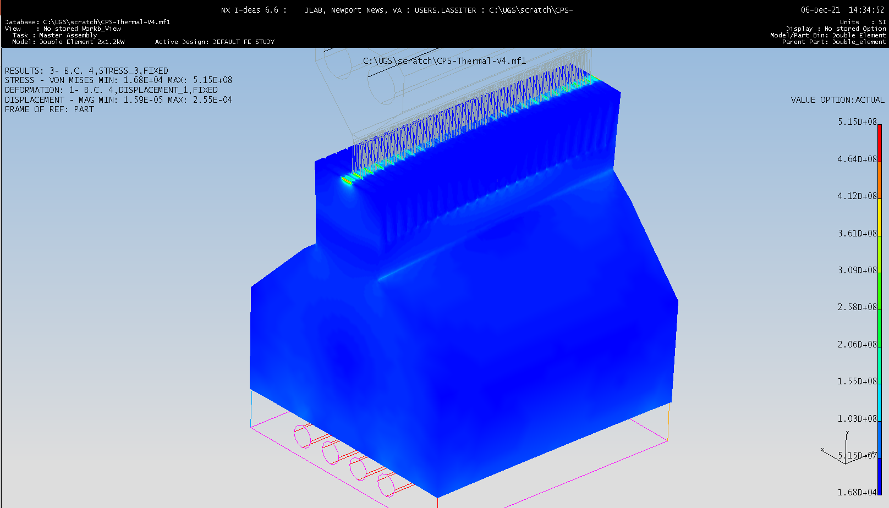
Displacement and Stresses for two 1.2kW heaters
0.26mm and 515MPa
Temperature along top Absorber is 212C.

Slide 8
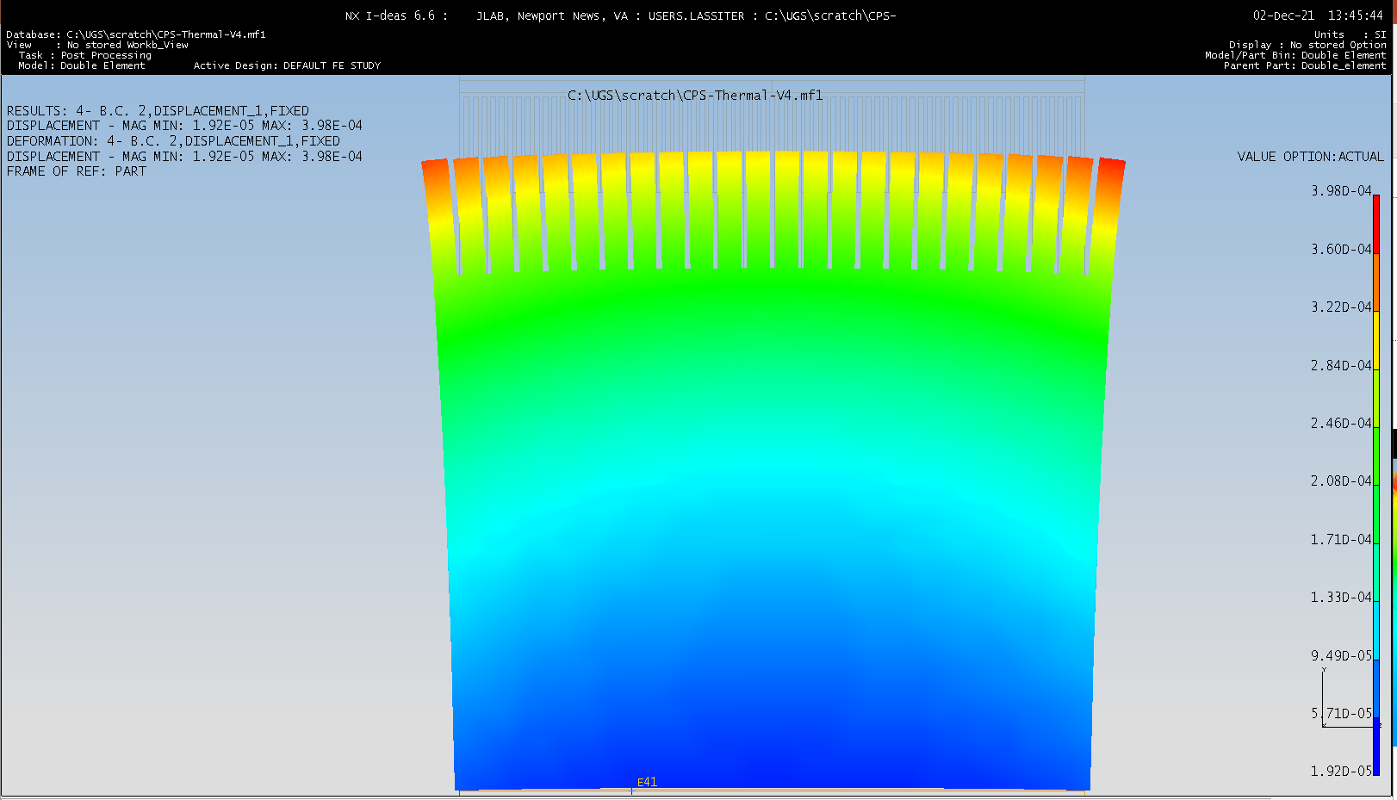
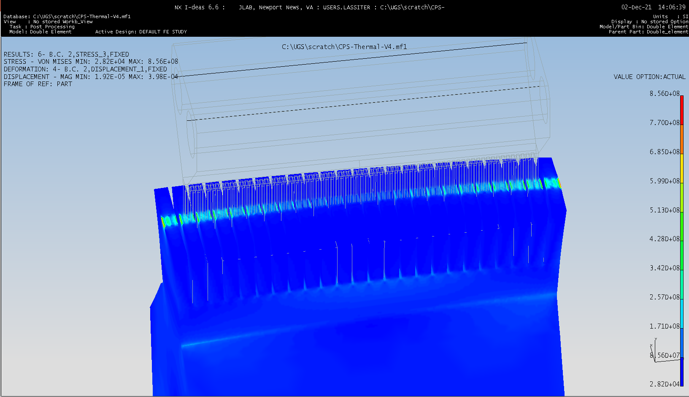
Displacement and Stresses for two 2kW heaters
0.4mm and 856MPa
Note: Heater element holder would have melted Tmax=1460C. (CU MP 1085C)
Temperature along top Absorber is 330C.

