Slide 1
Slow controls
Junhao Chen
Brad Sawatzky
Arun Tadepalli

Slide 2
FIELD

Slide 3
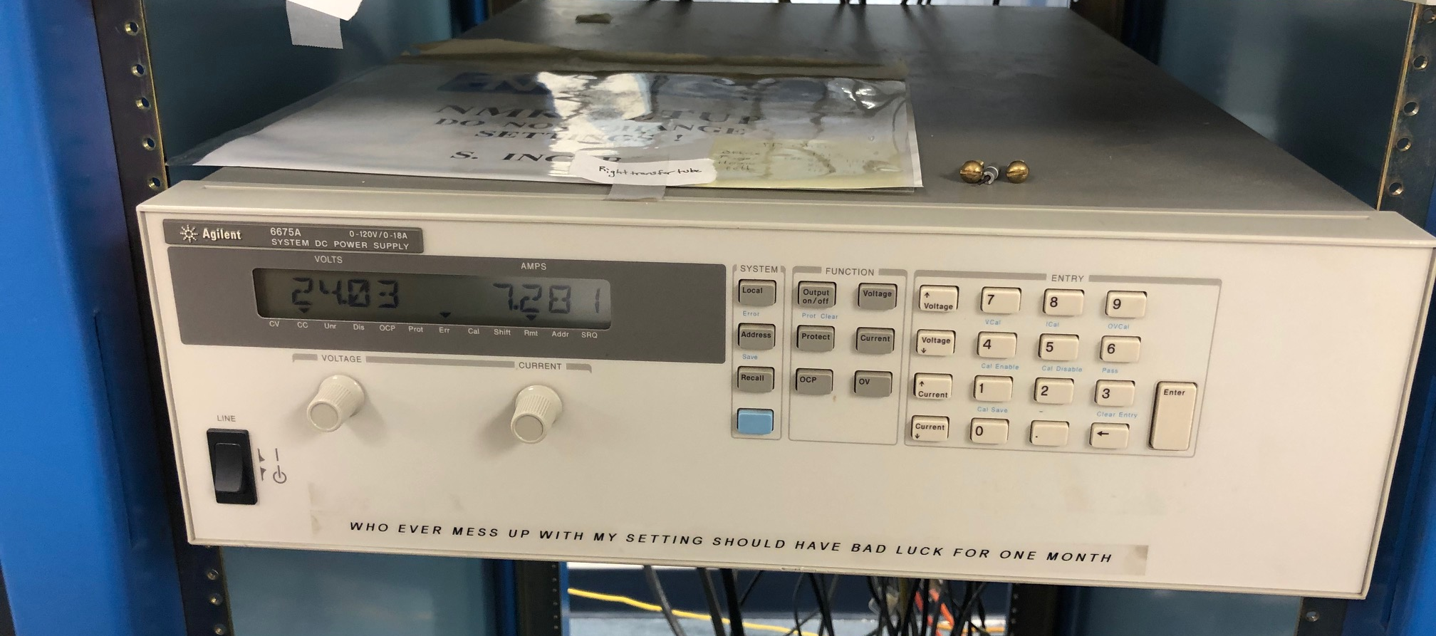
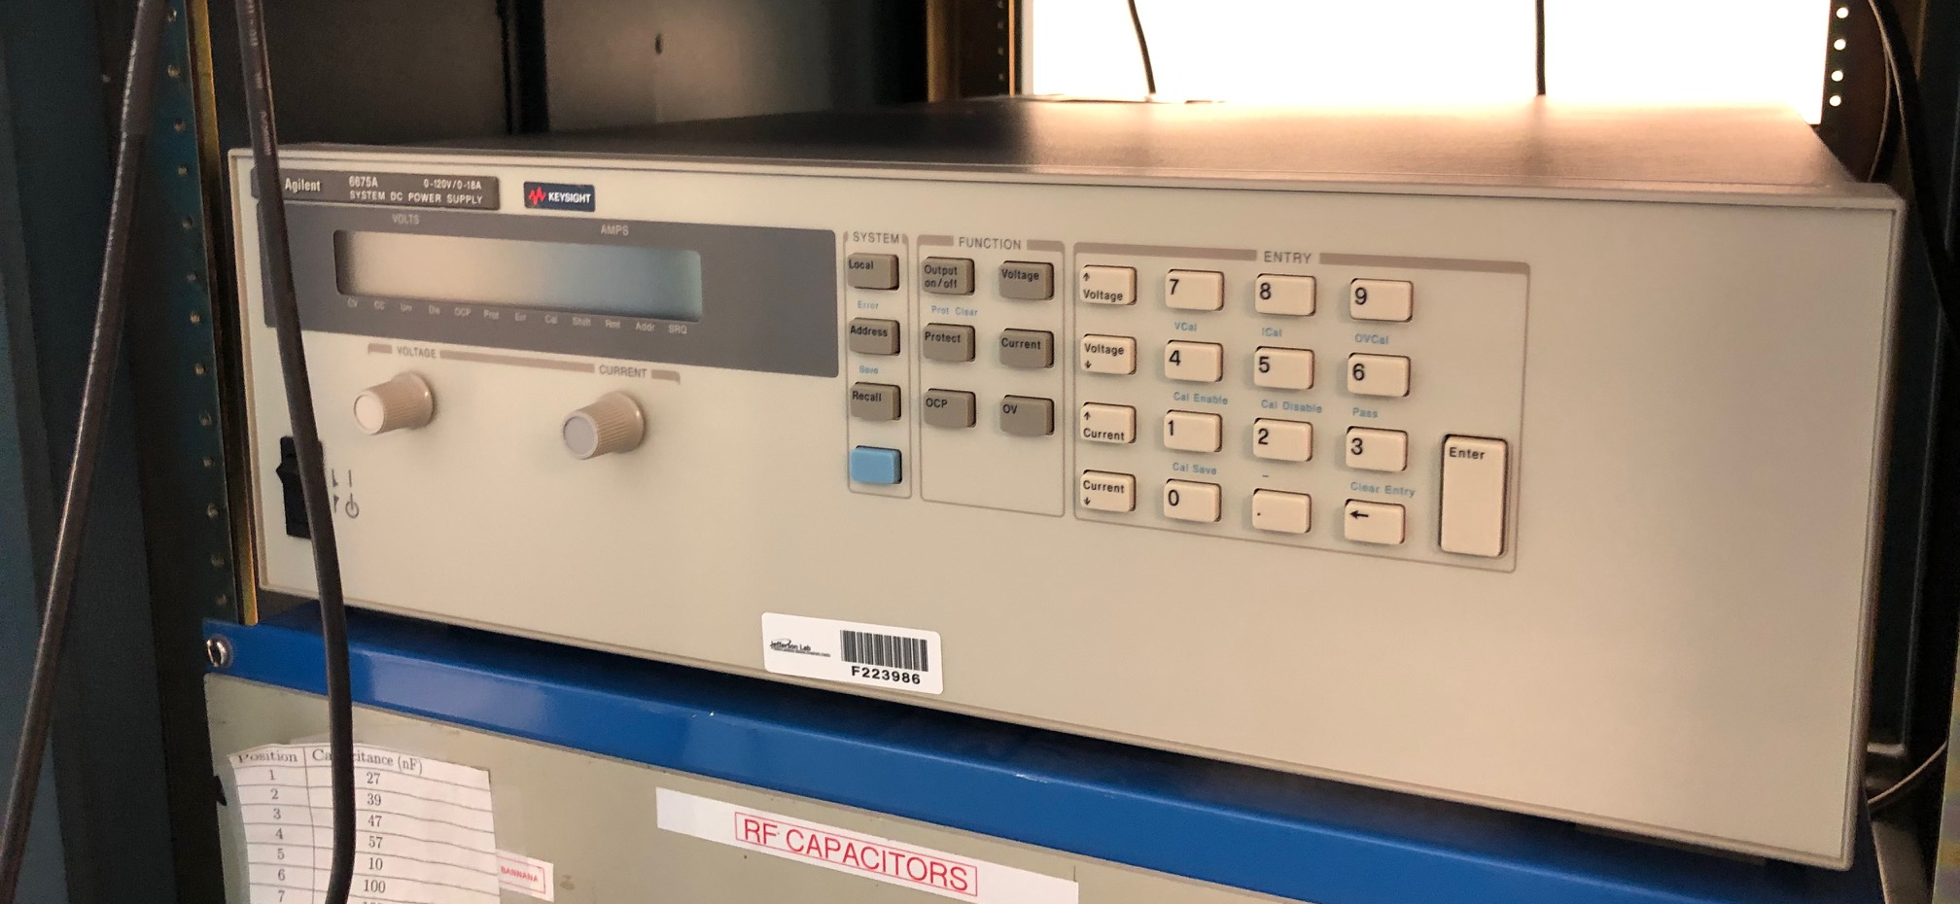
Main coil power supply
Agilent 6675A power supplies that are used for the two sets of coils
Need to monitor the current which is connected in series with the power supply system
multimeter which is HP 3440A
Need a cable interface between GPIB or RS232 to P.C. or VME that hosts EPICS
Yes, only the current meter
34401A need interface with
EPICS
GPIB OR RS232 → EPICS

Slide 4
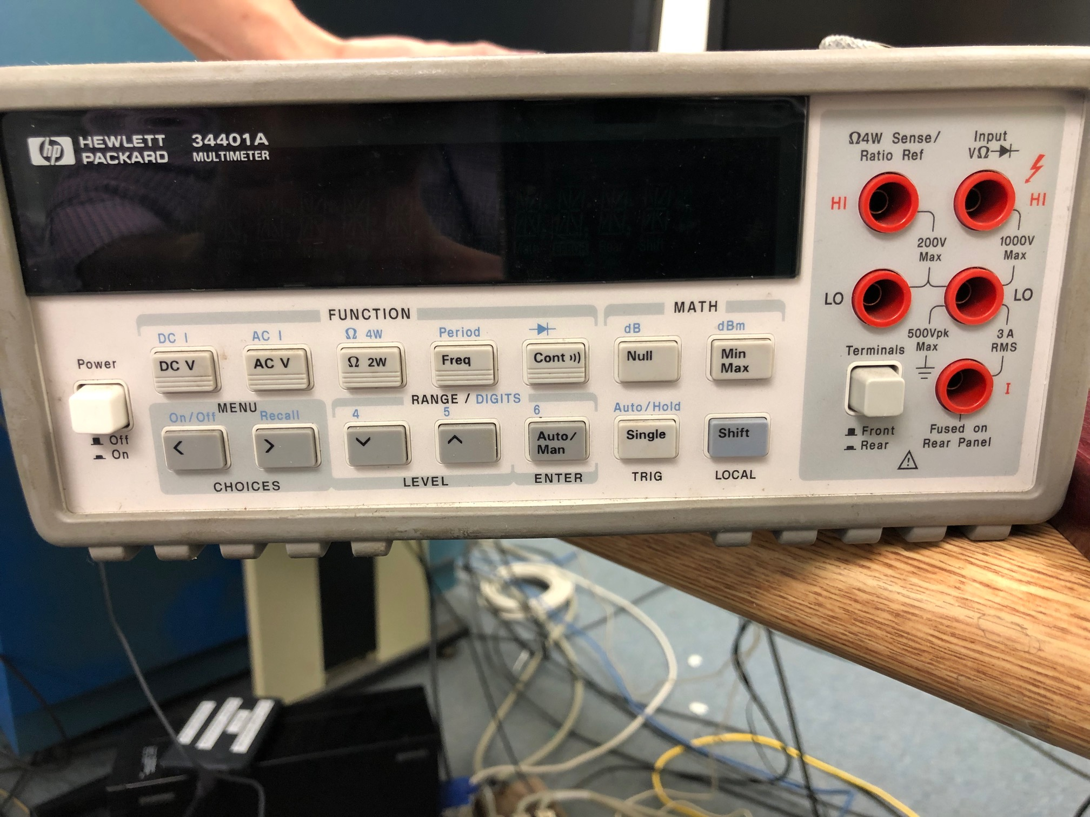
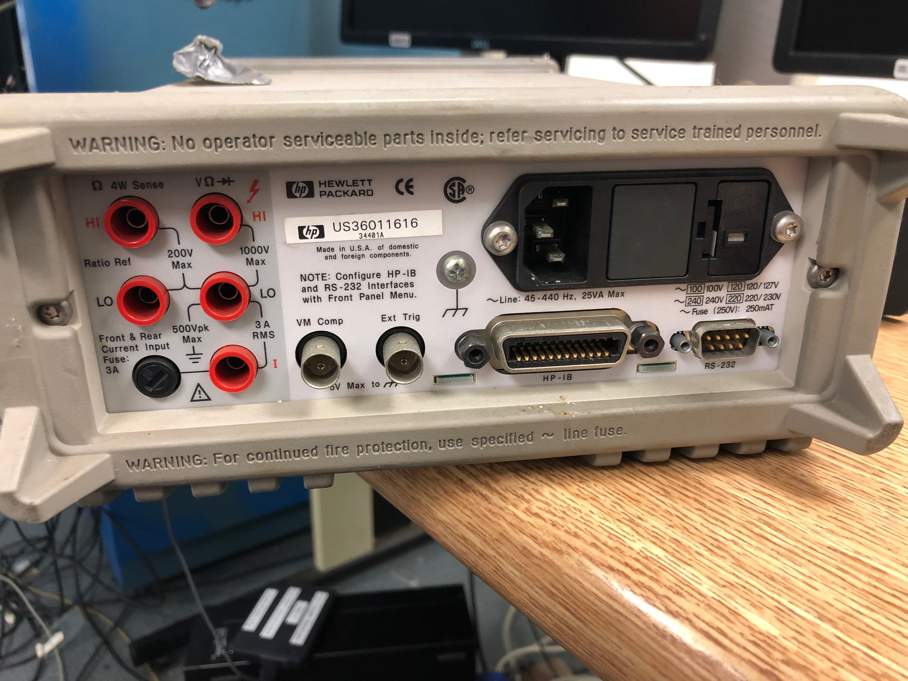
Multimeter 3440A
Do we have the cables to connect to this in series with the PS and monitor the PS current?
We don’t, the current is up to 10A and voltage is up to 30 V, maybe a work request?

Slide 5
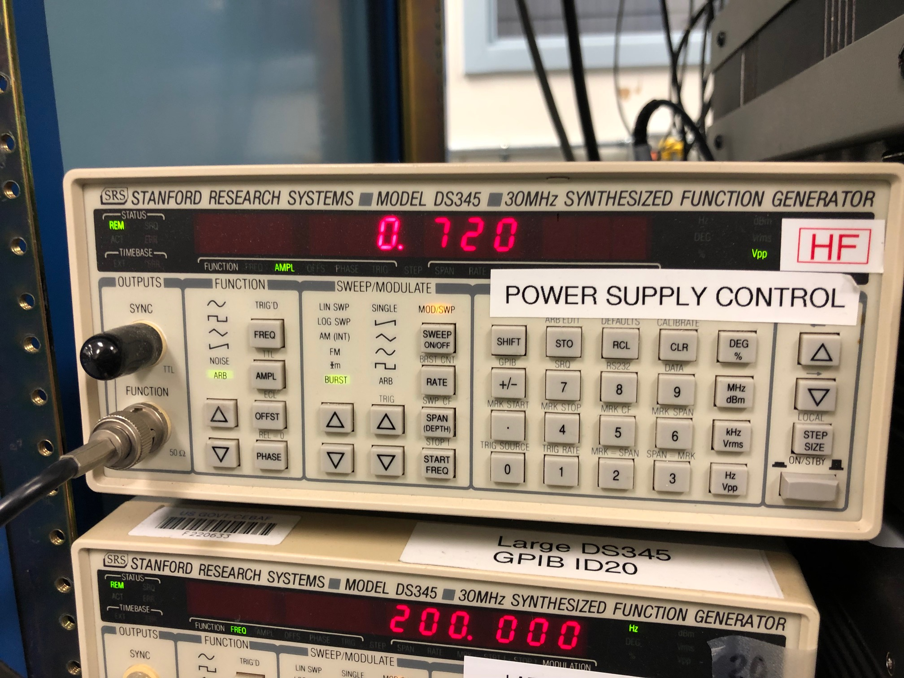
Field sweep
Two of these SRS DS 345 (in series) will be used for each power supply
We need another GPIB or RS232 to connect the multimeter to the system that hosts EPICS

Slide 6
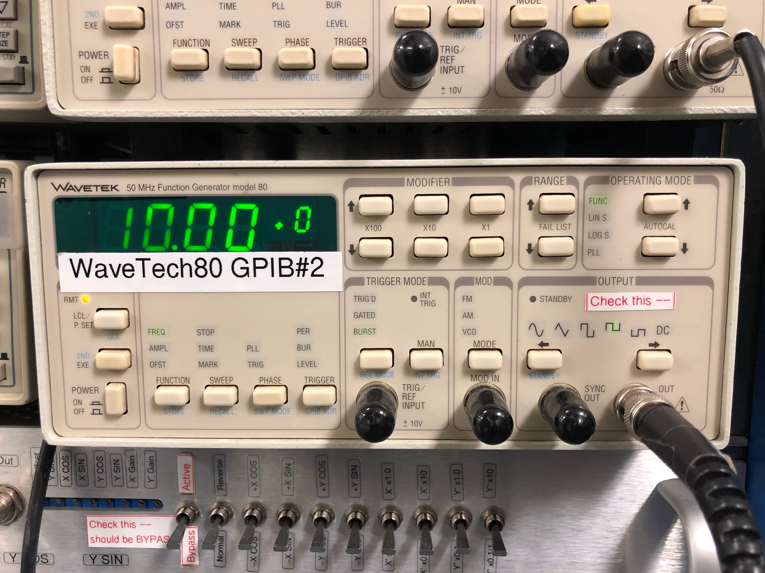
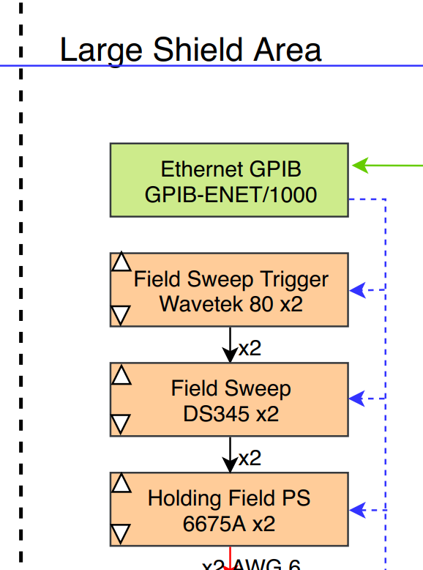
Field sweep trigger
One device 80 GP1B#2 is connected to two of the DS345 field sweeps
No need to read this back
Trigger remotely??

Slide 7
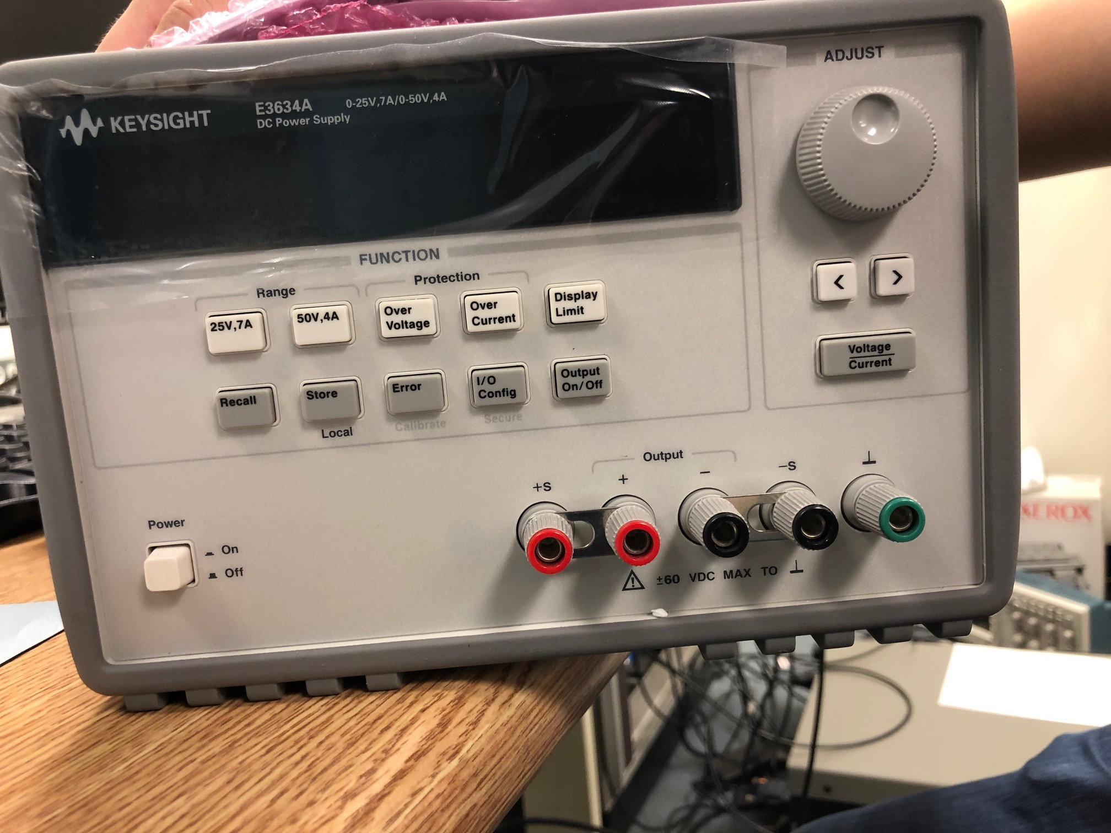
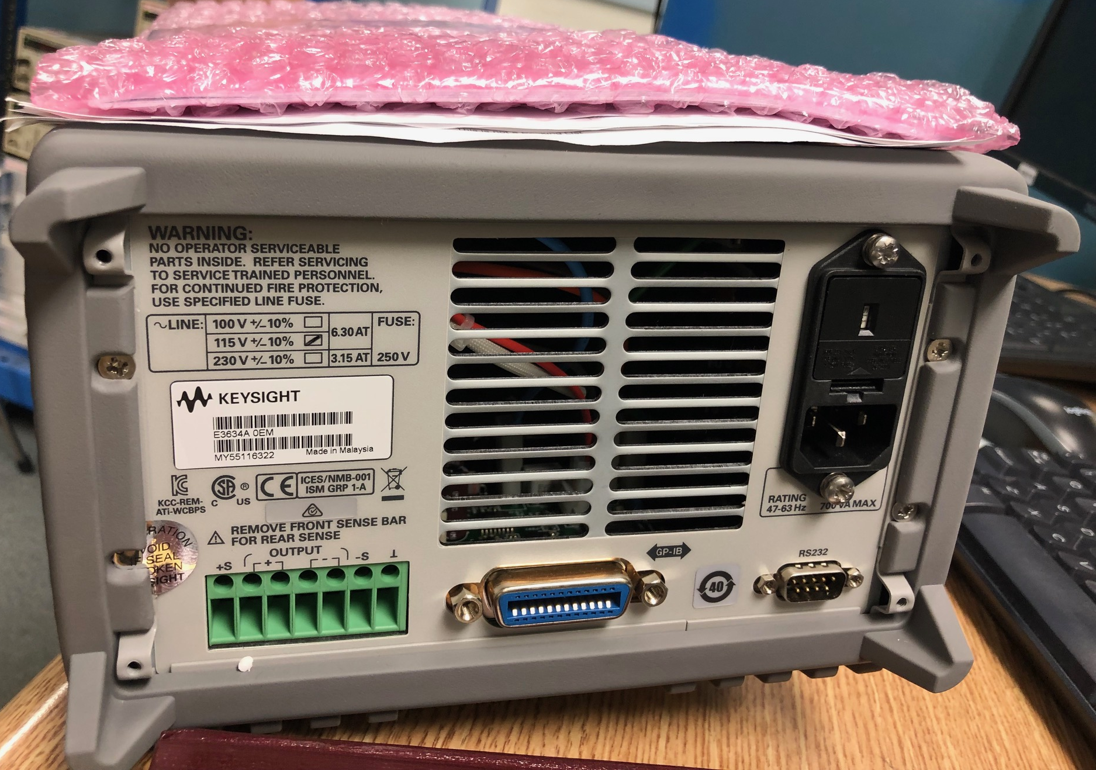
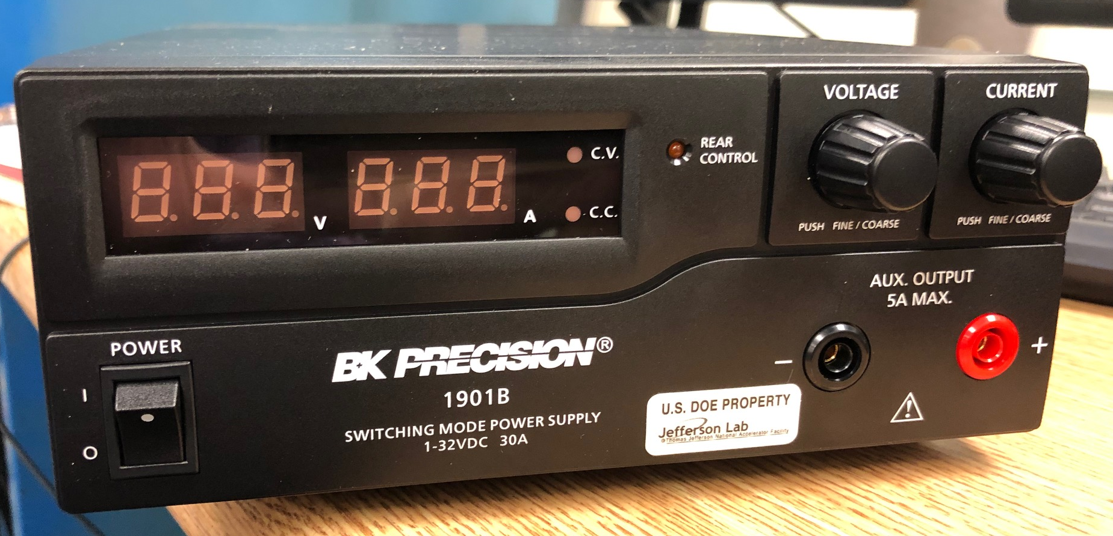
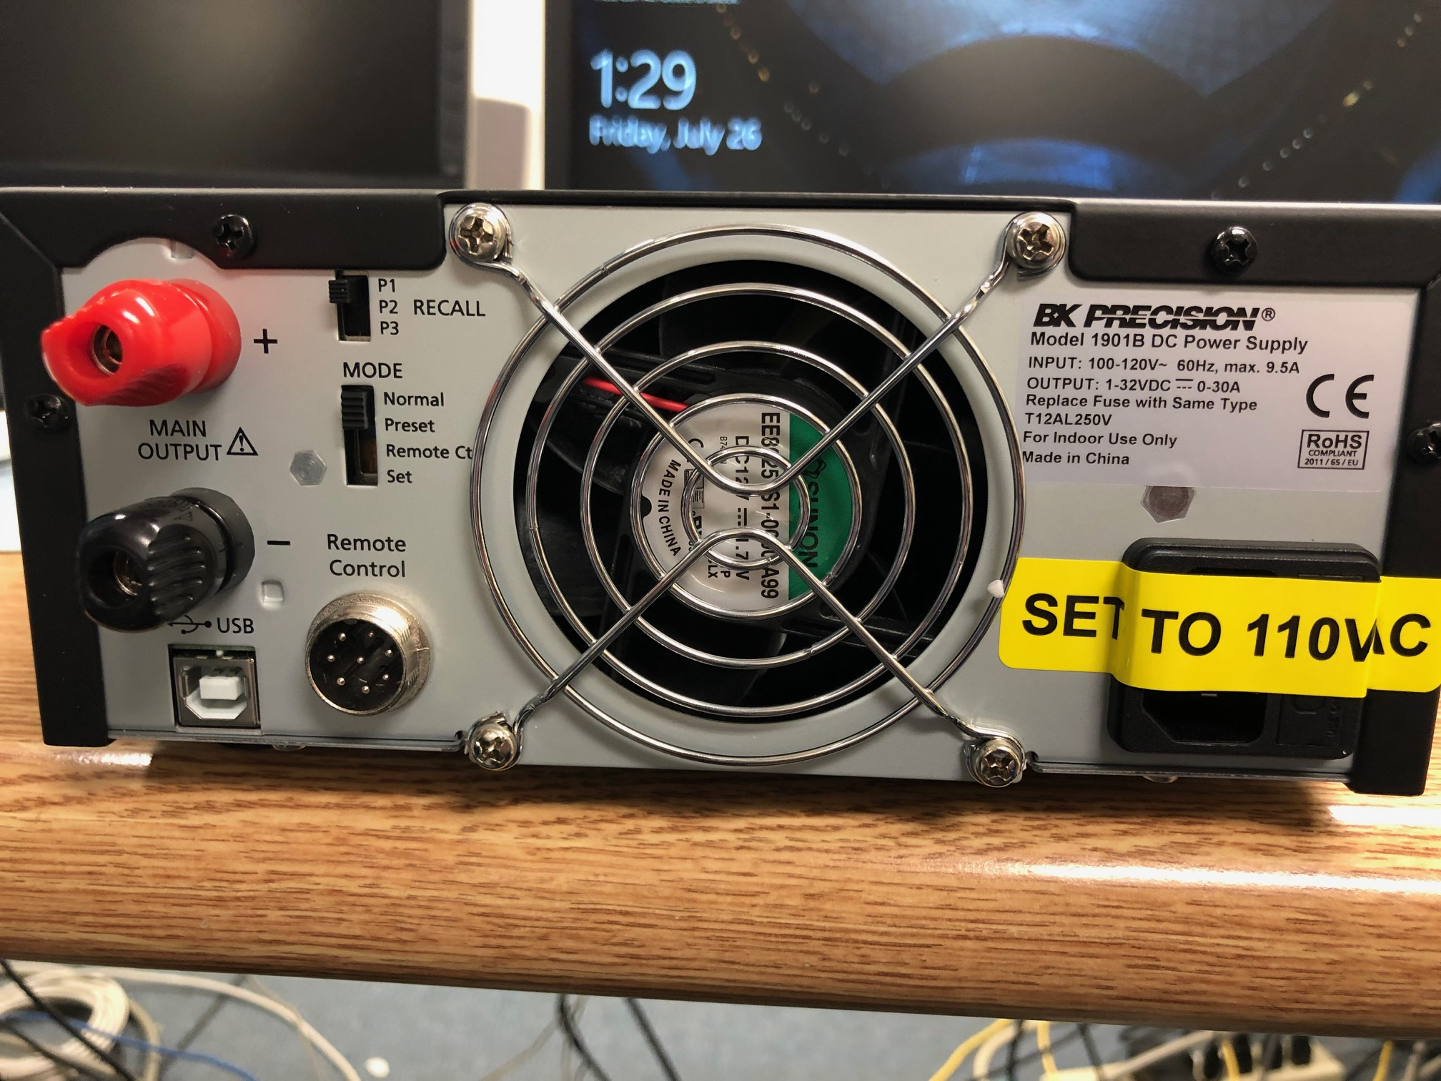
Correction coil
This takes two types of power supplies
2 BK precision
2 Keysight

Slide 8
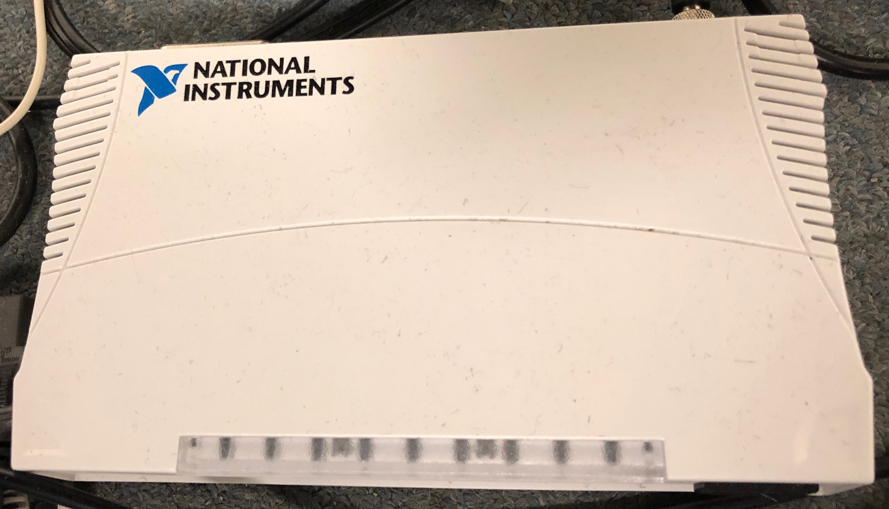
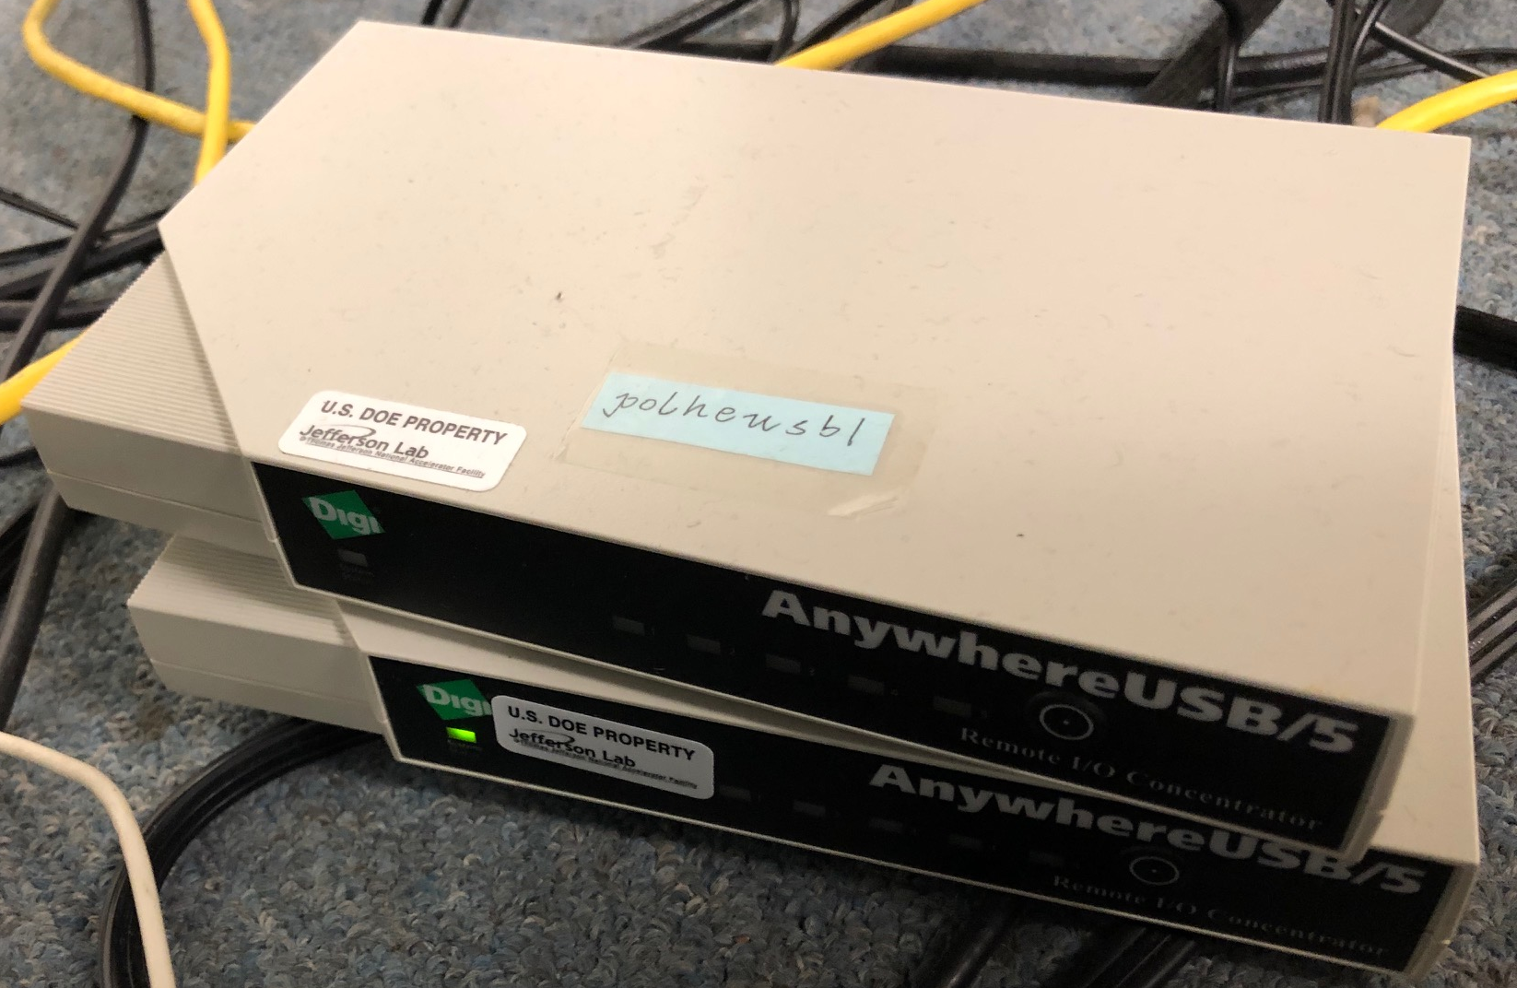
Circuit diagram
Power supply Keysight
ethernet
2 GPIB
GPIB
ethernet
Power supply B.K.
Counting room PC
ethernet
2 USB outlets
USB
USB hub
ethernet

Slide 9
NMR

Slide 10
RF generator
RF generator needs to connect to PC with labview using a GPIB

Slide 11
Attenuator
Connected in series with the RF field source
Does NOT need to be monitored

Slide 12
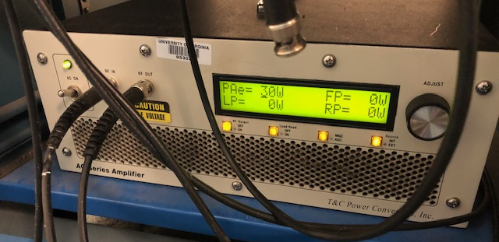
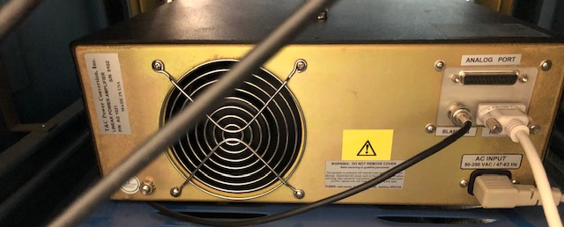
RF Amplifier
This is connected in between the attenuator and the impedance matcher
We need to control using labview

Slide 13
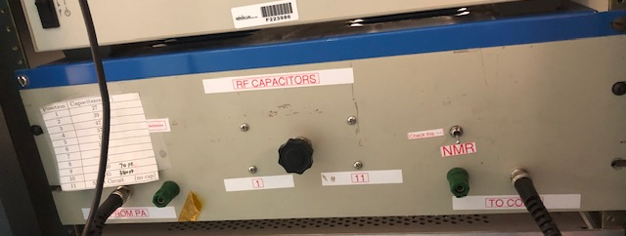
Impedance matcher
This is the impedance matcher which is connected in series between amplifier and the coil
This does NOT need to be connected to labview

Slide 14
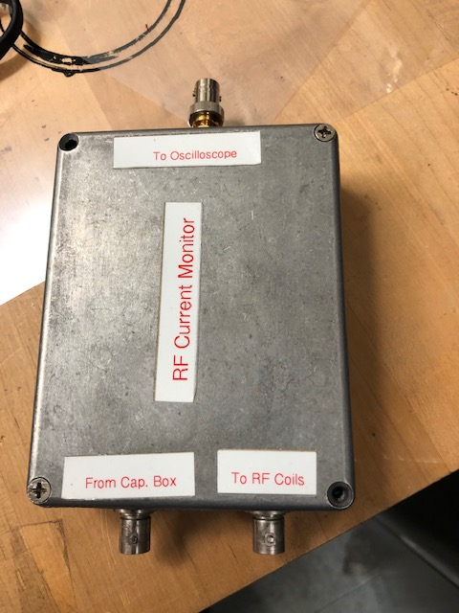
AC current gauge
This is connected in series and in between the impedance matching box and the coil
This is connected to an oscilloscope to monitor the RF power in the RF coil
The oscilloscope is monitored perhaps by connecting to a network USB hub which will be observed in labview

Slide 15
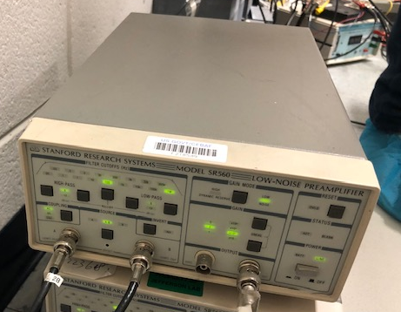
Pre-Amplifier
Four of these pre-amplifiers will be used for NMR pick-up coils
These are connected to the lock-in amplifier and the lock-in amplifiers are connected to the PC that hosts labview through GPIB

Slide 16
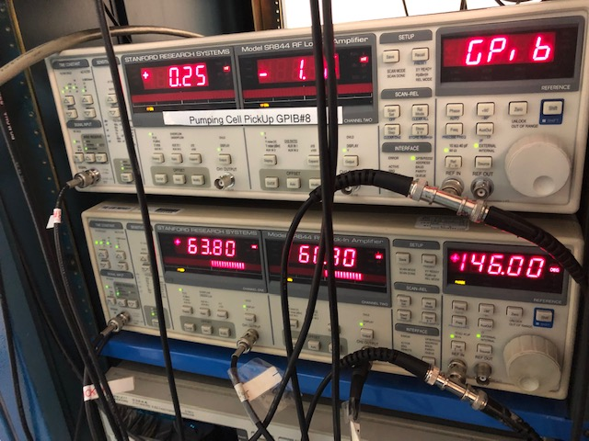
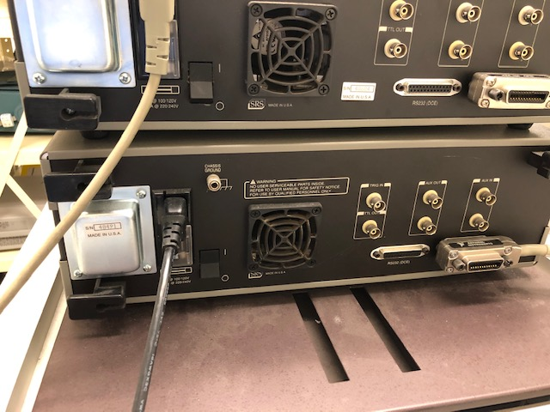
Lock-in amplifiers
Four of these lock-in amplifiers are connected to the PC with labview as stated in the previous slide

Slide 17
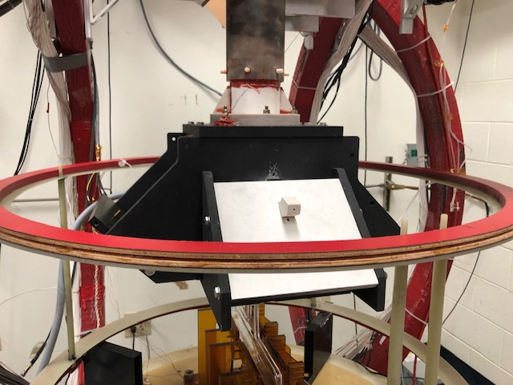
NMR RF coil
Current gauge is connected to the coil to monitor the RF power

Slide 18
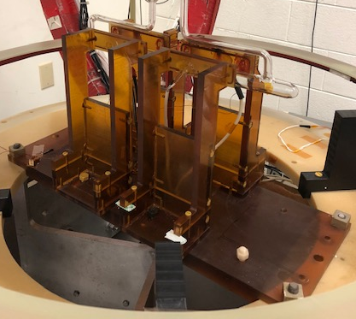
Pick up coils (2 pairs)
These are connected to the pre-amplifiers which will be connected to the lock-in amplifiers monitored through labview
Pick up coils

Slide 19
EPR

Slide 20
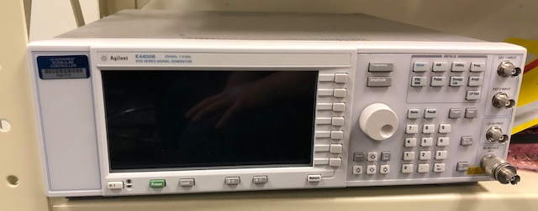
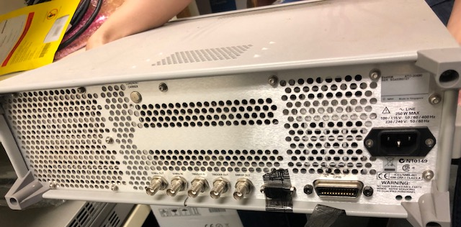
RF generator
This is monitored through labview through a GPIB connection

Slide 21
RF Amplifier
This need NOT be controlled through labview

Slide 22
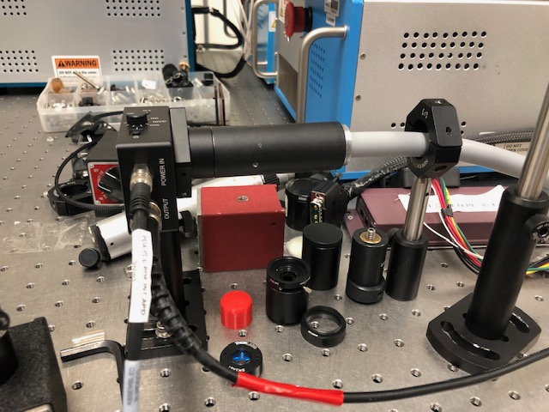
Photodiode
This is connected to the lock-in amplifier which is monitored through labview

Slide 23
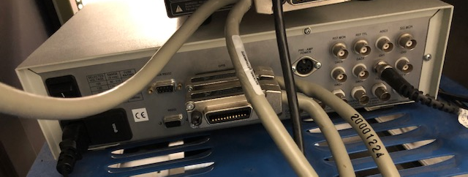
Lock-in amplifier for photodiode
This lock-in amplifier is connected to labview through a GPIB interface

Slide 24
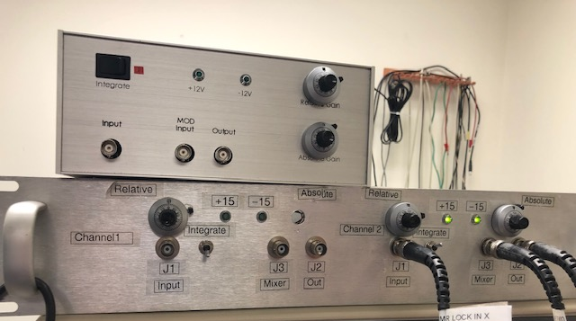
PI box
Spare PI box
Modulation generator and lock-in amplifier are connected to the PI box
PI box is connected to the RF generator

Slide 25
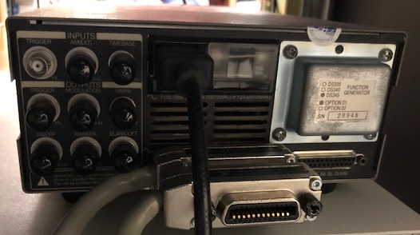
Modulation generator
Modulation generator is connected to the PI box and RF generator
It is monitored through labview through GPIB interface

Slide 26
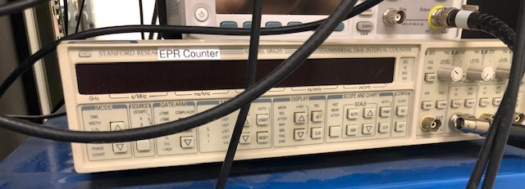
Frequency counter
RF generator is connected to the frequency counter
It is monitored through labview using a GPIB interface

Slide 27
EPR RF coil
EPR coil
This is connected to RF amplifier
It is NOT monitored

Slide 28
OVEN HEATING

Slide 29
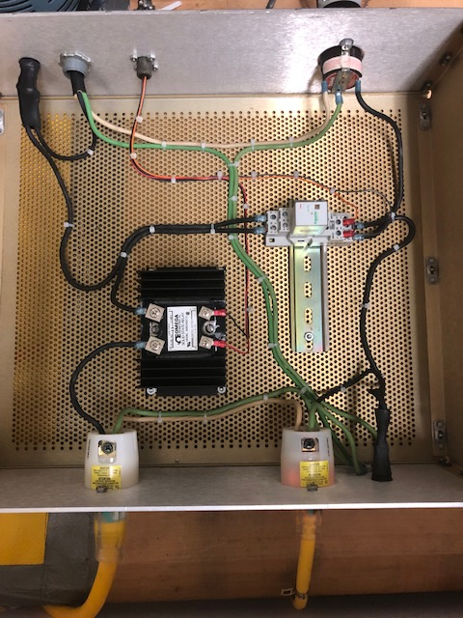
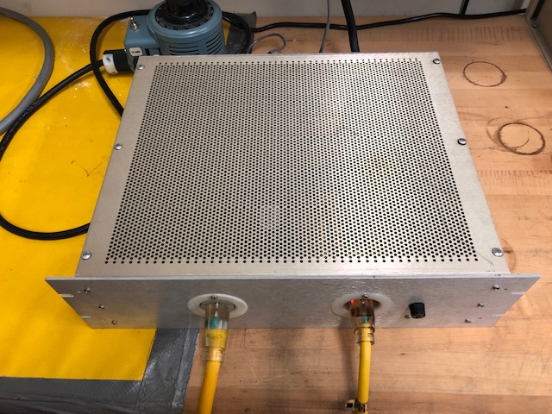
Heater relay box
There are two relays in this (open for now) box
They are part of the oven and laser interlock systems
They need not be monitored by EPICS

Slide 30
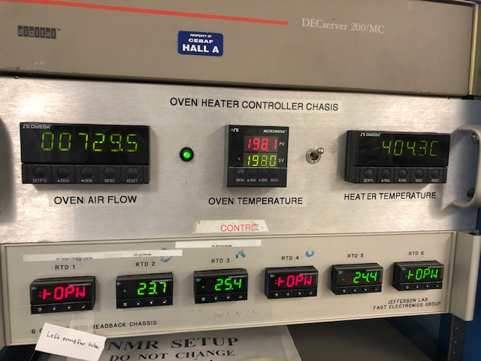
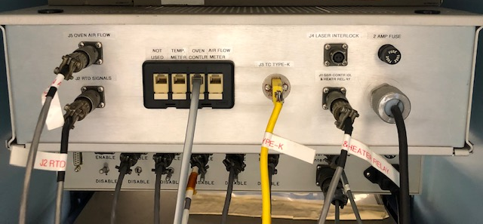
Heater controller and interlock
This system is connected to the over heater relay box
This is monitored and controlled through EPICS through RS232 connections

Slide 31
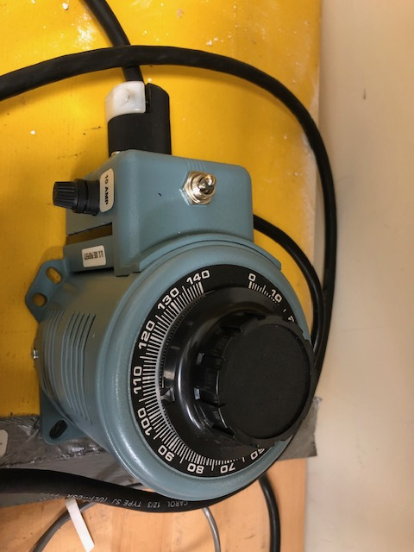
Variac
The oven heating system uses two power supplies
One is a constant source and the Variac is the source which the output power can be varied to regulate the heat to maintain the oven temperature
Does NOT need to be monitored

Slide 32
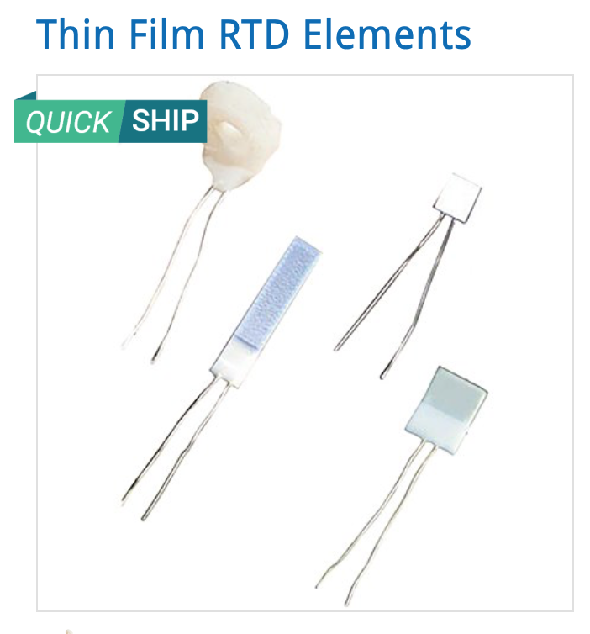
Oven and cell RTD
RTD model in use is F3105 model
Information on the next slide pertains to the actual readout of this RTD

Slide 33
Cell RTD readout
Currently the oven uses 6 RTDs (but only use 5 for now)
We want to implement 9 more (2 in target chamber, 4 in transfer tube and 3 in reference cell)
It is also a part of the laser interlock system
We need two more modules that look like the ones on the right
May be Mark Taylor has a module?

Slide 34
Convection heater power supply
Information about monitoring this type of power supply is already mentioned in slides 7 and 8
Power supply B.K.
Counting room PC
ethernet
1 USB outlets
USB
USB hub
ethernet

Slide 35
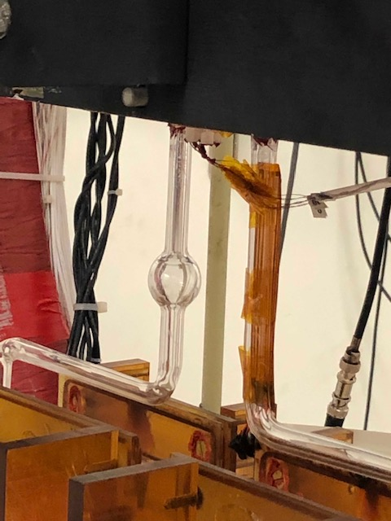
Convection heater
We do not need to monitor this heater

Slide 36
pNMR w/Lockin + DAQ

Slide 37
RF generator
This is connected to PC which is holding labview using GPIB
This will be located in the Hall C counting room and will send signals through a BNC cable

Slide 38
Trigger
Trigger is controlled using labview and connected to the PC in the counting room using GPIB interface
The signals are sent to the switches in the hall using BNC cables

Slide 39
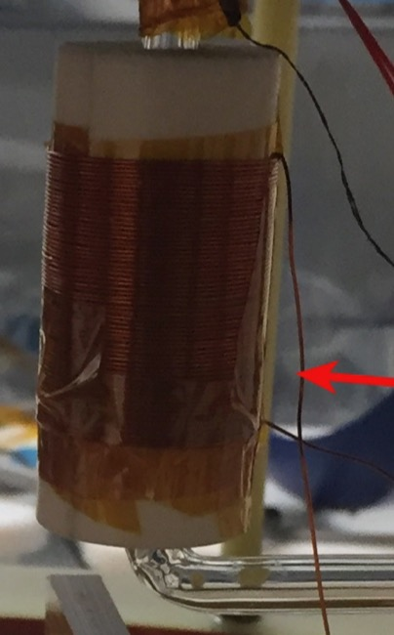
pNMR coil
We do not need to monitor this

Slide 40
Reference signal generator
This will be in the hall counting room and connected to the PC holding labview
Signal goes into the lock-in amplifier

Slide 41
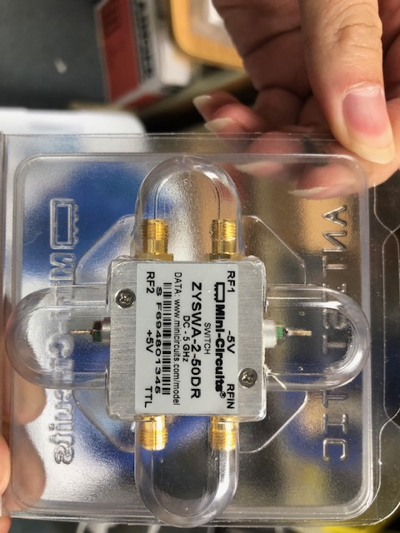
RF switch
Two such switches will be located in the hall
These need not be monitored directly

Slide 42
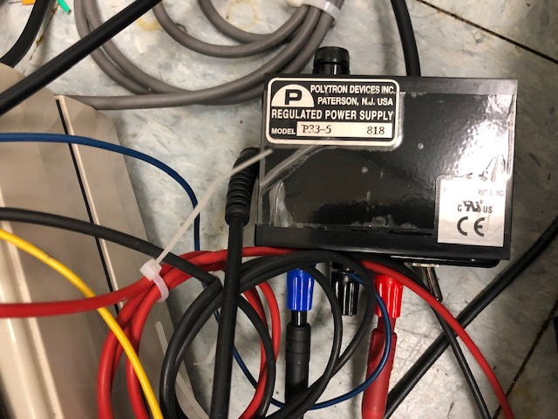
Switch power supply
We do not need to monitor this

Slide 43
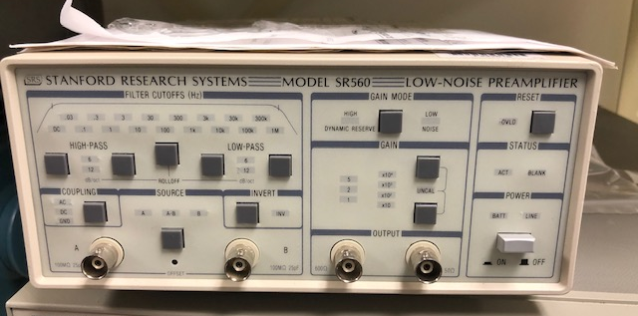
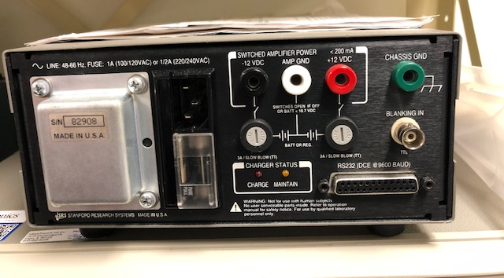
Pre-amplifier
This is connected to the switch and lock-in amplifier
It will not be monitored

Slide 44
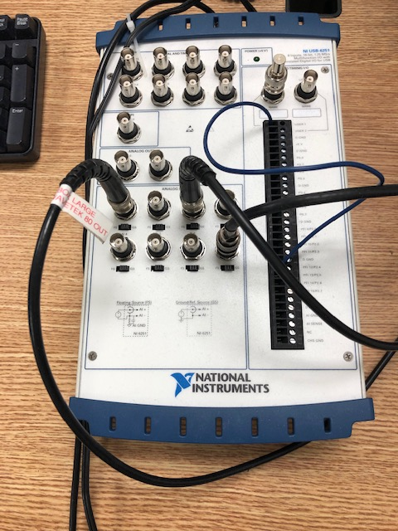
DAQ
It is connected to the PC in the counting room and stays in the counting room
This is readout using a USB interface using labview

Slide 45
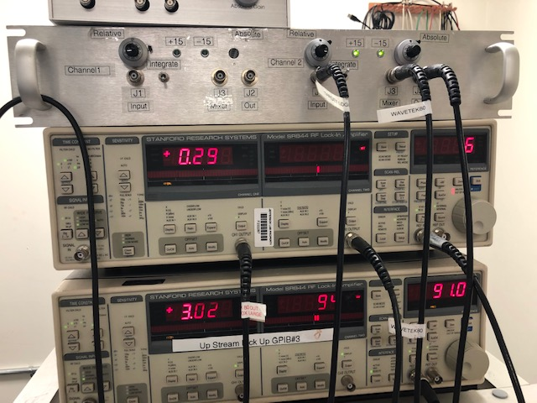
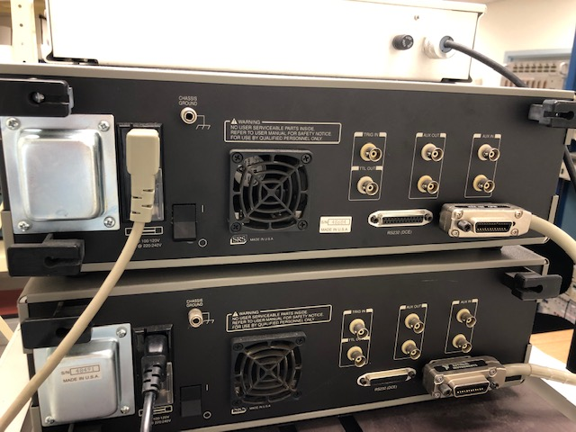
Lockin
This is controlled using the PC in the counting room through a GPIB interface

Slide 46
Polarization laser system

Slide 47
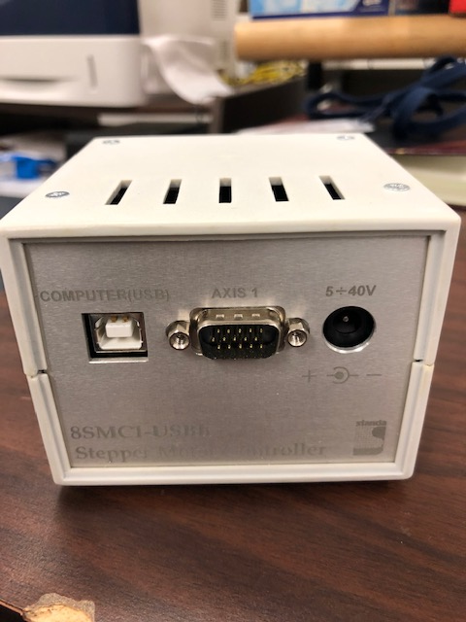
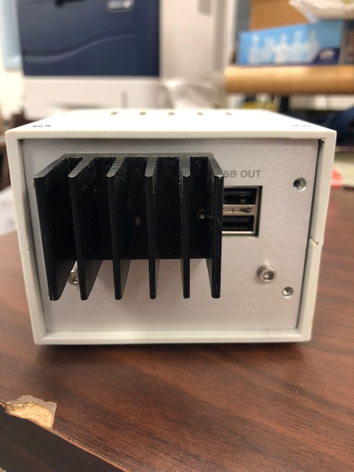
Stepper motor controller
The outlet labeled computer(USB) will connect to the USB hub which will connect to the USB of the PC which holds labview

Slide 48
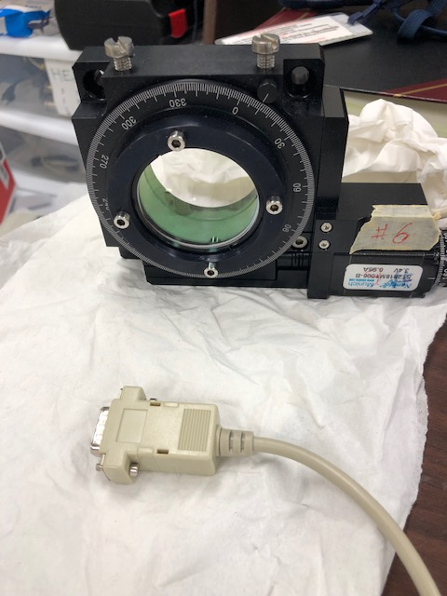
Motorized rotation stage
This “motorized rotation stage” is connected to the stepper motor controller
Its status is reflected by the stepper motor controller

Slide 49
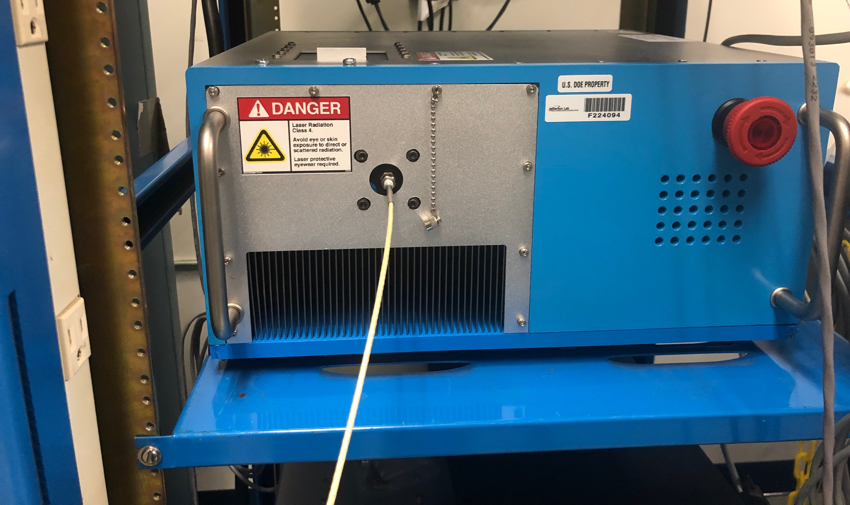
Laser
There are a total of 8 lasers and the specifications are mentioned above
Currently it is undecided how to monitor them. Three possible options are:
Raytum will write the drivers and provide support?
Whit will help with the integration?
EPICS group will help?
The plan may be is to have a giant screen in the counting room which will display all the 8 laser control programs GUI

Slide 50
Long fiber
Connects the laser in the counting house and the “optical area” in the hall
It is 110 m long stainless steel jacket optical fiber which is 600 μm fiber
Picture goes here

Slide 51
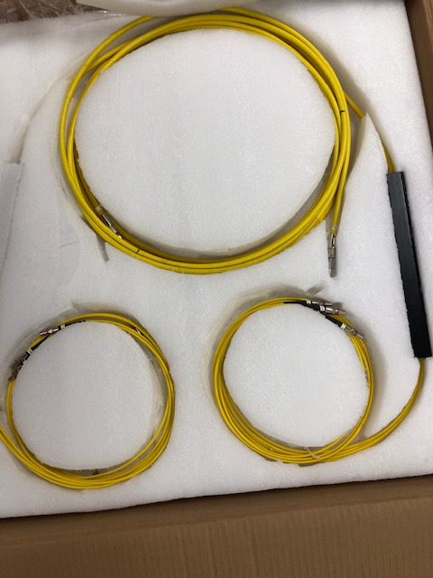
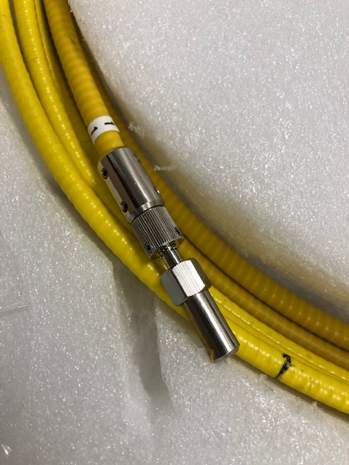
4-1 combiner
This connects 4 lasers (4 long fibers) into the 4-1 combiner input and will output 100 W into the polarization optics
12 RTDs for fibers will be attached to the 4 inputs and 1 output to monitor the temperature
The readout of the RTD will be monitored through EPICS
4-1 input cables
Output cable

Slide 52
Fiber end RTDs
Information mentioned on the previous slide should be sufficient
ANALOG SIGNAL
EPICS??
4-1 COMBINER
Fiber end
Busch that has RTD

Slide 53
RTD readout
Information provided in the previous slide is sufficient

Slide 54
Laser interlock in laser room
The laser conditions are monitored according to the magnetic door, oven temperature, heater temperature, cell temperature, RTD attached to the fiber ends, flow rate of gas into the oven and the emergency interlock buttons are all connected to the laser interlock in the laser room
Should anything happen, it will be triggered and shutdown the laser system

Slide 55
Laser interlock in the hall
This is being taken care of by Mark Taylor

Slide 56
Laser spectrometer
Detects the transmission spectrum for optical pumping lasers after the cell
This is connected to the network USB hub and to the PC which hosts its proprietary software

Slide 57
Reference cell and Cooling Jets & Target Ladder
Reference cell and cooling jets are being taken care of by Todd Averett
Target ladder being taken care of by Jack Segal

Slide 58
Airflow meter
Junhao has some pictures of the air flow meter
Todd Averett is dealing with them
We need to monitor the flow rate of the cooling jet airflow through connections in the back panel. We are not sure what kind of connection is it yet..

Slide 59
Reference cell pressure
There are many components to the reference cell
From a slow controls point of view, we only need to monitor (one or two analog signals?) coming out of the control box

Slide 60
Target ladder stepper motor controller
Jack Segal is in charge of this equipment
NO PICTURE!

Slide 61
BACKUP

Slide 62
GENERAL GPIB TO PC connection
GPIB cable connects to PCIE-GPIB
PCIE part
GPIB part

Slide 63
Some changes since previous experiment?
RTDs were readout using a module which was connected to a VME crate (for Transversity)
For this experiment, the module (not tested yet!) is the same but the option to readout the module (VME??) is still being considered

