Slide 1
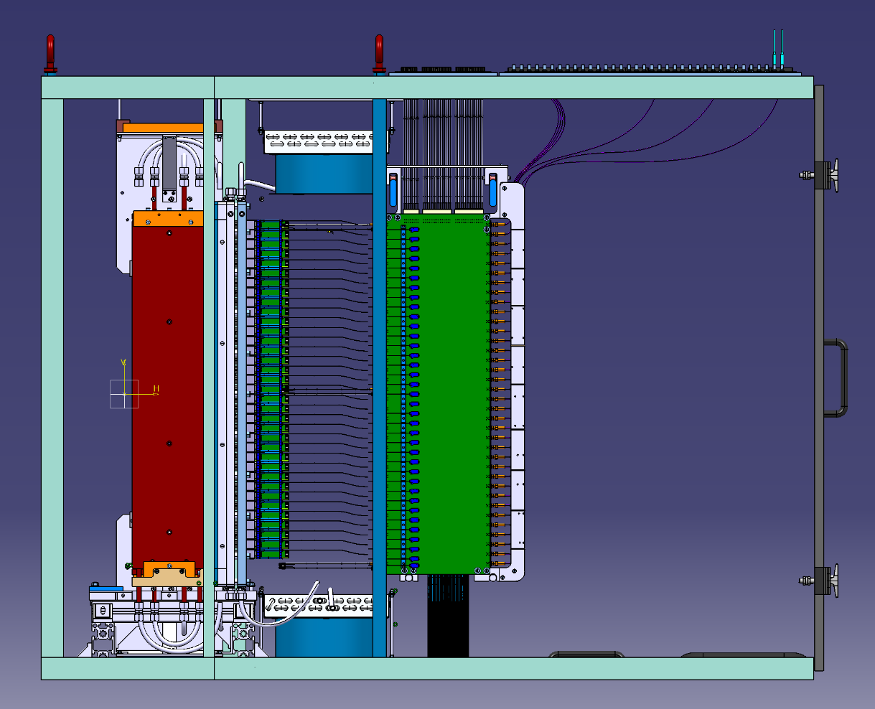
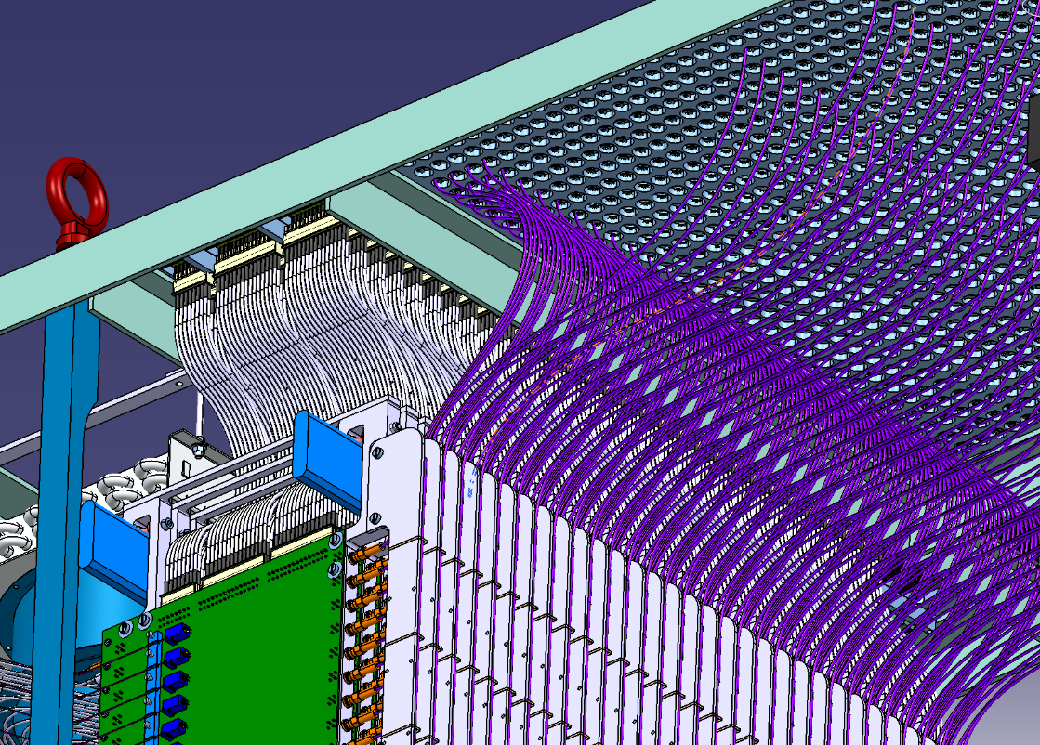
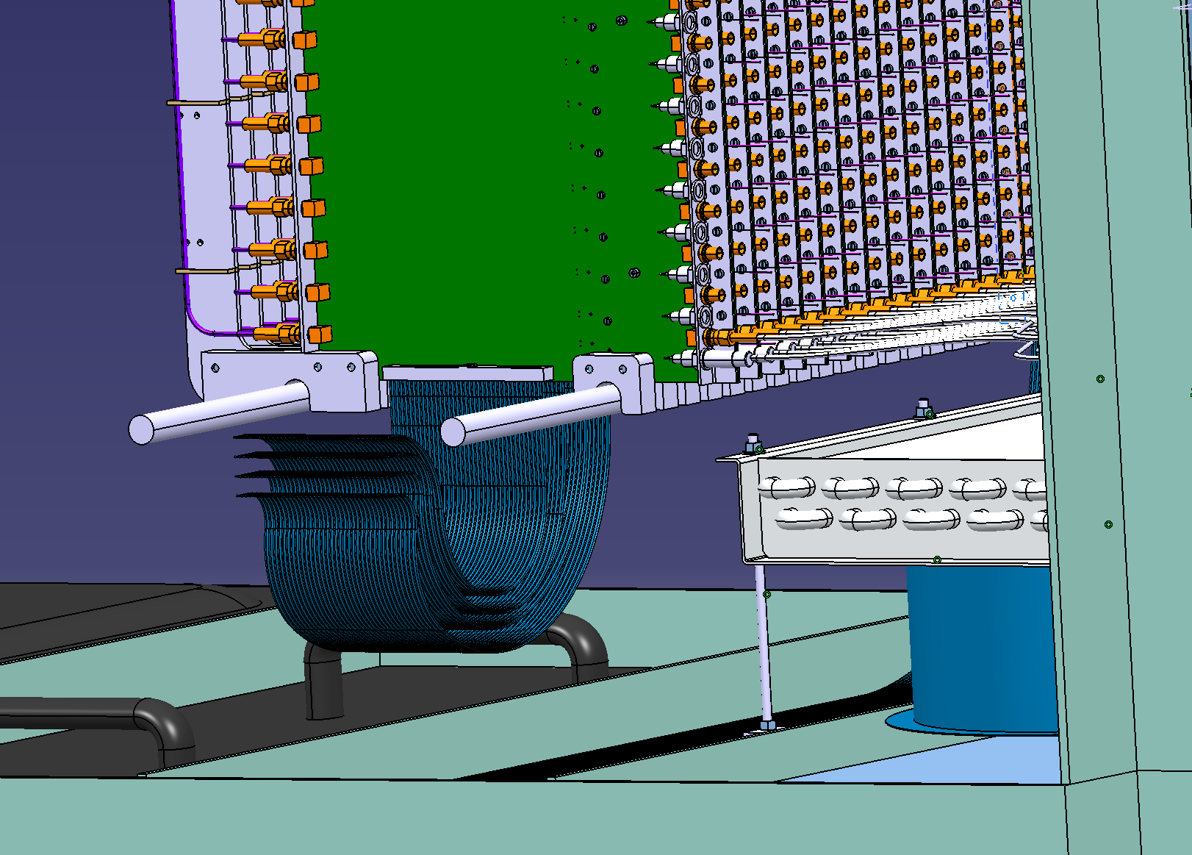
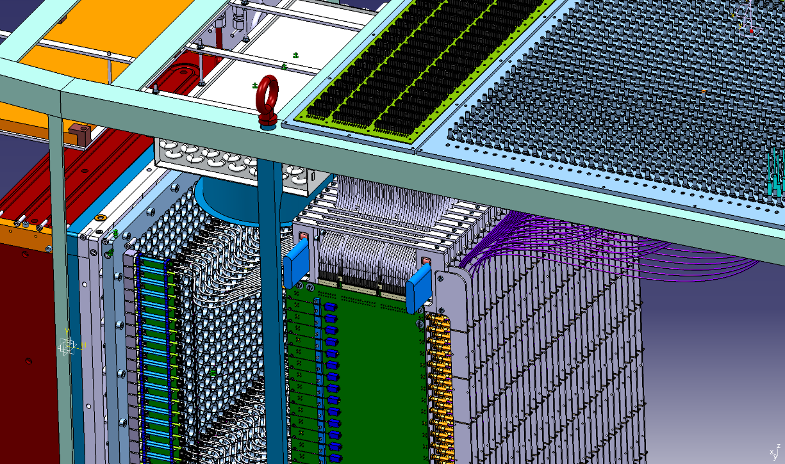
2 cables per channel
(HV & signal)
Top of the box (view from inside)
Signal cables
HV
cables
Panel-mounted LEMOS
LEDs
HV
cables
LEDs
General view (side)
Optical fibers
HV panel (SAMTEC)
Signal panel (LEMO)
Ribbon cables for LEDs control
Top view
Bottom of the box (view from inside)

