Slide 1
------------------------------------
SHMS "pivot-patch" cable run
------------------------------------
Experiments: NPS, LAD(?), CGEN(?)
- Run from pivot around the carriage to beam-left to under-floor
of electronics hut is roughly 65--75'
- Radiation is significant concern (_do_ need a robust bunker somewhere..)
- Probably do _not_ want to run cables along beam-right side of carriage
(radiation damage)
Assume beam-left (large angle) side of carriage
Assume patch panel in front of carriage?
Rough cable count:
NPS 1200 cables
LAD < 600 cables?
CGEN < 600 cables

Slide 2
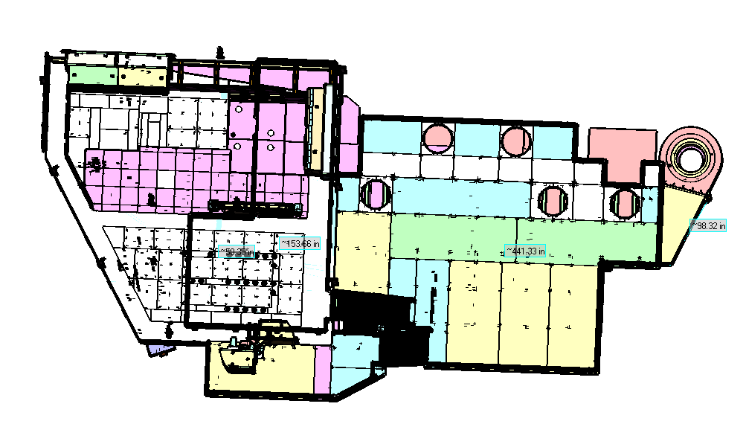
Patch panel here?
(next to small crane)

Slide 3
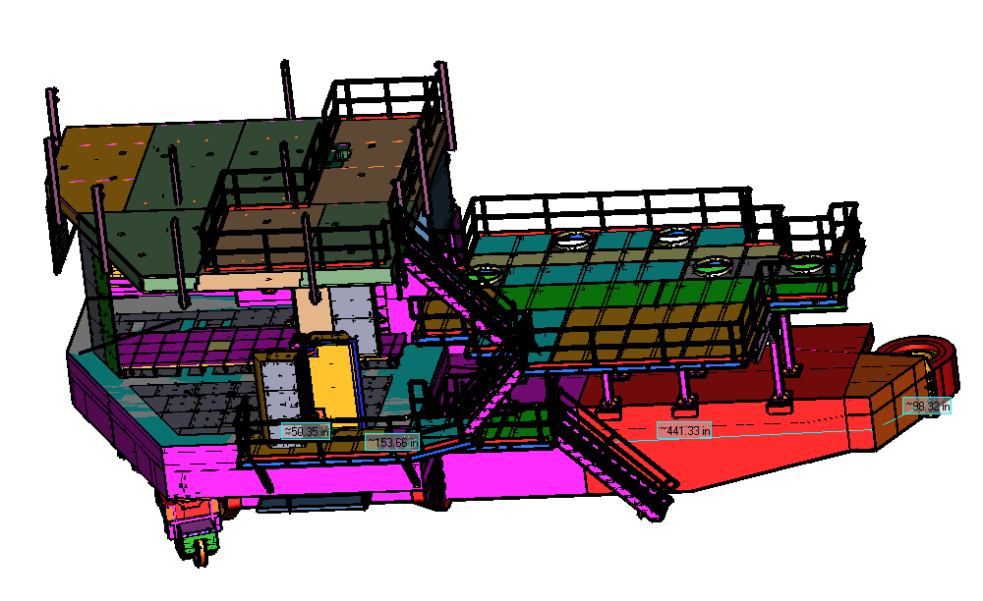
(Signal) cable run here?

Slide 4
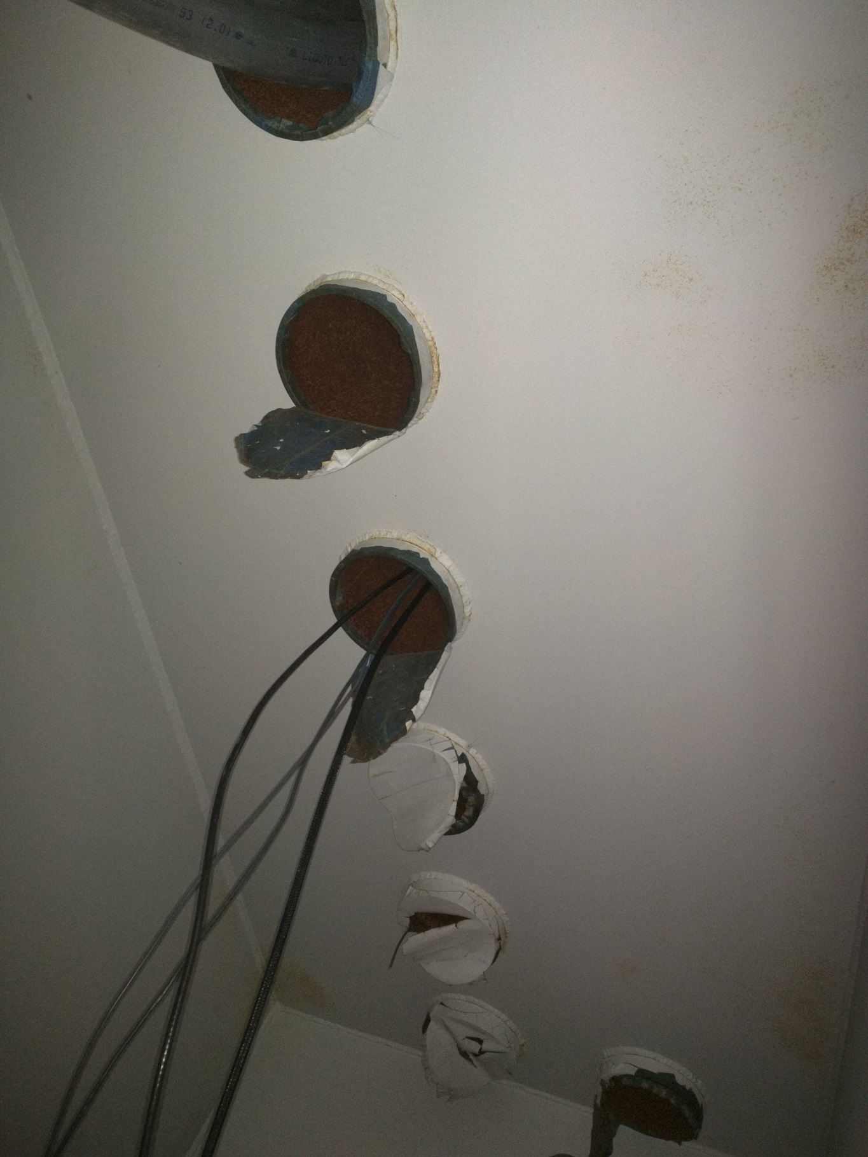
Penetrations into SHMS electronics hut

Slide 5
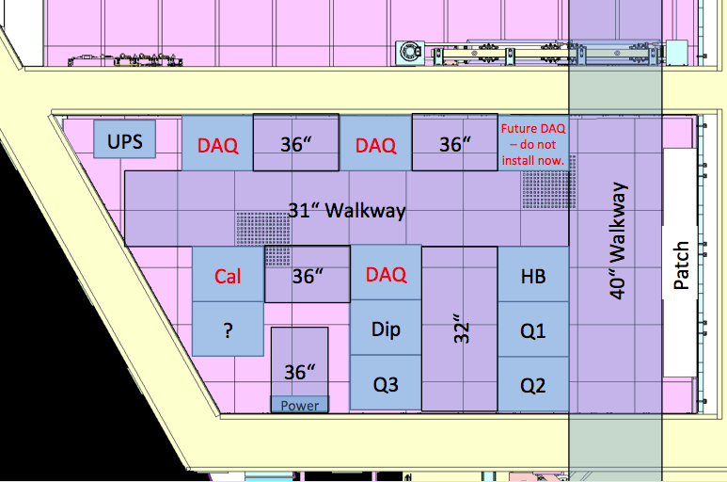
Use 1 DAQ space for patch for all 1200 signal cables
flashADC will require 5 crates, so likely 1 and 2/3 rack space
Could in principle try to use 3 red slots for DAQ (1 empty, 1 half empty) and future DAQ along wall

Slide 6
------------------------------------
SHMS "pivot-patch" cable run
------------------------------------
Experiments: NPS, LAD(?), CGEN(?)
1200 HV cables (NPS-driven others are less)
- RG59 : 0.242" OD; 0.023 lbs/ft
- 72 in2 + overhead
- Cable tray: nominal 24" wide 4--6" tall tray
- fills 1--2 penetrations
1200 RG213 cables
- Diam: 0.405" OD,
- Weight: 0.115 lbs/ft
- Sig Sp: 66%
- Termination of old cables?
- reterminate at least one end -- cost?
- Cable tray:
- 200 in2 + overhead
- nominal 30" wide 10" tall tray
- nominal 24" wide 12" tall tray
- fills 3--4 penetrations 1200 RG58 cables only 1-2 penetrations
Note: later thinking points to that if the choice is for the HV crates to be upstairs in the Counting House, we can better simply have a HV patch/breakout panel at the front of the SHMS carriage, and move the 16-channel cables up from there.

Slide 7
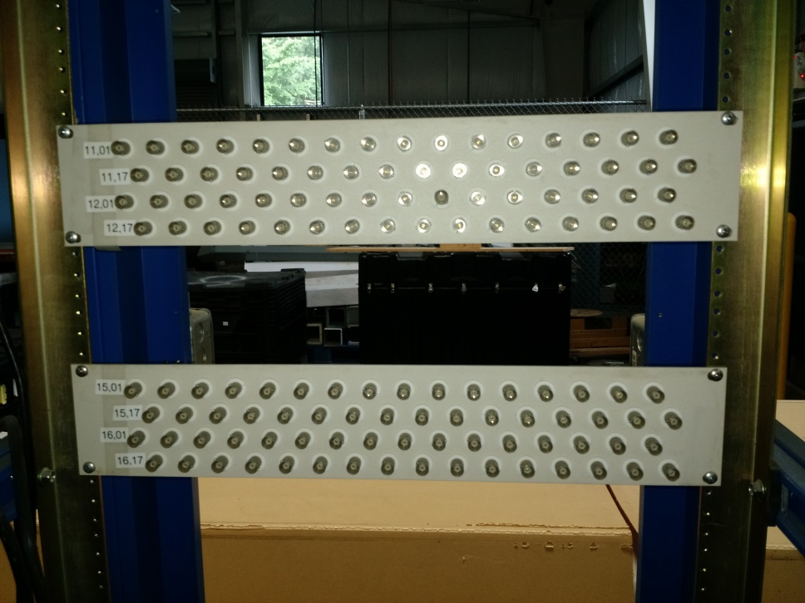
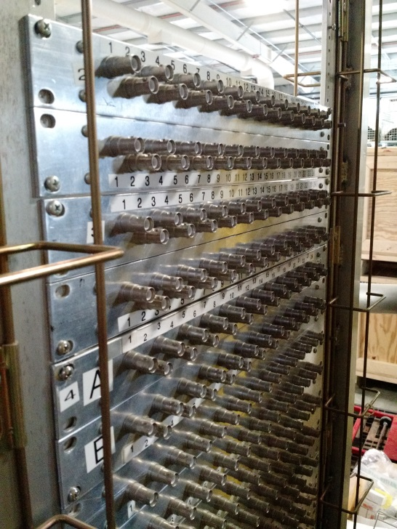
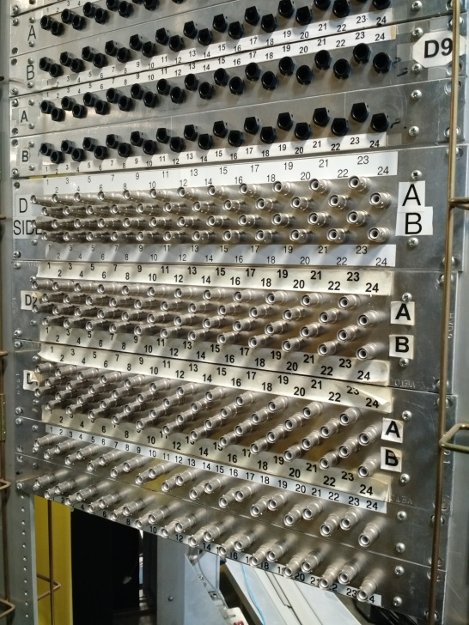
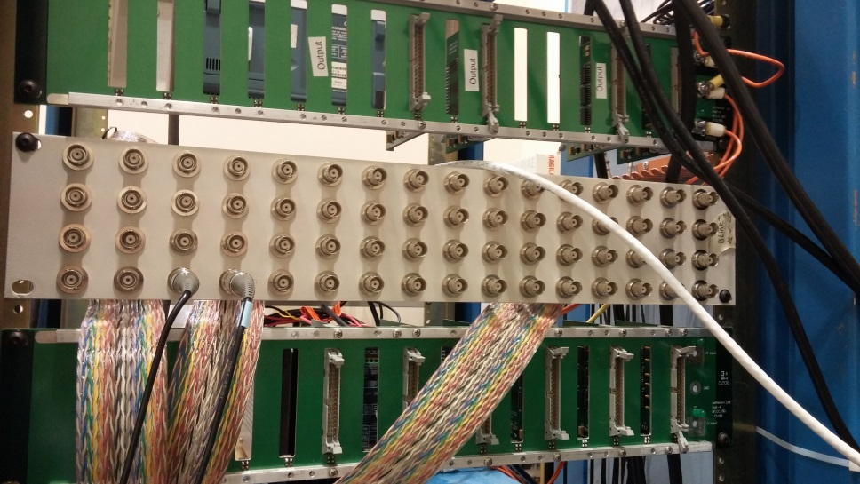
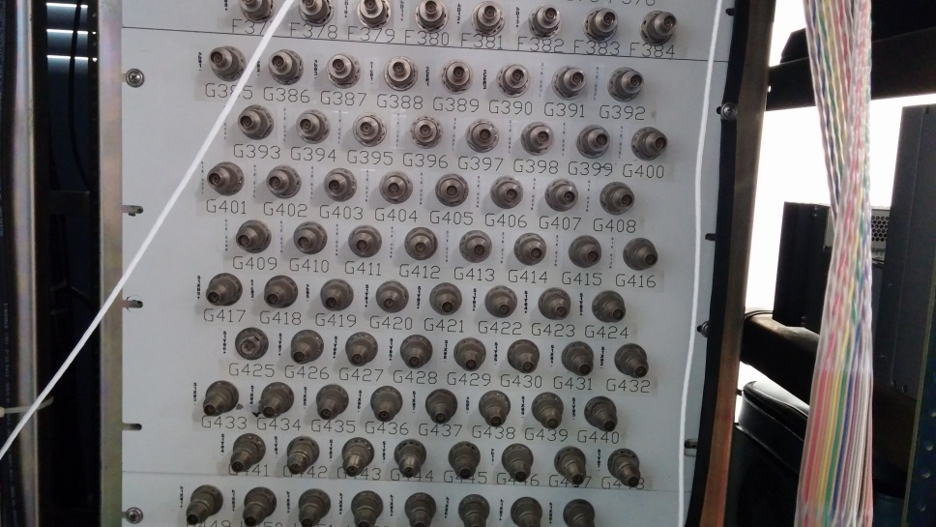
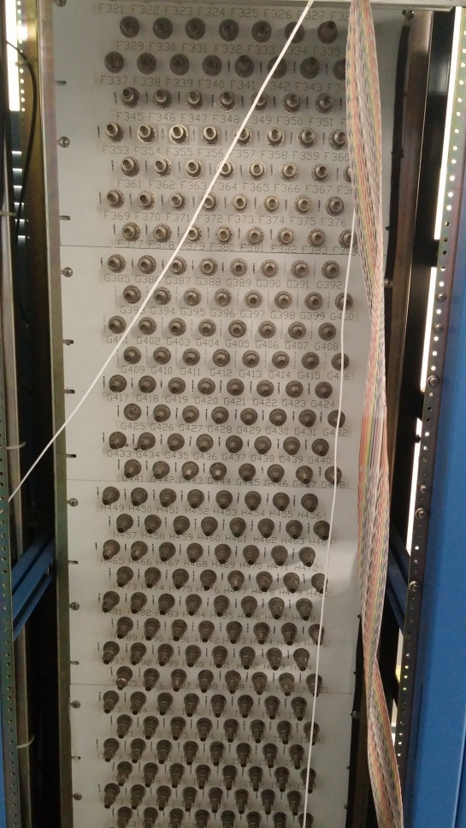
High density BNC patch High density HV breakout panel (BETA weldment in ESB)
Like this 64 cables on 3.5 inch high panel
Can fit over 1200 cables in one rack
Iike HMS: Here can fit at best 5 times 64 cables in rack

Slide 8
Hall C HV Count
Total Hall C (negative) HV count:
813 ch (Older CAEN units: 13 crates, 64ch/crate)
336 ch (New CAEN units: 2 crates: 192ch +144ch)
-------
Channels presently allocated to the spectrometers:
HMS is using a (nominal) 200 channels
SHMS is using a (nominal) 400 channels
-------
There are at least a few more of the older CAEN (64ch) crates kicking around site that are _not_ included in the above count. (Those crates are in use in the EEL/ESB for test-beds, staging, etc.)
Not all of the older crates and not all of the older cards are functioning, so you may wish to subtract 10--20% off the 'old crate‘ channel count for contingency.
-------
Need to decide where we want the HV mainframes.
In electronics hut or as in 6-GeV era in counting house?
Note: choice seems for HV crates to be upstairs in the Counting House

Slide 9
Consensus seems to be that the most generic solution for Hall C would be to have:
Patch panels at front of SHMS deck, to accommodate 1200 channels
Signal cable runs at beam-left (large-angle) side of SHMS
Use penetrations into SHMS electronics hut for signal cables
Try to fit in one rack a patch panel for 1200 connectors (→ regular BNC)
HV patch/breakout panel also at front of SHMS deck, then go upstairs to CH
To do:
Do we need more HV mainframes (can fit up to 240 channels in one caen mainframe)
Yes, need 1-2 more HV mainframes
Where do we plan to have the HV mainframes – in CH or electronics hut?
Choice seems to be in CH
Work this plan out in more detail to see if everything fits
Get buy-in from Thia & Steve
Folded in now

