Slide 1
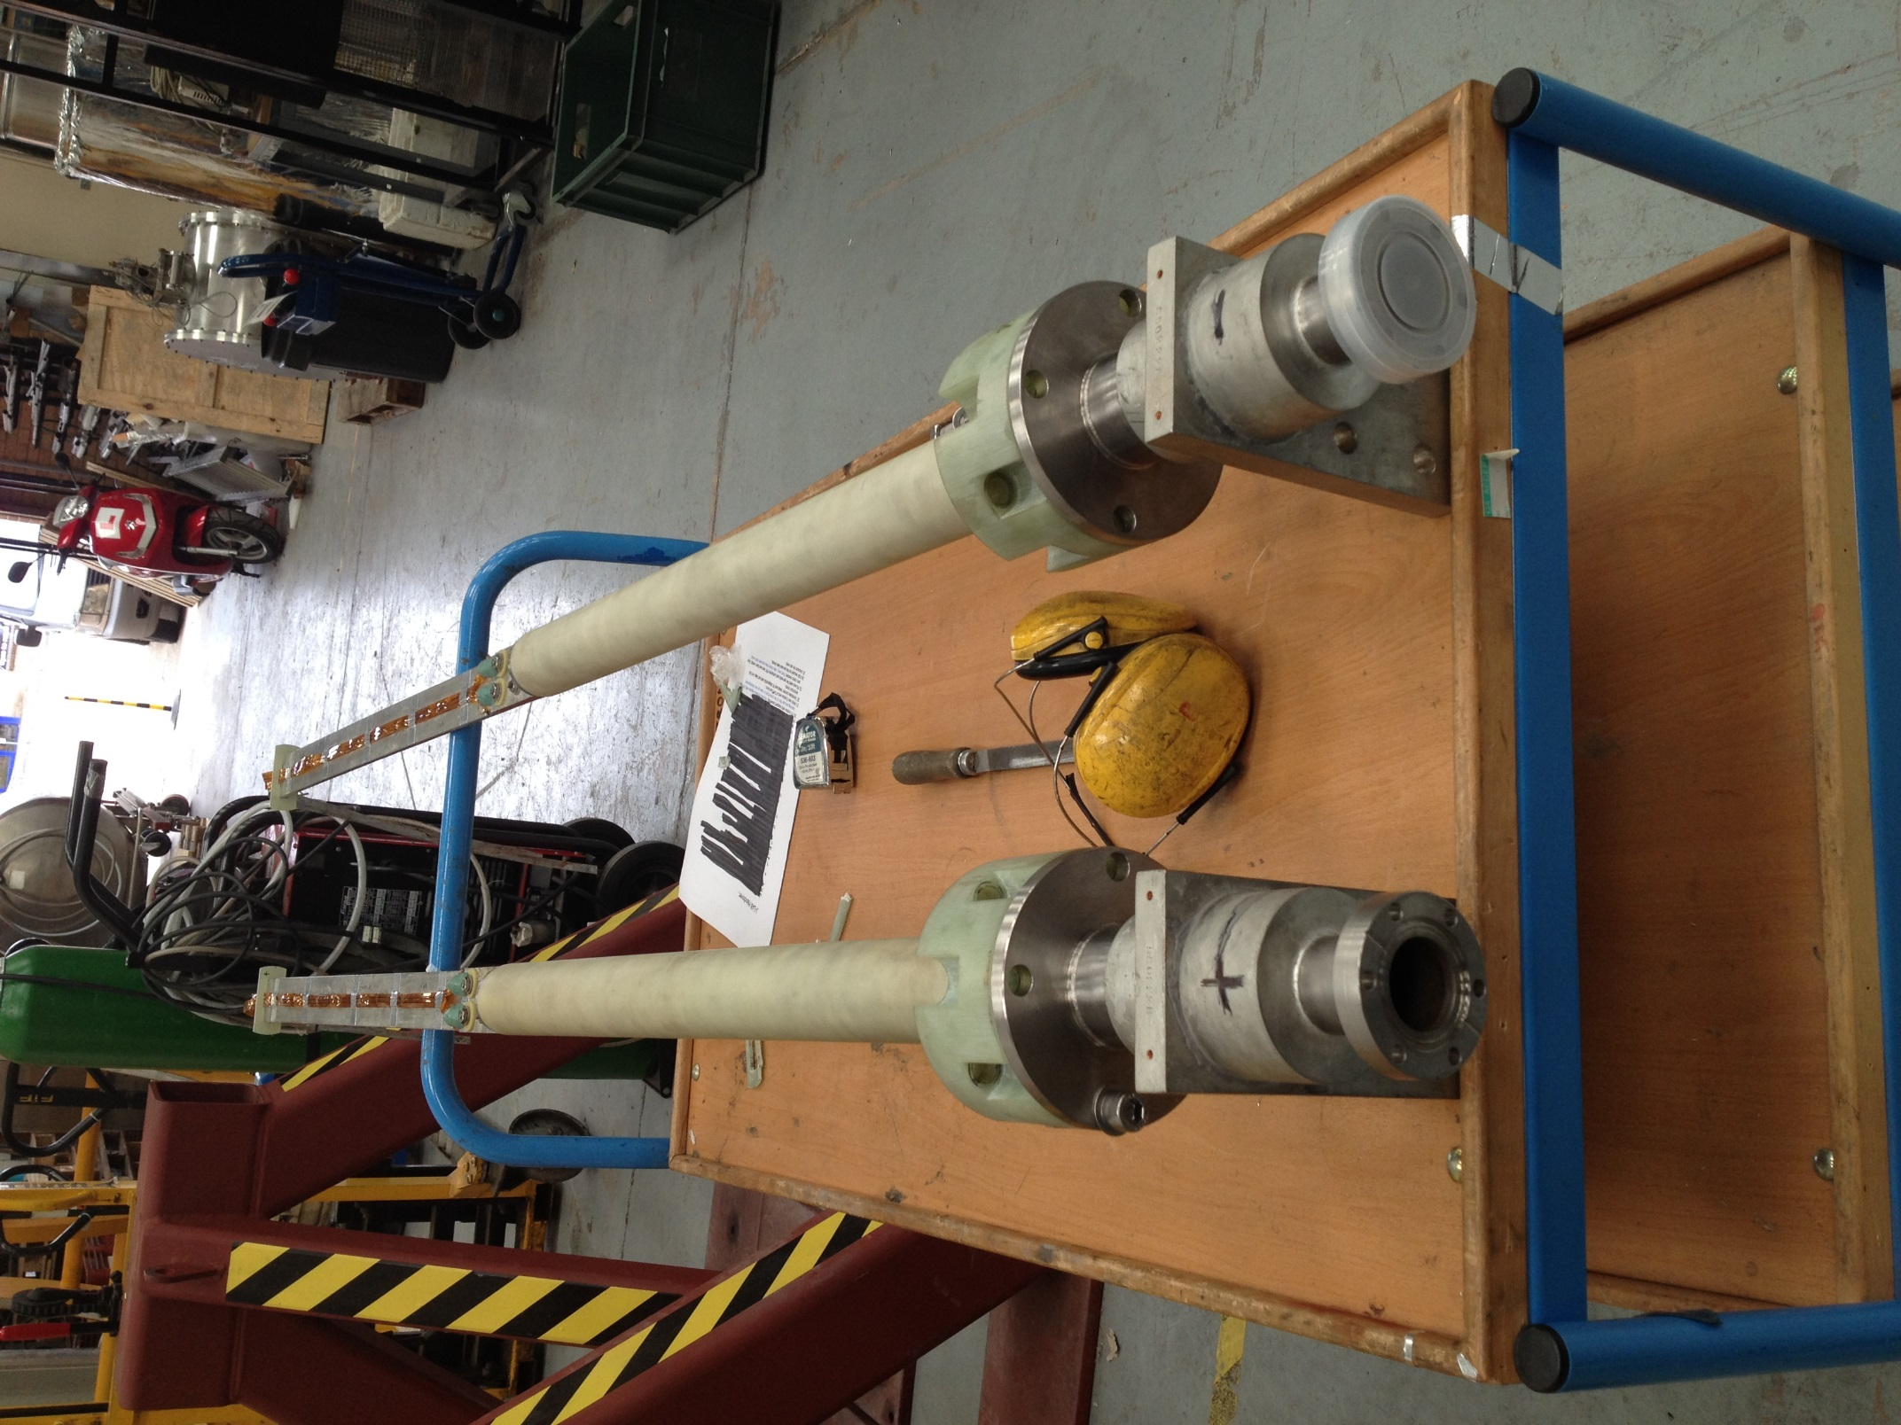
Room Temperature Voltage tap and Temperature Location
Location U in schematic 67125-00113
Middle M1 Current lead within Cryo Box
Voltage tap location M1 in 67125-00113
Middle M2
Current lead within Cryo Box Voltage tap location M2 in 67125-00113.

Slide 2
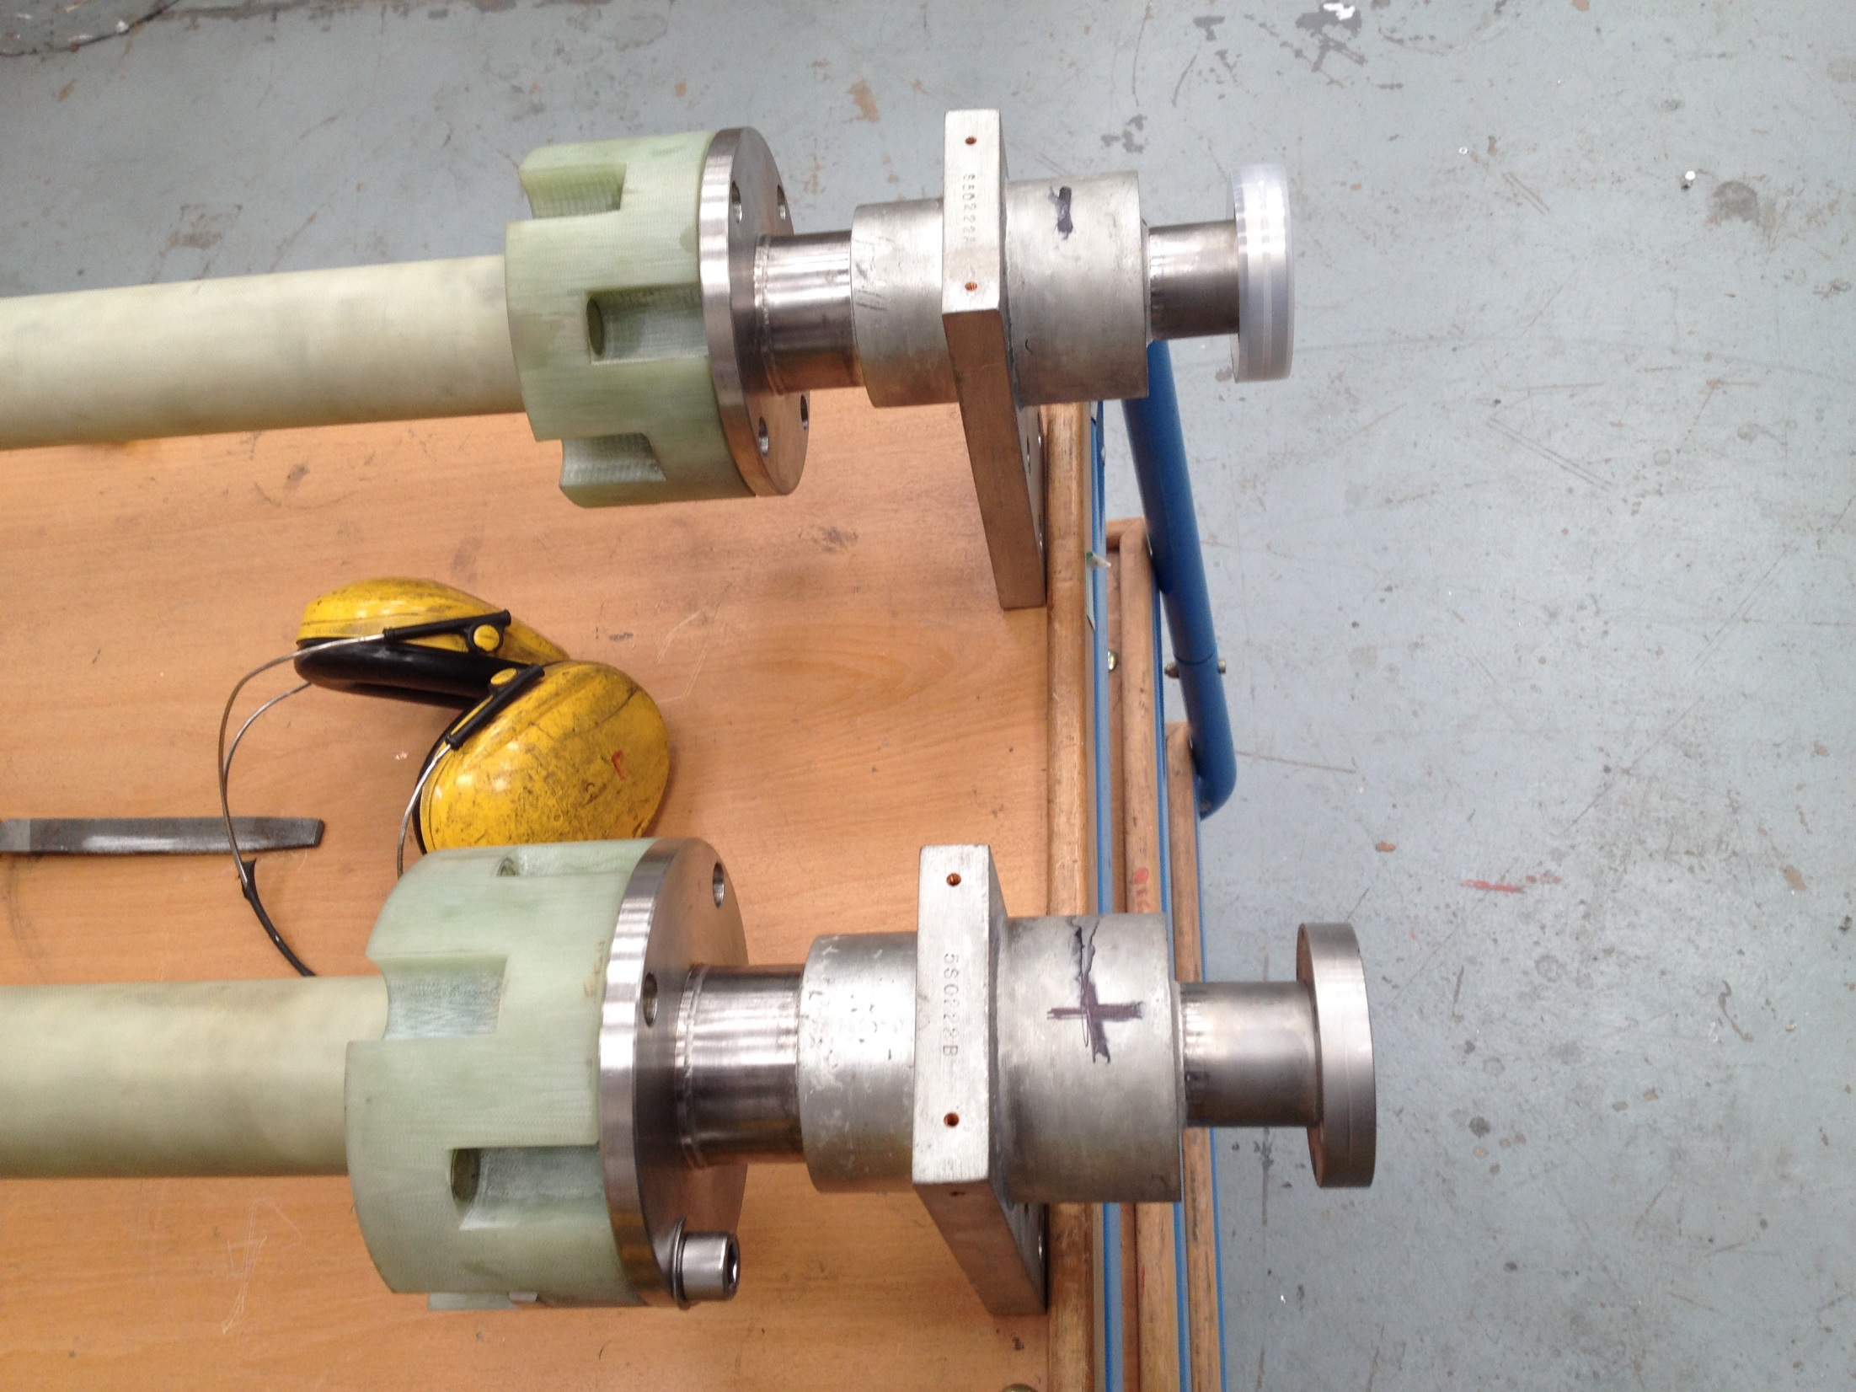
Current Lead Warm End
Tap locations for Voltage tap and temperature sensor.
Holes need to be drilled and tap on HB and Q2,Q3 & Dipole Current leads.

Slide 3
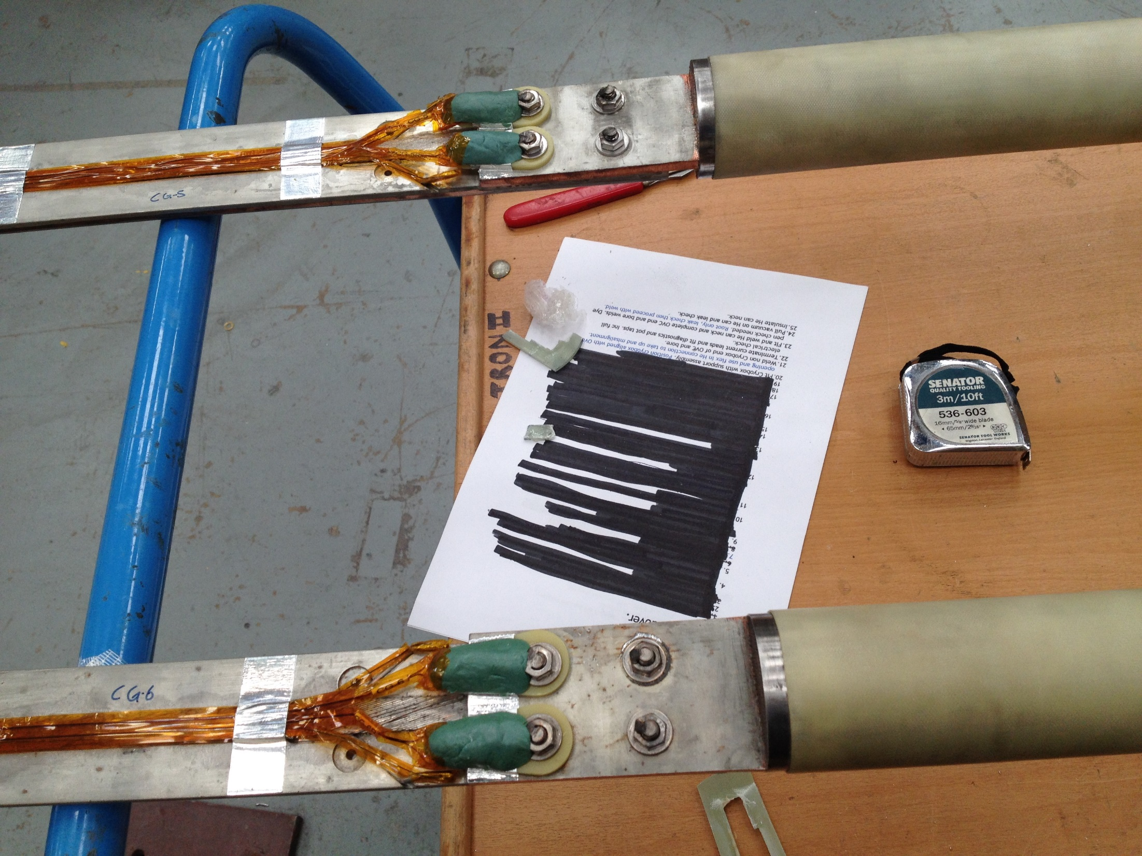
Position M1 on drawing 67125-00113
Two Voltage taps and two temperature sensors per lead at this location
Current leads come with a small G10 tab to mount temperature sensors.
Long Voltage tab leads need to be trimmed down to allow G10 tube to pass over.

Slide 4
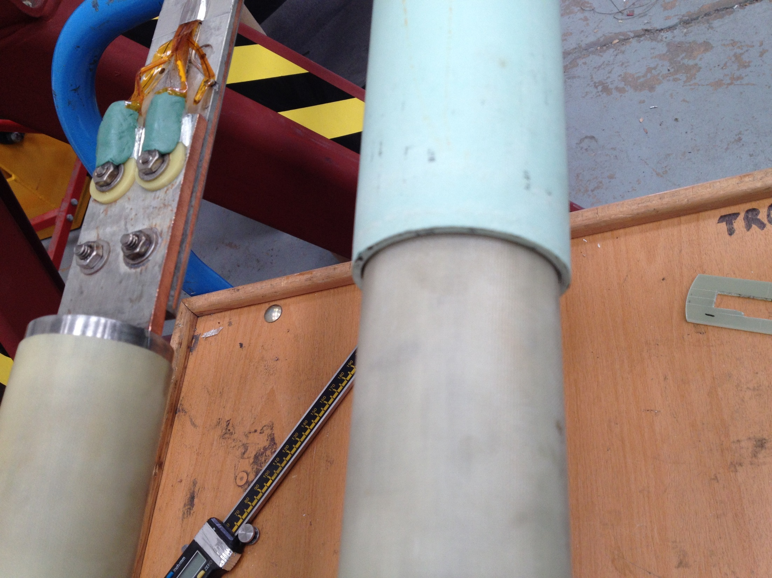
Another view of M1 location.

Slide 5
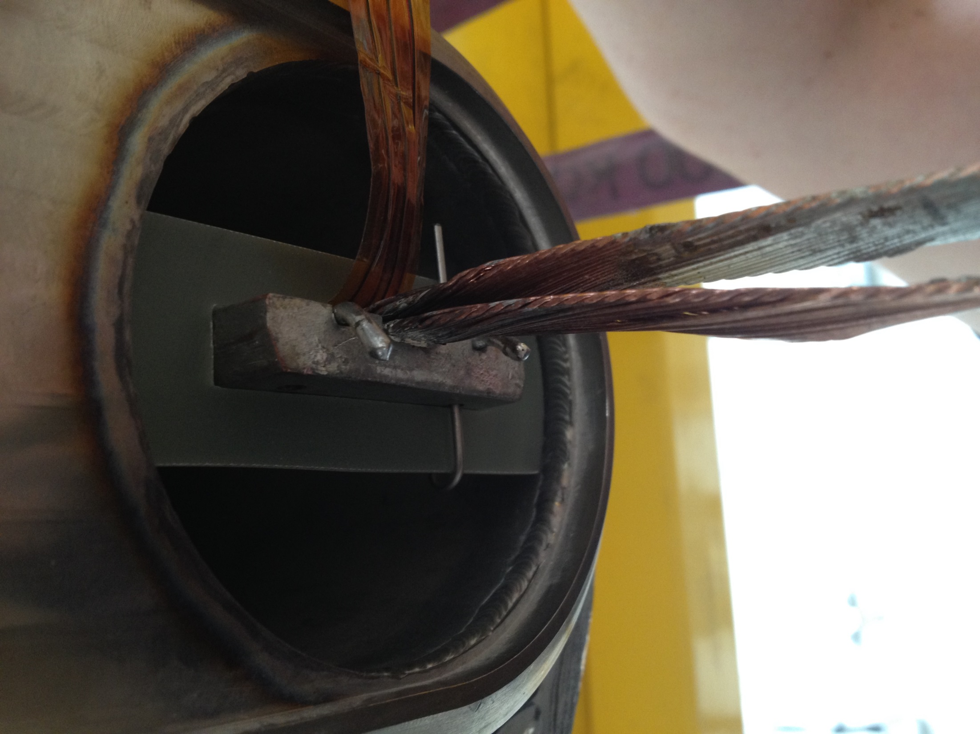
Location of voltage tap leads at M2 location. Long leads have been cut down. Voltage tap wiring not installed in this photo such that centering ring and lower G10 tube can be installed.
Location is at bottom of cu stabilizer of the current lead.

Slide 6
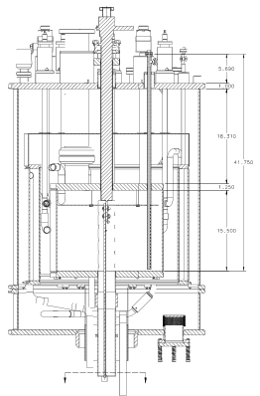
Voltage Tap locations
Voltage Taps L1 and L2 are on either side of the splice between the magnet coils and the current leads.
Location U
Location M1
Location M2
Location L1
Location L2

