Slide 1
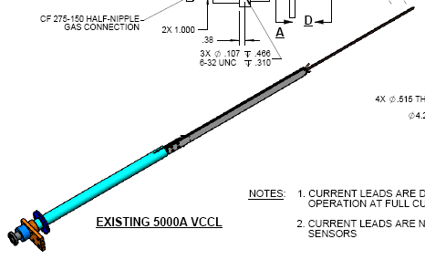
Stabilizer with SSC cable solder into a channel

Slide 2
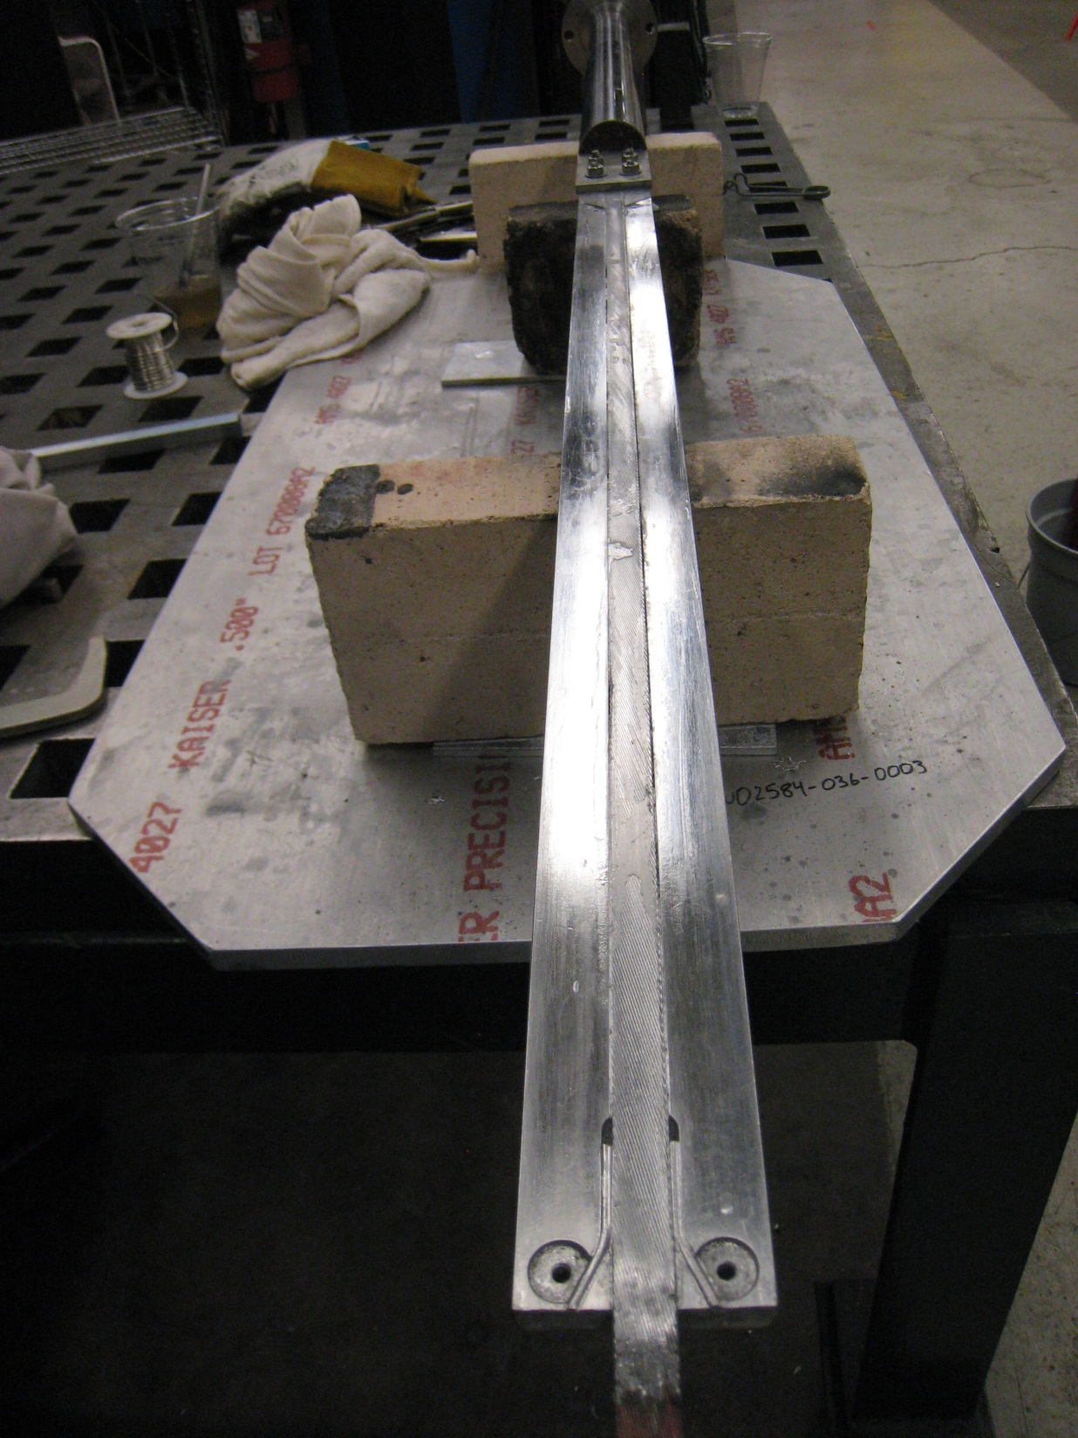

Slide 3
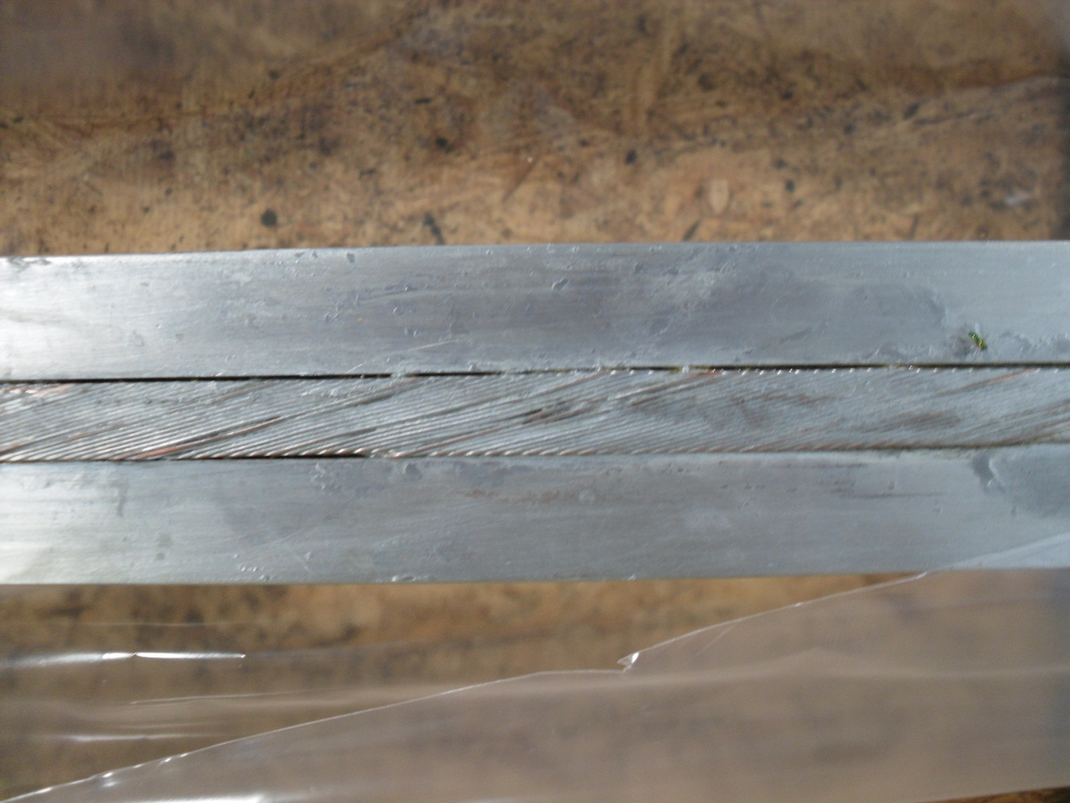
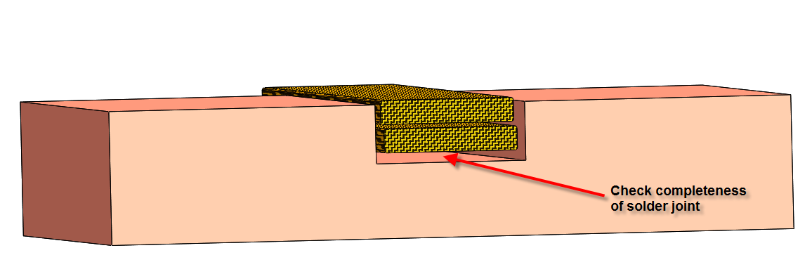
X-ray the cable in the channel., along the entire length of the stabilizer.

