Slide 1
Main page for SHMS Q1
Temporary Data Log control

Slide 2
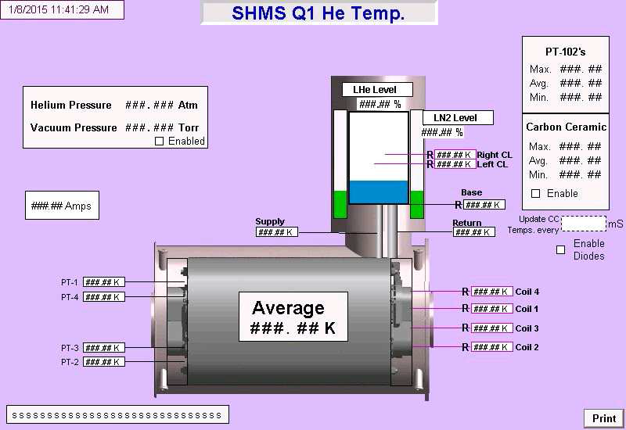
Helium temperatures

Slide 3
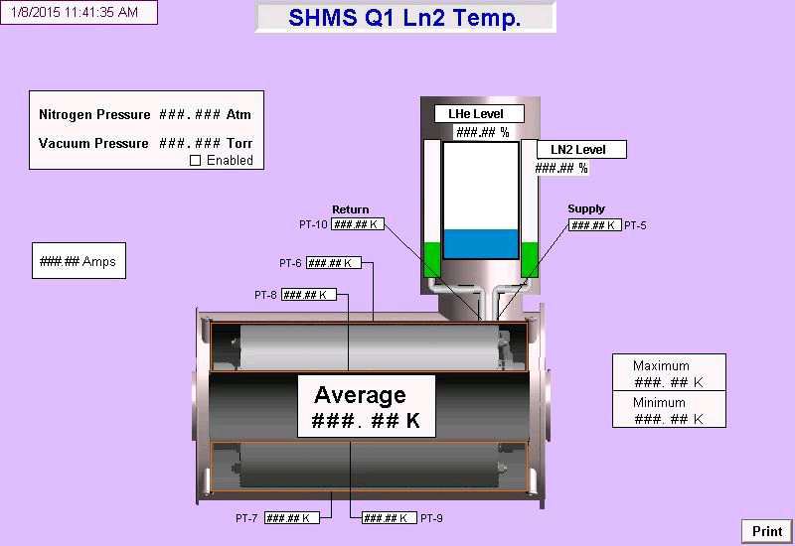
Nitrogen temperatures

Slide 4
Support Link forces

Slide 5
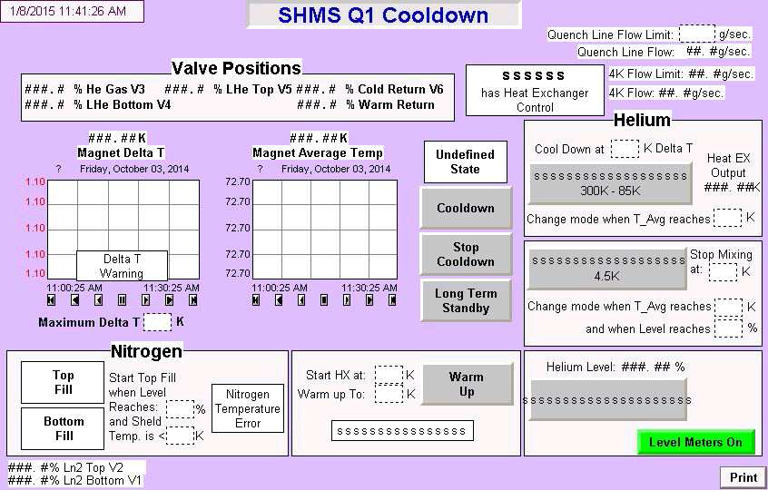
Cool down control

Slide 6
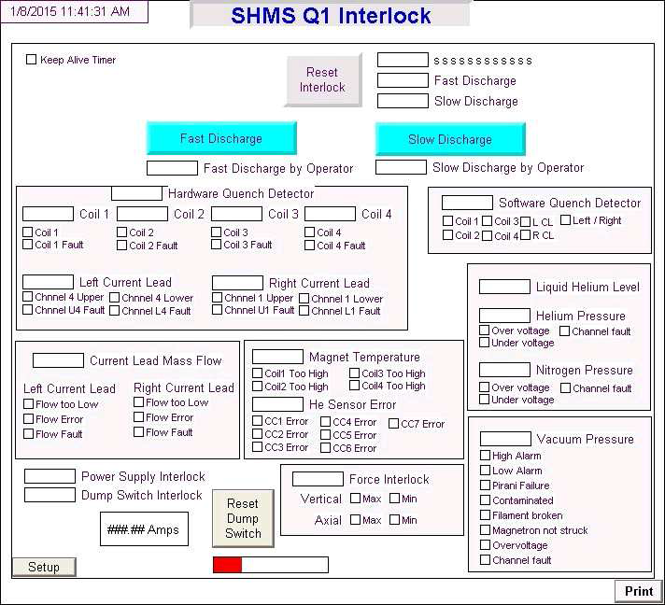
Interlocks

Slide 7
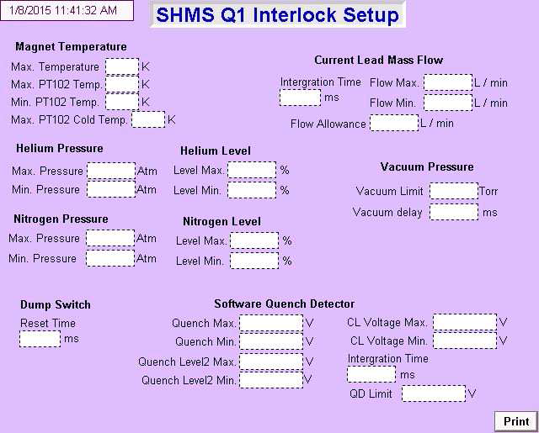
Interlock setup (expert screen)

Slide 8
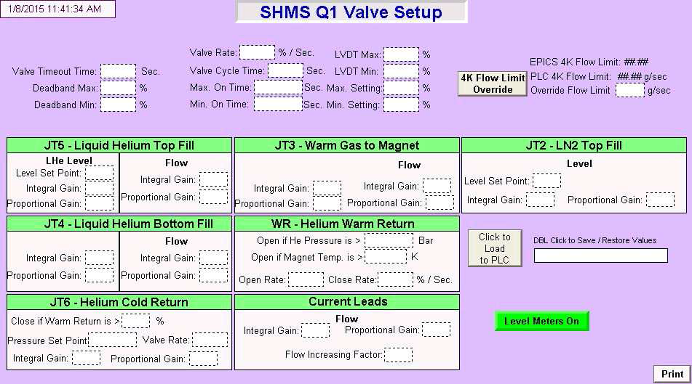
JT Valve control (expert screen)

Slide 9
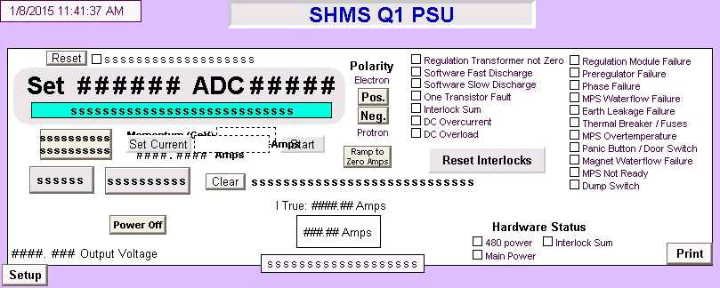
Power Supply control

Slide 10
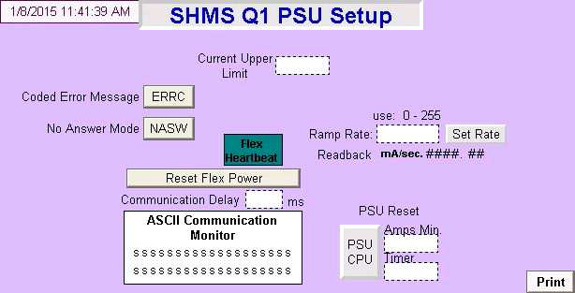
Power Supply setup (expert screen)

Slide 11
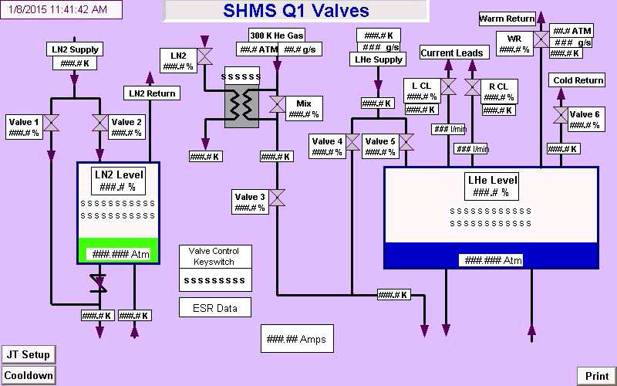
JT Valve control

Slide 12
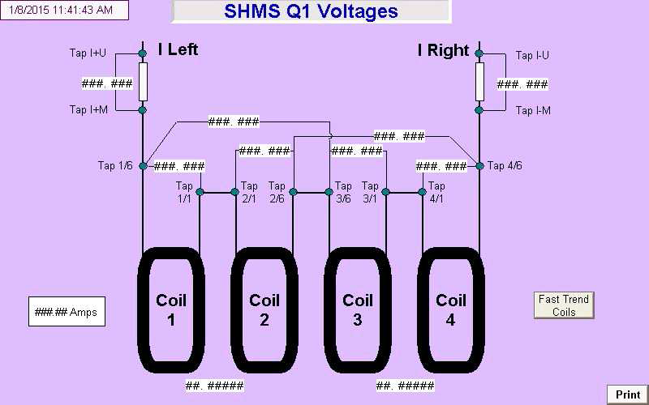
Voltage screen

Slide 13
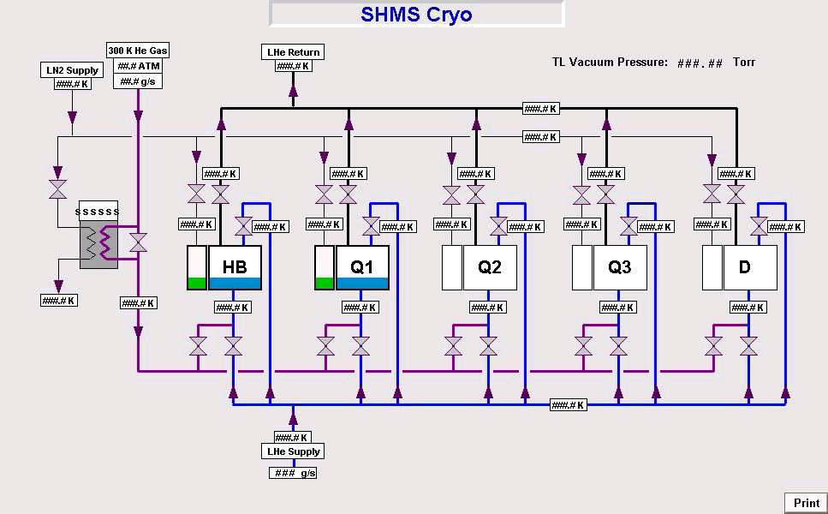
Transfer Line

