Slide 1
Danfysik PSU Fast Discharge Timing
Steven Lassiter
Eric Sun
Mike Fowler

Slide 2
Objective
Measure the timing of the fast dump circuit.
Directly interrupting the 24V to the control contact relay of the Dump switch. (K7 : A1 to A2)
Using the PLC interlock signal to initiated the fast dump
Using the Danfysik Quench detector to generate a interlock signal
Using the Panic Button on the Front door of the PSU.

Slide 3
Danfysik system 8500 PSU

Slide 4
Dump Switch

Slide 5
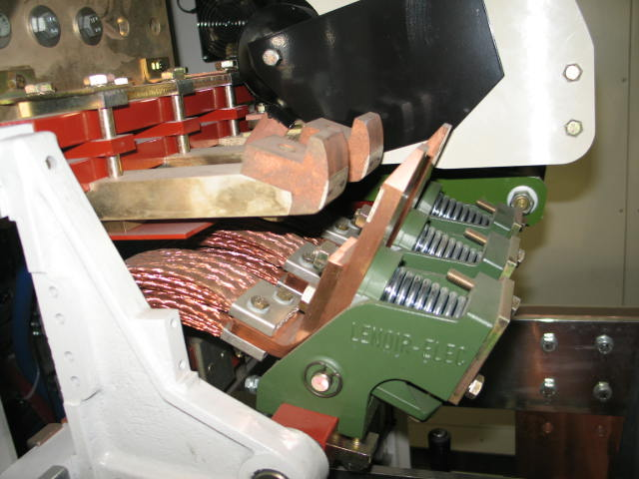
Dump Switch
It appears that each spring has a different amount of compressing, with the least compressed spring having the arc blast shield on it.

Slide 6
Breaking 24V to Relay K7

Slide 7
24V Relay Results
Time (sec.000) | Event | Elapse Time ms | Observations
0.738 | Interlock sent to PSU | 0
0.808 | 24V to relay drops out | 70
1.528 | Dump Voltage & PSU lead output Voltage Spike | 790 | Time between lose of 24V to switch starting to opening is 720ms.
1.568 | Current starts to decay | 830 | Time for switch to fully open is 870-790= 80ms
1.608 | Steady current decay begins as indicated by smooth Voltage signals. Switch appears to be fully open. | 870 | Several Spikes in voltage output before smooth decay begins. May be due to the three dump switches unloading at different times.
2.718 | Current passes Zero | 1,980

Slide 8
Fast Dump using PLC

Slide 9
PLC FD Results
Time (sec.000) | Event | Elapse Time ms | Observations
 | Interlock from PLC to PSU | (70) | Need to measure. Value from 24V relay data
1.894 | 24V to relay drops out | 0 (70)
1.954 | Dump Voltage & PSU lead output Voltage Spikes | 60 (130) | PSU turns off, then ramps down at -6.2V ??
1.964 | Current starts to decay | 70 (140) | PSU outputting -6.2V Small Voltage across Dump
2.614 | Dump switch opens Time 1 | 720 (790) | Jump in PSU output and Dump voltage.
 | Dump switch fully open Time 2 | 800 (870) | Use the 80ms open time
3.394 | Current pass zero | 1,500 (1,570)
Time 1 = 720ms from lose of 24v to Dump switch opening start.
Time 2 = 80ms for Dump switch to fully open.

Slide 10
Fast Dump using Quench Detector

Slide 11
QD FD Results
Time (sec.000) | Event | Elapse Time ms | Observations
43.498 | Quench Detector interlock signal goes out | 0
43.508 | 24V to relay K7 drop out | 10
43.588 | Current starts to drop, PSU Lead Voltage and Dump Voltage all start to change | 90 | PSU turns off, then ramps down at -6.2V. Start of Front Porch
44.228 | Dump Switch opens | 730 | Sharp spikes in Voltages
45.018 | Current passes Zero | 1,520

Slide 12
Fast Dump using Panic Button

Slide 13
PB FD Results
Time (sec.000) | Event | Elapse Time ms | Observations
33.774 | Panic Button Interlock | 0 | Button Pushed on Door
33.824 | Current decay starts, PSU Lead and Dump voltage rise | 50 | No Bang heard right away. Bang is heard at end. Not Dump switch but main contactor switch.
 | Current decays at steady rate |  | PSU lead voltage -6.2V to -5.1V
35.454 | Current pass Zero | 1,680 | No Dump switch

Slide 14
Conclusions
The time delay between lose of 24V to relay K7 and the switch fully opened is 800ms (720 +80). This is much larger than any time in the specification which (at maximum) is <300ms. Not acceptable.
The switch opening time appears to be 80ms.
The Panic Button does result in an opening of the dump switch as drawings indicate it should. Needs to be corrected.
The Quench Detector interlock give the fastest discharge time of 1.52secs from 393A and with a ~17mili-ohm dump resistor.
Dump switch needs to be modified, changed out or a faster switch added in series with it.

