Slide 1
HB 3500A Trip
Dec 16, 2015

Slide 2
Notes
Voltage and current signals from the HB dipole magnet (two coils).
Scope signals are uncalibrated. Some effect on timing results, but should be in the ball–park.
Scope’s differential probes voltage signal has more noise than is seen on PLC data and QD input.
Coil voltages have been scaled to yield an average bucked signal of 0.000V before event occurs. Calibration of probes will effect this.
Looking to obtain a dump switch opening time of 50ms to 65ms from start of quench event.
Expected QD interlock signal to trip off PSU no more than 10ms after threshold is reached, data suggest it is 71ms.

Slide 3
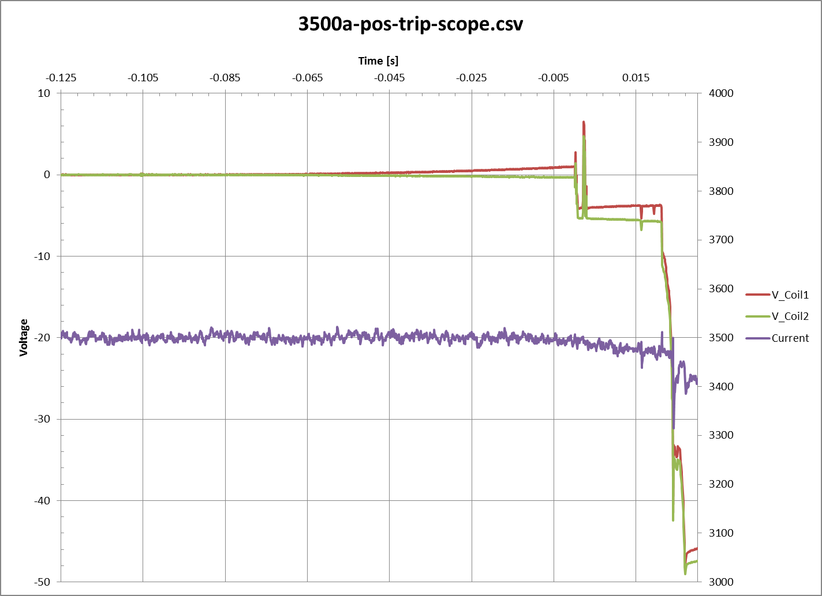
Event t=-0.105s
PSU reacts to QD’s interlock t=0.000s
10mv threshold reached ~t=-0.071s
Dump switch opens t=0.021s
Time from QD threshold reached to Dump switch opening is of the order of 0.092 secs.
Time from Quench event starting to dump switch opening is 0.126s

Slide 4
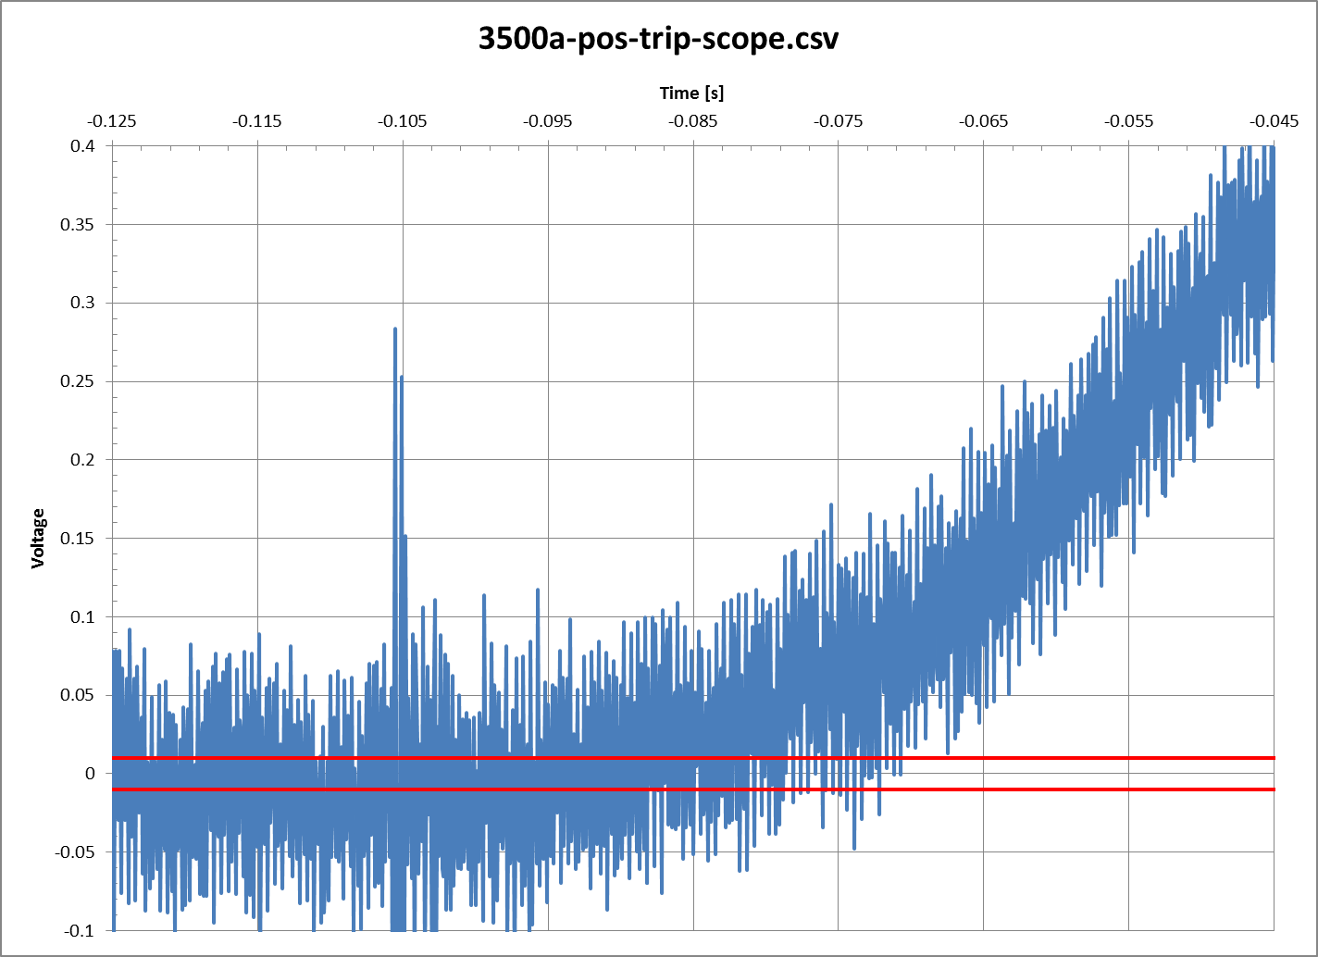
Bucked Coil Voltages
Buck coil signal obtained by subtracting coil 1 voltages from coil 2 voltages in spreadsheet.
Event t=-0.105s
Bucked signal exceeds 10mV and stays above threshold t=-0.071s
Threshold range +/- 10mV

Slide 5
Path forward
Calibrate signals and re-measure QD timing.
Compare to factory test results.
Modify QD’s R-C components to reduce delay in triggering an interlock.
Use new differential scope probes.

