Slide 1
Q1 500a current decay curves
Steven Lassiter

Slide 2
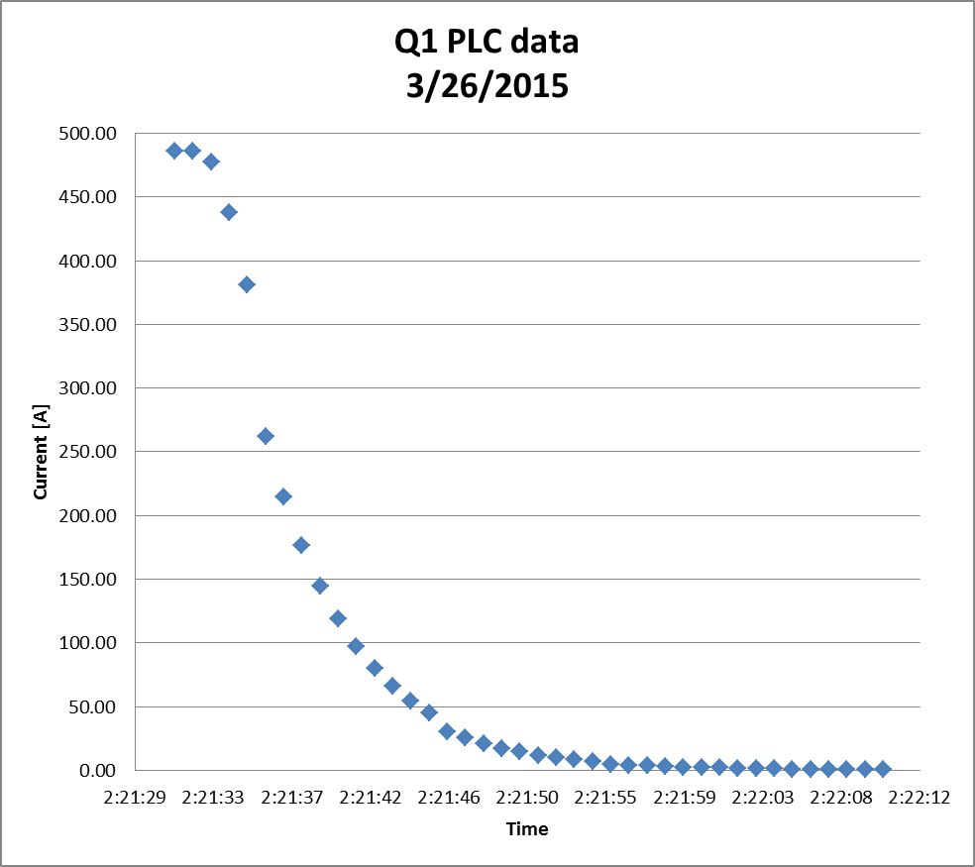

Slide 3
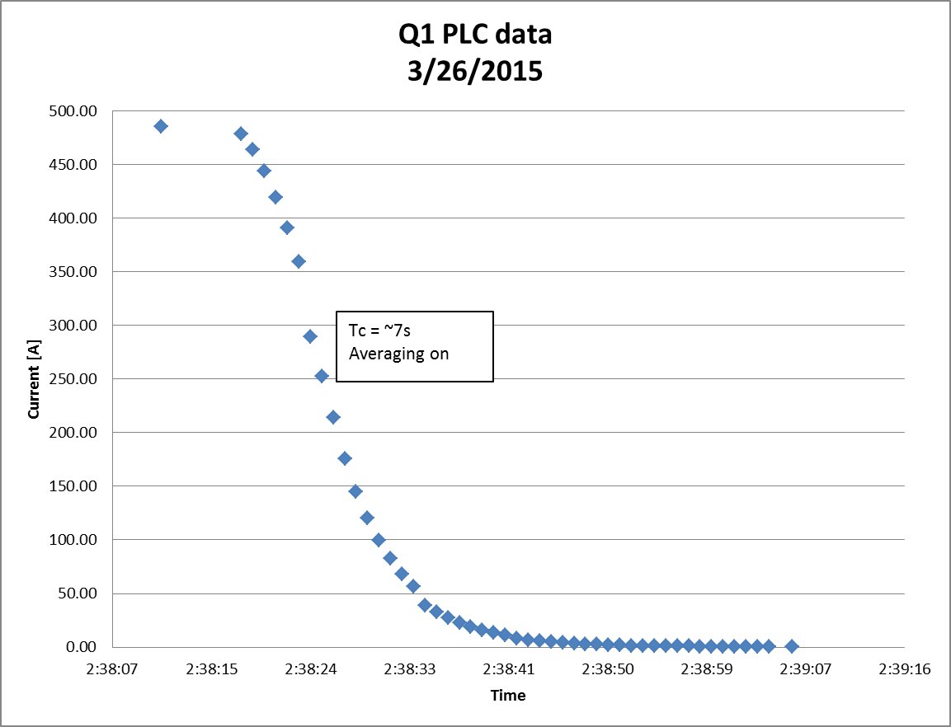

Slide 4
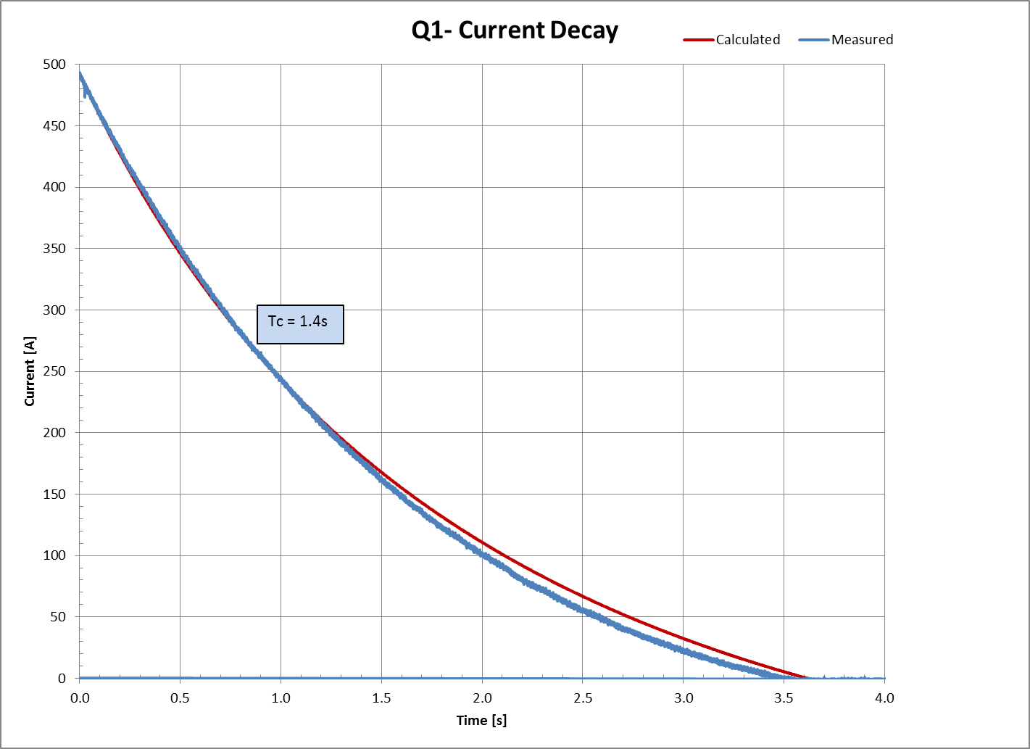
Scope data

