Slide 1
E12–14–009: Ratio of the electric form factor in the mirror nuclei ³He and ³H
Luke Myers, John Arrington, and Doug Higinbotham Spokespersons

Slide 2
Motivation
One-time opportunity for ³H at JLab
Precise theoretical calculations of <r²_{rms}>_{3H}, <r²_{rms}>_{3He}
Experimental results: large uncertainties, discrepancies
 | <r²_{rms}>_{3H} | <r²_{rms}>_{3He}
GFMC | 1.77(1) | 1.97(1)
χEFT | 1.756(6) | 1.962(4)
SACLAY | 1.76(9) | 1.96(3)
BATES | 1.68(3) | 1.97(3)
Atomic | -------- | 1.959(4)

Slide 3
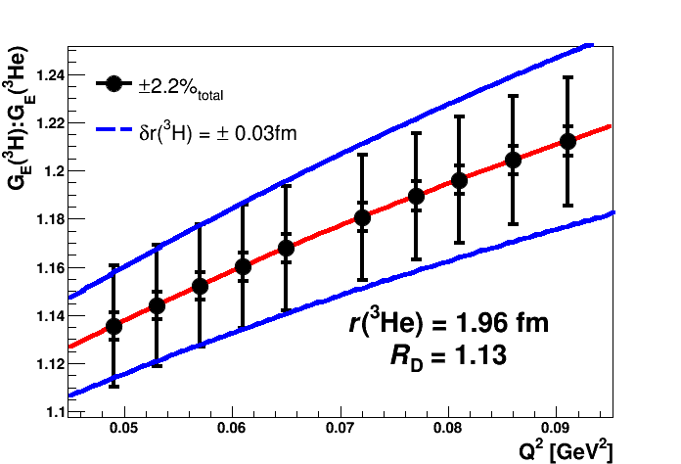
Expected Results

Slide 4
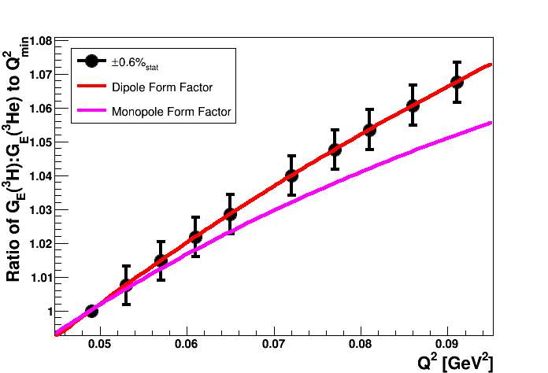
Expected Results

Slide 5
Experimental Setup
Hall A, as in MARATHON (E12-10-103) and x>1 (E12-11-112)
Beam: 1.1 GeV @ 5 μA for 1.5 days
Special collimator plate

Slide 6
Kinematics with LHRS
θ_{HRS} | p_{HRS} | Q² | ³H Rate | ³He Rate
[deg] | [GeV/c] | [GeV²] | [Hz/bin] | [Hz/bin]
12.5 | 1.07 | 0.049-0.065 | 210 | 510
15.0 | 1.07 | 0.072-0.091 | 60 | 125
Only one momentum setting
Works for ³H, ³He as well as ¹H, ²H, ¹²C
¹²C data for systematics cross check
Count rates are HUGE!
I_{beam} ~ 5 μA
Even with losses, 10⁵ counts/bin/hr

Slide 7
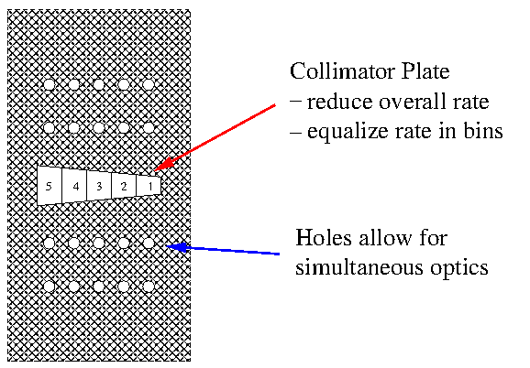
Collimator Plate

Slide 8
Beamtime Request
Description | Time
Accelerator scaling to 1.1 GeV | 4 hr
BCM calibration and luminosity scans | 2 hr
Optics and acceptance studies with collimator | 4 hr
Production running at 12.5º (1.5 hrs/target) | 9 hr
Target changes at 12.5º | 1 hr
Move spectrometer from 12.5º to 15.0º | 2 hr
Optics and acceptance studies with collimator | 4 hr
Production running at 15.0º (1.5 hrs/target) | 9 hr
Target changes at 15.0º | 1 hr
Total Beam Time Request | 1.5 PAC Days

Slide 9
Conclusions
• Currently, <r²_{rms}>_{3He} – <r²_{rms}>_{3H} = (0.20 ± 0.10) fm
• A 2% measurement of the form factor ratio
<r²_{rms}>_{3He} – <r²_{rms}>_{3H} ≈ (0.20 ± 0.03) fm
• Only 1.5 days of beamtime requested for experiment
⇒ ¹H, ²H, ³H, ³He and ¹²C
• Our best chance to measure the ³H radius!

