Slide 1
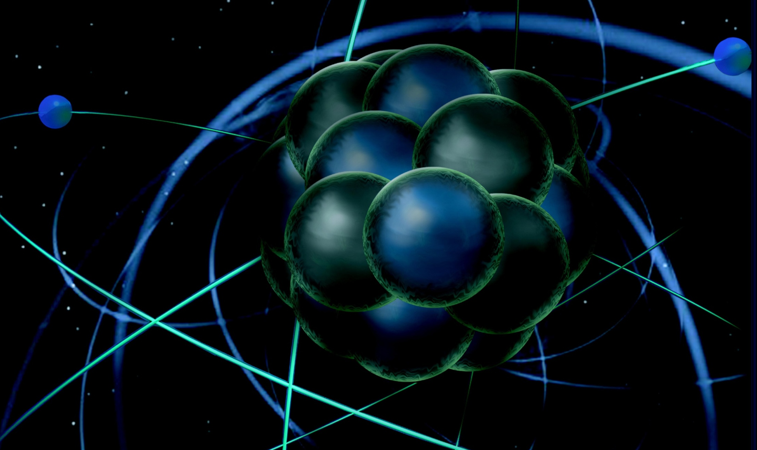
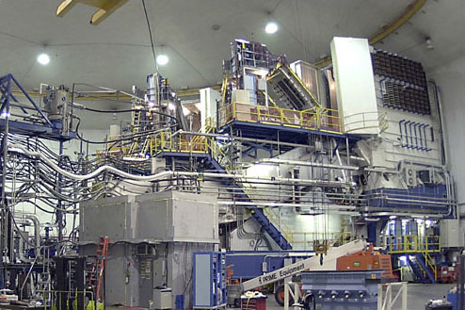
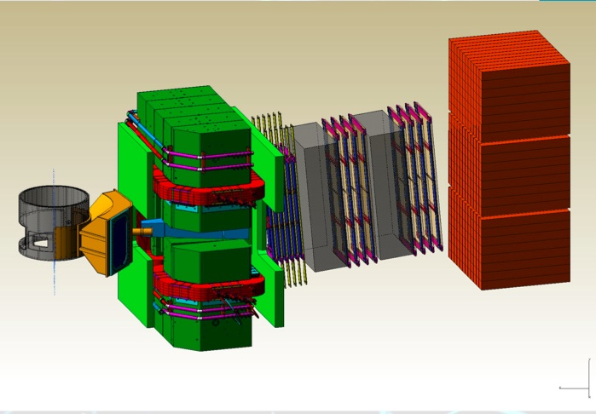
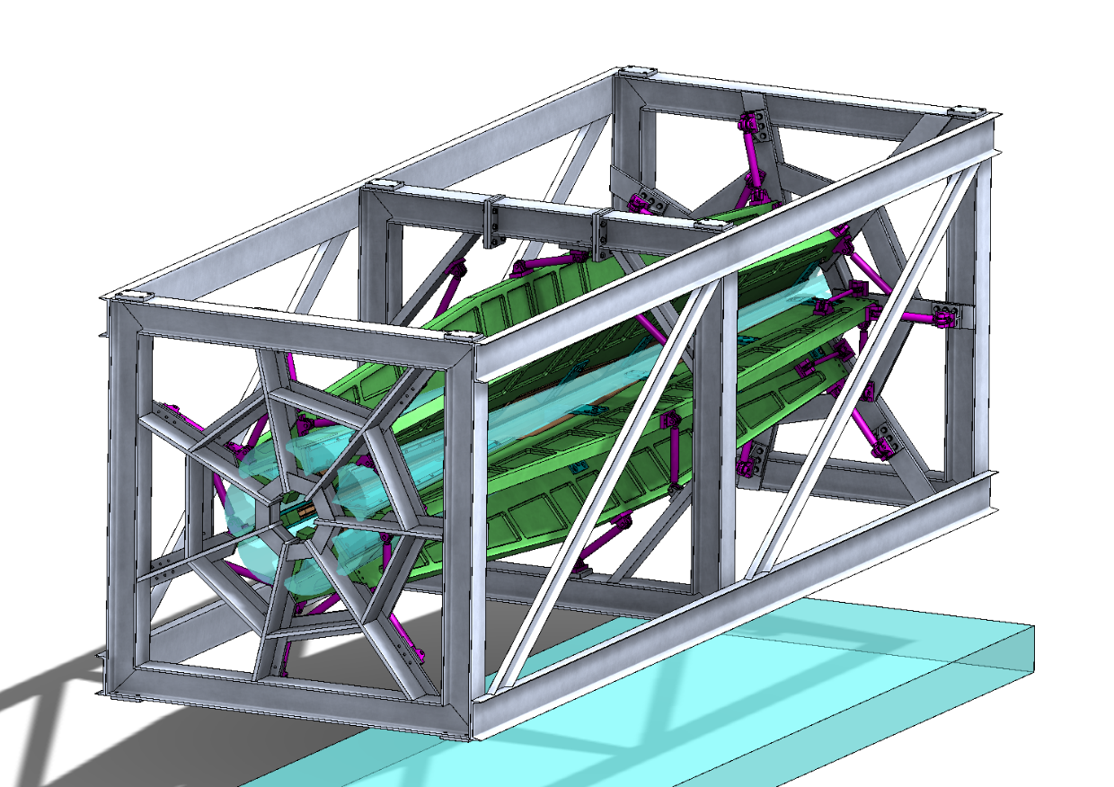
Combined Run Plan Discussion
Thia Keppel
Tritium Collaboration Meeting
December 2015

Slide 2
Tritium Run Period
138 days scheduled
10/1 - 10/12 days beam restore/target install?
10/13 - 11/22 39 days at 11 GeV
11/22 - 11/19 down/restore
11/30 - 12/18 19 days
12/18 - 12/20 3 days for 4 Hall demo
2/10 - 2/19 10 days restore
2/20 - 5/9 80 days other than E changes
69 (75!) PAC days approved x 2 = 138 (150) days!
MARATHON 42 days
SRC 19 days
(e,e’p) 12 days
3H elastic 1.5 days
Might be able to include Ar Spectral Function (9 days)
1.1 GeV can run after, E12-14-009 (3H elastic) currently scheduled for 6/1-4/2017, 4 days
Common checkout? 2-3 days
Efficient running (better than 50%), restoration times 1-2 days

Slide 3
How do we fit 150+ days into 138? I. Groundrules
MARATHON
BigBite 42-57 degrees, HRS-R 15-23.4 degrees, 11 GeV n/p, multiple lower energies for R
SRC
17-30 degrees, both HRS, 2.2 and 4.4 GeV
(e,e’p)
HRS-L 20-35 degrees, HRS-R 48.67-58.55 degrees, 4.4 GeV
Elastic HRS-L only (could be right?)
12.5-15 degrees, 1.1 GeV
Minimum angle between BigBite and HRS with “new” Q1 for BB outside is 58 degrees - or 52.5 degrees at 2 m distance
Need to add 12.5 degrees for HRS minimum to get minimum BB angle in this configuration
If we use BB, it will have to be “inside” HRS’s

Slide 4
Groundrules – Other BB Concerns
Three resistive quads (BB + 2 Q1s) will require water service upgrade to Hall
Might also need a new power supply, unless we only need two (right arm/BB share a supply)
Parking either HRS at very large backward angles will require some Hall modifications
Need to find space for power supplies
Can’t block truck ramp access door with tritium target in place (for fire anyway?)
All of the above must be considered in concert with the tritium target installation
BB angle moves
Avoid access to detectors from within keep-out area
BB de-install/move
Access platform for target installation

Slide 5
MARATHON with 2 x HRS Only?
From Makis:
In 55 [(42 PAC)+(13 extra)] days we can fit a compromised run plan where:
The highest x = 0.87 point is eliminated. This point is in the resonance region with W^2 = 3.0 GeV^2. Note that this point was not in the original 2006 proposal with the 2 HRS’s and the thicker target. It was added in the 2010 proposal with the thin 1kCi target.
All the running for the 3H/3He R = sig_L/sig_T measurements is eliminated.
The statistics of the highest DIS point x = 0.83 is compromised from 25,000 to 15,000 counts (in a +-4.5% momentum bite).
The statistics of the next DIS point x = 0.79 is compromised from 25,000 to 20,000 counts (in a +-4.5% momentum bite).
All other lower-x points are done with the original statistics of 25,000 counts, and at E’=2.7 GeV due to Right-HRS dipole current limitation.
All of the above assume a F2n/F2p behavior as in the proposal plot (“middle of the road”).
…also ANL analysis…

Slide 6
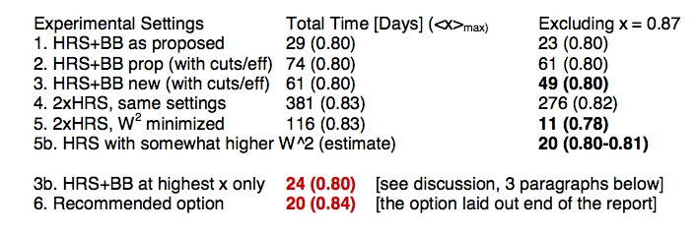
MARATHON with 2 x HRS Only?
From Zhihong, John, Roy:
BB at 47 degrees

Slide 7
Other things to consider
Optics cell installation later (but, there’s the platform..)
How much might we reasonably expect to gain in HRS acceptance with new tune?
Need to design collimators, sieves, and how to change documentation as well
Do we want to map BigBite (if we decide to use it)?

Slide 8
Nuclear Dependence of R: Experimental Status
Published/Preliminary extractions from JLab
L/T separations on proton and deuteron at low Q²
E99-118 (Hall C): PRL 98 142301 (2007)
0.05 translates to max 1% change in F₂^{3H}/F₂^{3He} ratio!
E00-002 (Hall C): preliminary, publ. drafted
ΔR: negative shift
Conclusion: ~20% effect in deuterium
L/T separations on D and Al, C, Cu, Fe in the resonance region
ΔR: negative shift
E04-001/E06-109 (Hall C): under (near final) analysis
Preliminary: R_{Al,Cu,C} – R_{D} negative shift
8

