Slide 1
MeAsurement of F₂^{n}/F₂^{p}, d/u RAtios and A=3 EMC Effect in Deep Inelastic Electron Scattering Off the Tritium and Helium MirrOr Nuclei
JLab Experiment E12-10-103 - Update
Makis Petratos
For the JLab MARATHON Collaboration
Tritium Collaboration Meeting
JLab, December 7, 2015

Slide 2
3He, 3H and 2H Deep Inelastic Scattering
Experiment will measure Deep Inelastic Scattering (DIS)
from 3He, 3H and 2H.
Objective is to measure EMC-type cross section ratios of
3He and and 3H (relative to deuterium).
Ultimate goal is the extraction of the nucleon F₂^{n}/F₂^{p}
structure function and the d/u quark distribution ratios.
Electron-nucleus cross section formalism:

Slide 3
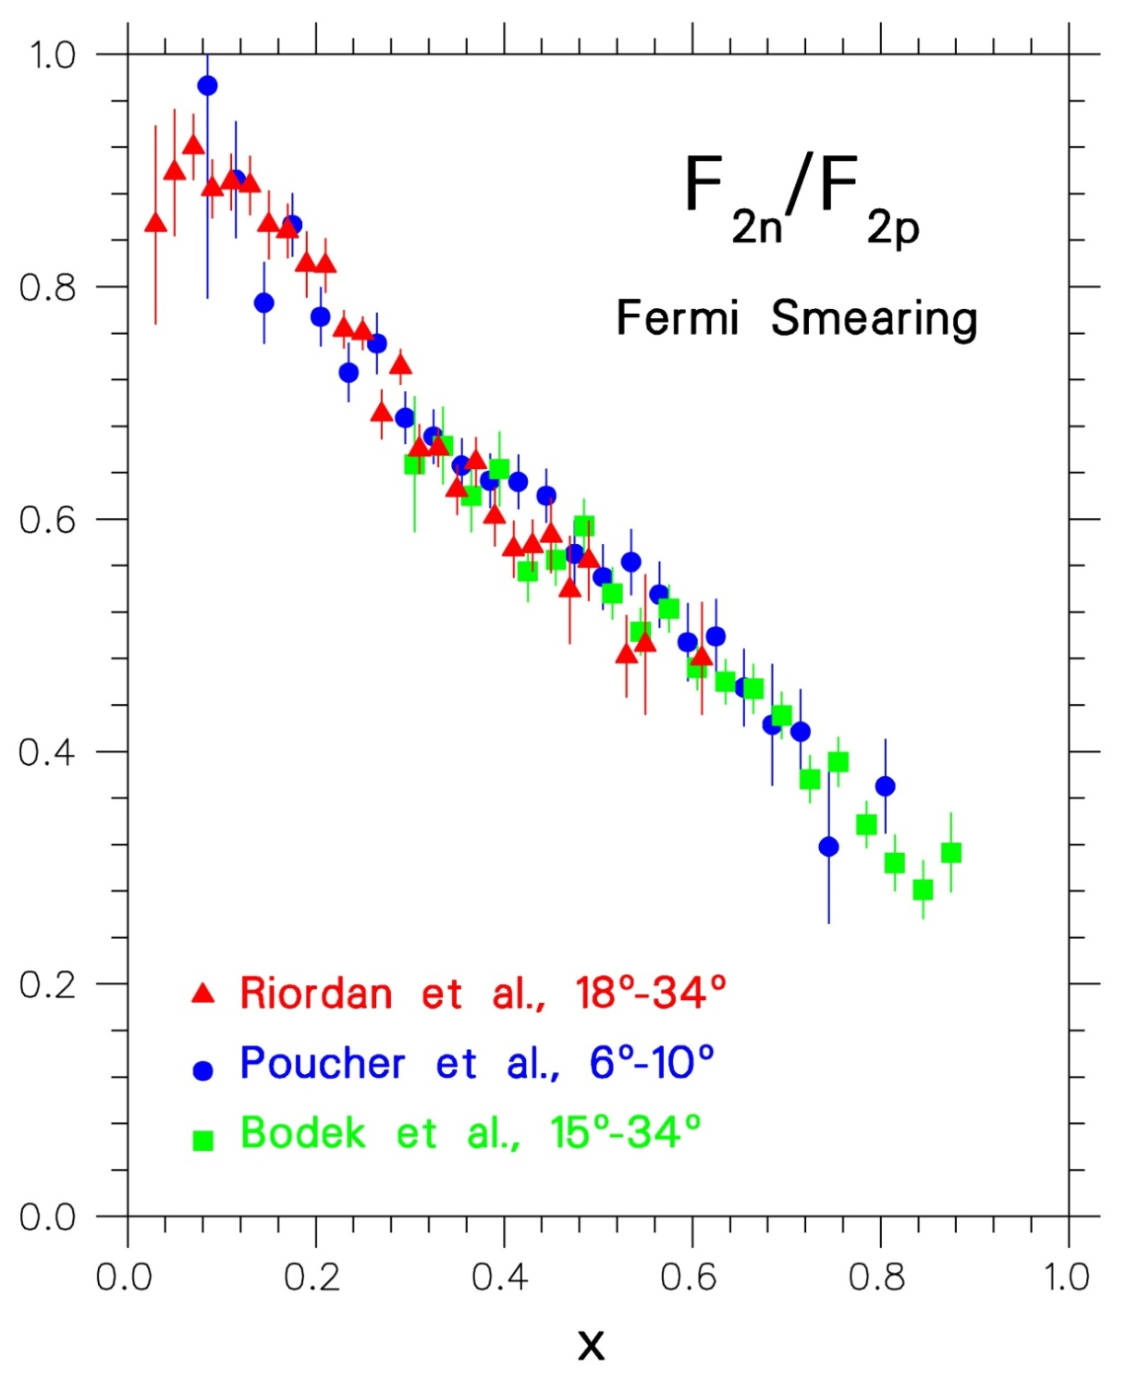
SLAC 1968-1972
Friedman, Kendall, Taylor
Nobel 1991
F₂^{n}/F₂^{p} extracted from p and d DIS
using a Fermi-smearing model and a non-relativistic N-N potential
Data in disagreement with
SU(6) prediction: 2/3=0.67!
High momentum quarks in
p(n) are u(d) valence quarks
There are no high momentum strange quarks in p and n
Sea quarks dominate at small x
Data consistent with di-quark model by Feynman and others

Slide 4
F₂^{n}/F₂^{p} Ratio Uncertainties

Slide 5
Nucleon F₂ Ratio Extraction from ³He/³H
Just perform DIS from ³He and ³H. Binding of nucleons in
the two nuclei is of same nature. Differences between bound
and free nucleons in the two nuclei is calculable, summarized, for their ratio, by some parameter R* (W. Melnitchouk et al.).
If R=σ_{L}/ σ_{T} is the same for ³He and ³H, measured DIS cross
section ratio must be equal
to the F₂ structure function
ratio as calculated using R*:
Determine nucleon F₂ ratio
using A=3 DIS cross section
data and R*(≈1) from theory:

Slide 6
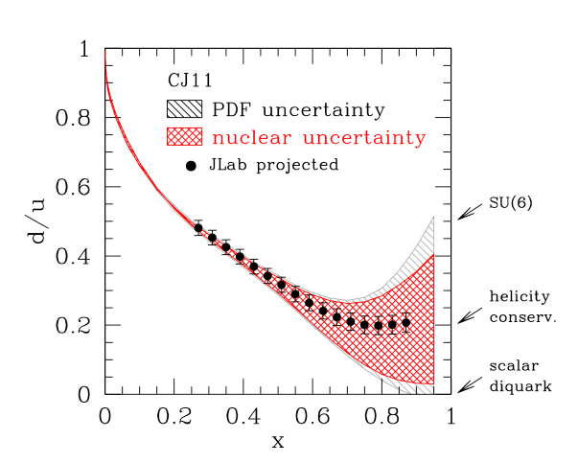
MARATHON Projected Data

Slide 7
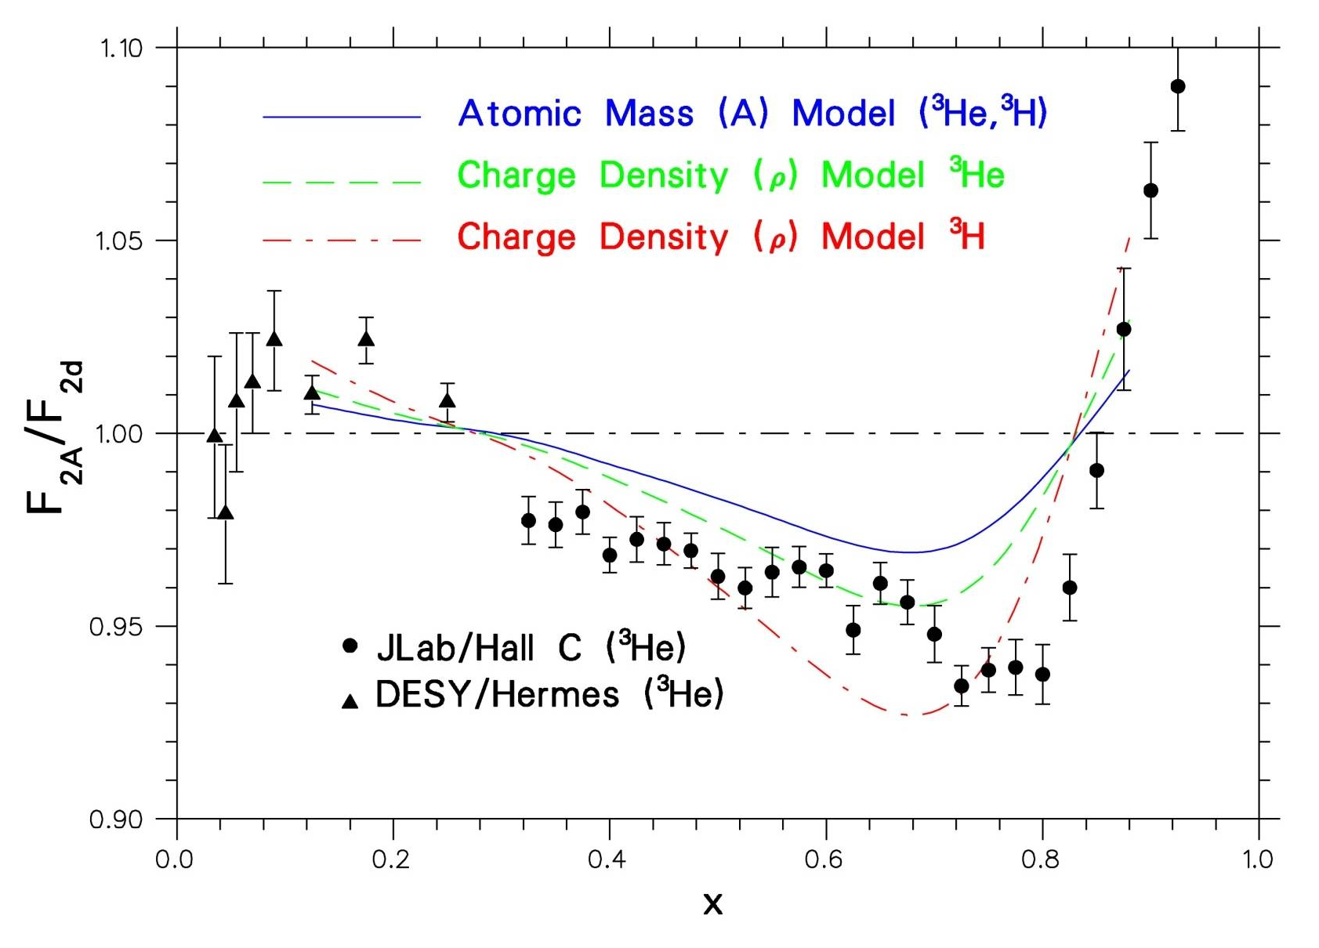
EMC Effect for A=3 Mirror Nuclei
Hall A data on ³H, ³He will be of similar precision to Hall C data

Slide 8
Experimental Plan and Requirements
³He/³H DIS measurements approved to run in Hall A:
  Beam Energy: 11.0 GeV – Beam Current: 20 µA
  Small angles (15º - 23º): Left HRS system
  Large angles (4 settings: 42º , 47º , 52º, 57º): BigBite system
  ~1400 hours for d/u measurement (@ 50% efficiency)
Desirable to check that the ratio R=σ_{L}/σ_{T} is the same for ³He and ³H: Rosenbluth separation of DIS cross sections. Jlab schedule provides for 4.4, 6.6 and 8.8 GeV energies but not for 3.3, 5.5 and 7.7 GeV.
  ~250 hours for R=σ_{L}/σ_{T} measurement (@ 50% efficiency)
Target system with helium/tritium/deuterium/hydrogen high pressure cells [25 cm long, 1.25 cm diameter, 14 atm (³H), 30 atm (¹H, ²H, ³He)] is under development.

Slide 9
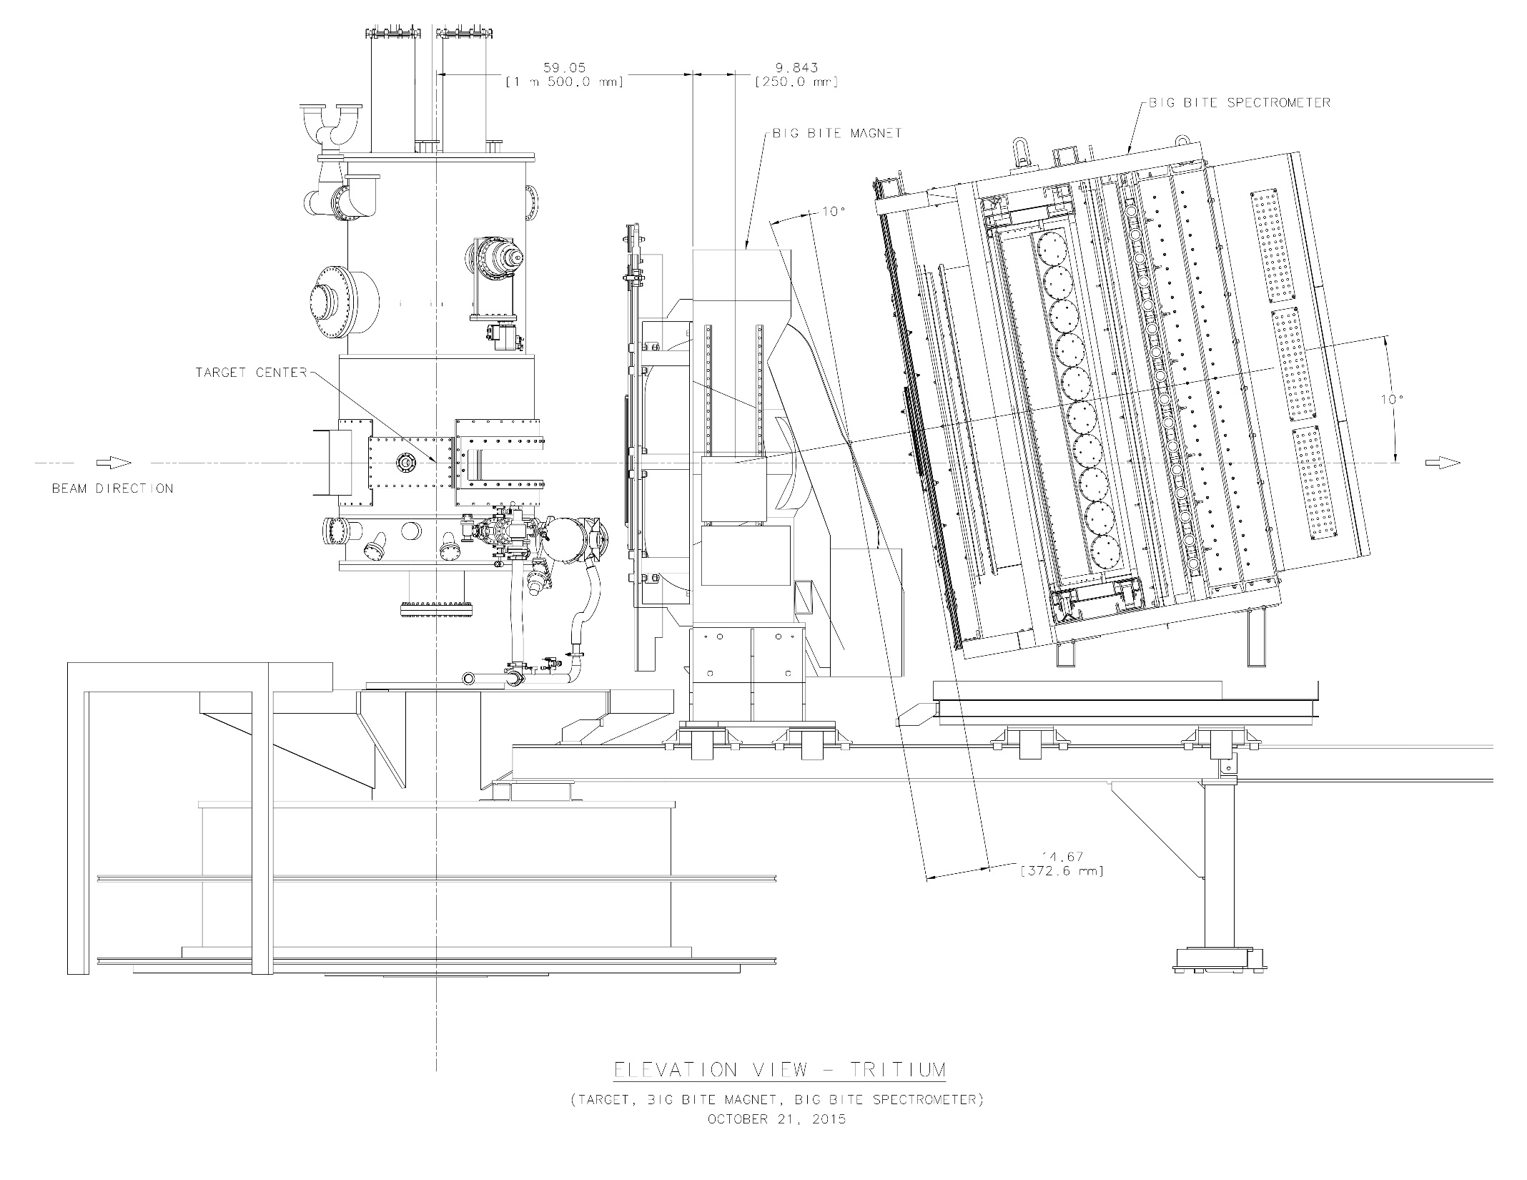

Slide 10
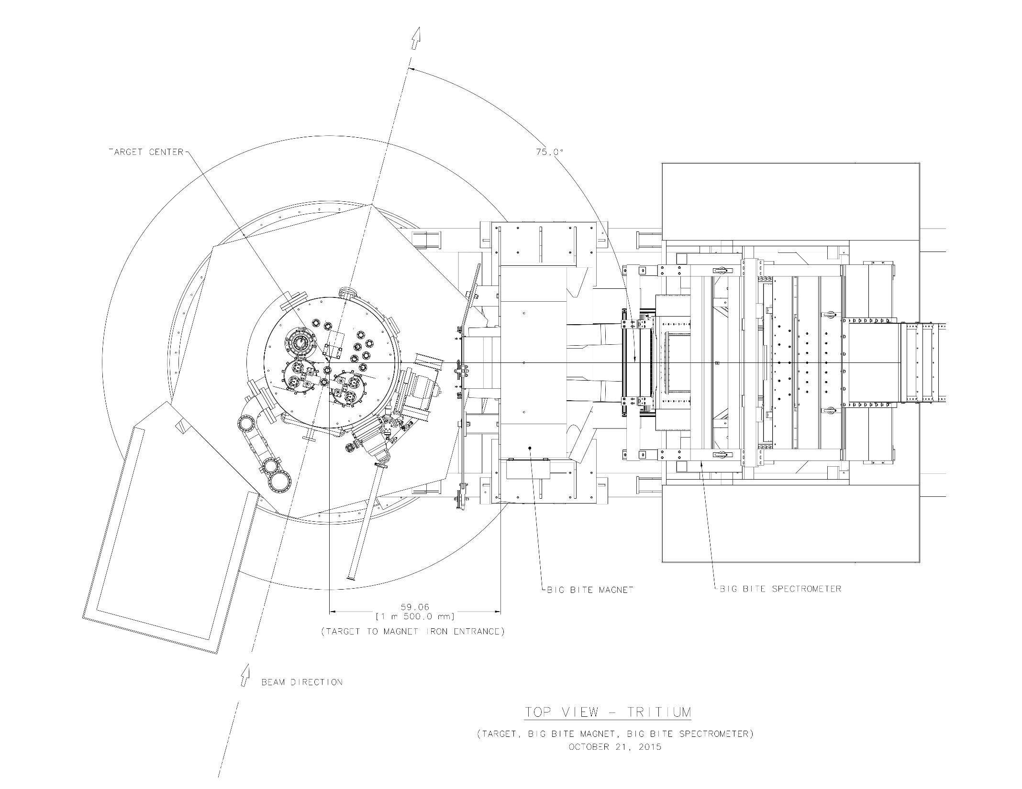

Slide 11
BigBite Spectrometer – Issues
Detectors and associated electronics under assembly.
Data acquisition software under development.
BB was successfully employed in previous Hall A experiments:
  Drift Chamber set and Scintillator (trigger) Hodoscope package
  Pb-glass Calorimeter and Gas Threshold Cherenkov Detector
Cherenkov detector issues:
  Extension of Cherenkov radiator box in progress
  Ongoing search of required C₄F₁₀ gas
  Original detector phototubes have been diagnosed as unusable
  Phototubes from old neutron detector are not sufficiently tested
  Possible failure of tubes during experiment will be catastrophic
  Phototubes are for scintillation light, not ultraviolet sensitive
  Need wavelength-shifting coating
Wire chambers totally untested up to date.

Slide 12
Left HRS - Issues
Detectors will be used as in the Spring 2016 DVCS and G_{Mp} experimental configurations.
DAQ and Online Analyzer software will be the same as the DVCS and G_{Mp} packages.
Experiment assumes use a new iron-dominated magnet in place of the ailing superconducting Q1 element.
Need a reliable set of reverse matrix elements over entire momentum range of spectrometer.
Loss of 3.3, 5.5 and 7.7 GeV beam energies means that R measurements will be based on 2-point Rosenbluth separations.
Loss of end cap collimation capability means:
  Impossible to measure R separately for 3He and 3H
  Ratio of R’s for 3He and 3H will be measured

Slide 13
[2 x HRS] vs [HRS + BB] Running
Question raised at/after Fall 2015 Target Safety Review: What can be accomplished by using the two HRS’s and not the BigBite, which needs “cumbersome” angle changes?
Quick calculation concluded that a compromised data scenario was possible.
It was assumed that we can spend the time to dismantle and remove BigBite (say 15 days) and the time to check out BigBite (say 10 days) on taking tritium data with the 2 HRS’s (in a scenario where we use for MARATHON both HRS’s only, not the BigBite). These 25 days would amount to an equivalent of say 13 proposal/PAC days.
In 55 [(42 PAC)+(13 extra)] days we can fit an acceptable run plan as a compromise.

Slide 14
[2 x HRS] Possible Run Plan Scenario
The highest x = 0.87 (resonance) point is eliminated. This point is in the resonance region with W² = 3.0 GeV². (This point was not in the original 2006 proposal with the 2 HRS’s and the thicker target. It was added in the 2010 proposal with the thin 1 kCi target.)
All the running for the 3H/3He R = σ_{L}/σ_{T} measurements is eliminated.
The statistics of the highest DIS point x = 0.83 is compromised from 25,000 to 15,000 counts (in a +-4.5% momentum bite).
The statistics of the next DIS point x = 0.79 is compromised from 25,000 to 20,000 counts (in a +-4.5% momentum bite).
All other lower-x points are done with the original statistics of 25,000 counts, at E’ = 2.7 GeV due to Right-HRS dipole current limitation.
All of the above assume a F2n/F2p behavior as in the proposal plot (“middle of the road”).

Slide 15
Summary - Issues
BB Cherenkov tubes, Cherenkov tubes, ….. , Cherenkov tubes, …., and spare Cherenkov tubes.
BB wire chambers must be fully installed and checked as soon as possible, to avoid any surprises.
Will the BB spectrometer be ultimately allowed to move for sure to different angles? Must know answer soon!
Need on-site presence and dedicated work of postdocs in addition to the Kent State graduate student work (Sheren Alsalmi, Tyler Hague, Michael Nycz, Tong Su)!

Slide 16
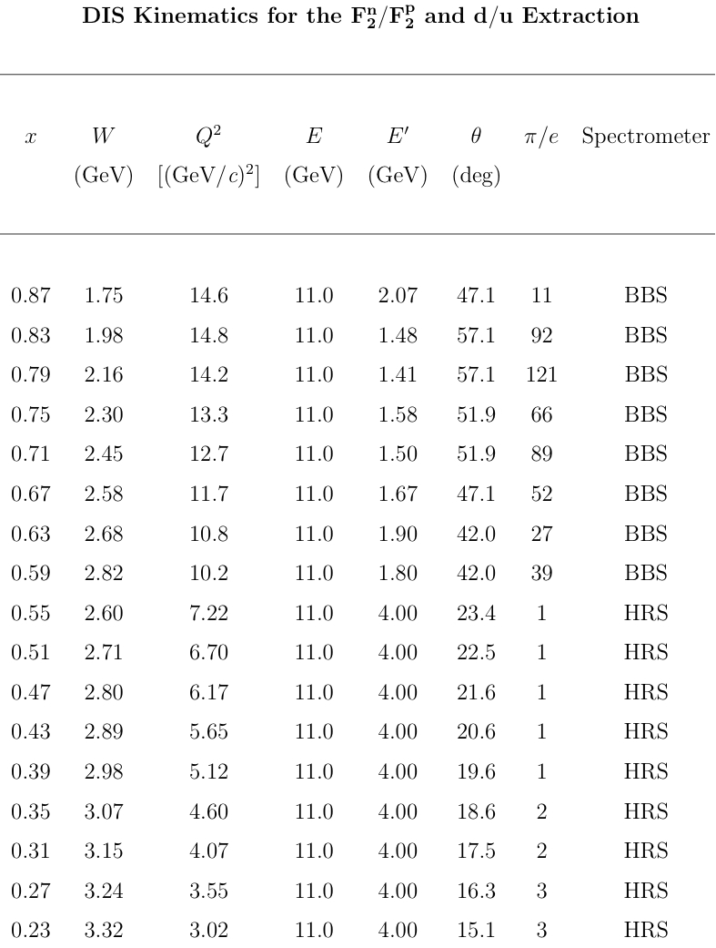

Slide 17
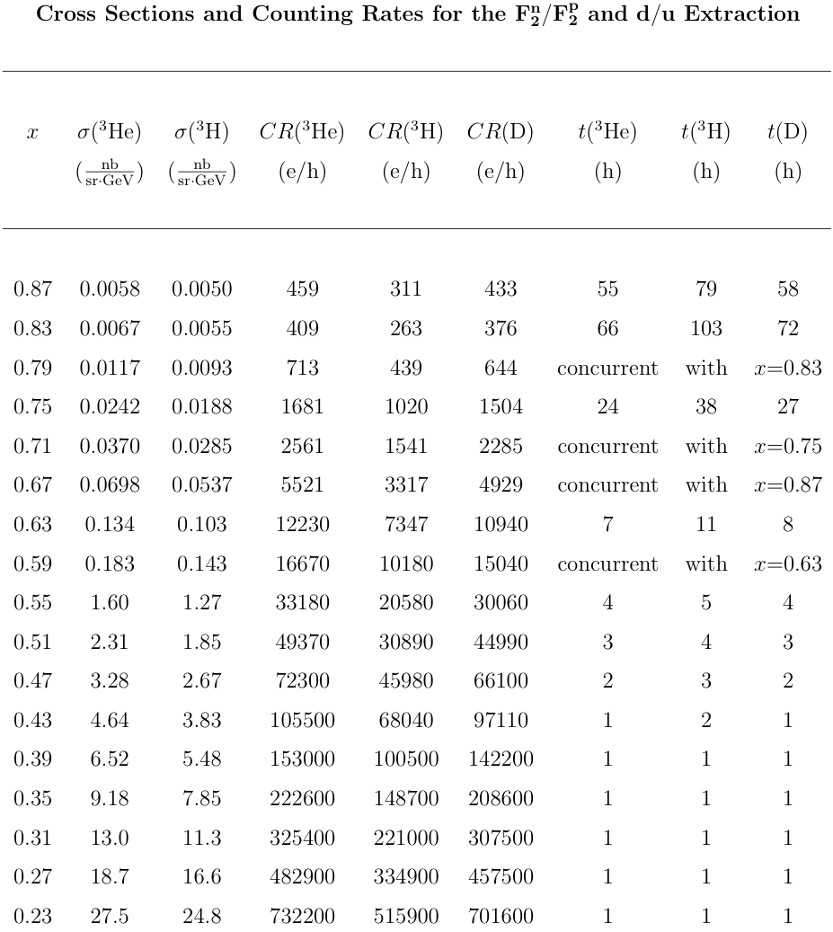

Slide 18
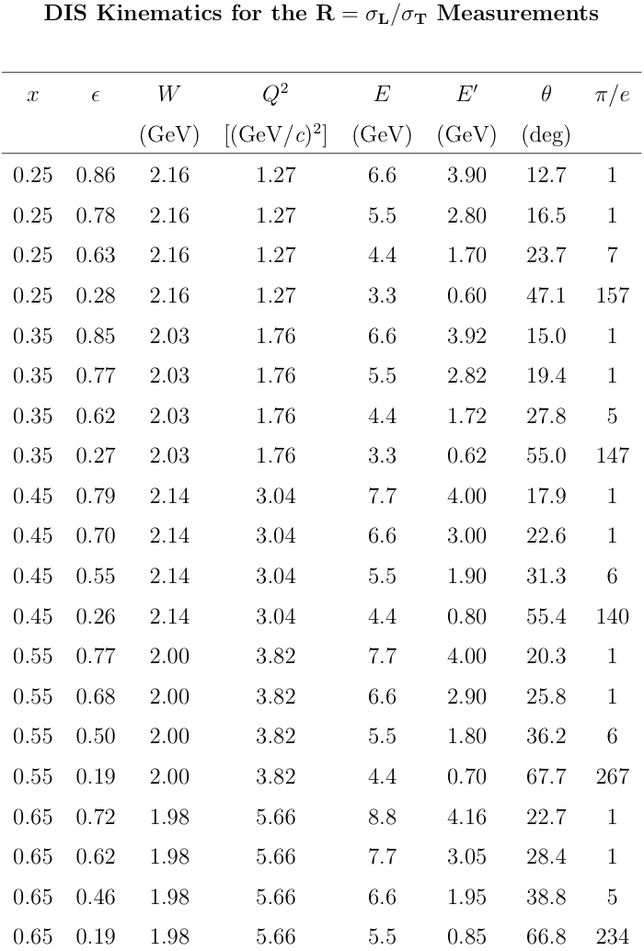

Slide 19
