Slide 1
Nucleon Momentum Distributions in Asymmetric Nuclei
A Comparison of ³He(e,e’p) and ³H(e,e’p)
PR12-13-012
Lawrence Weinstein
Old Dominion University
Co-Spokespersons: Shalev Gilad (MIT),
Or Hen (MIT), Werner Boeglin (FIU)

Slide 2
Short Range Correlations in Nuclei
Almost all nucleons with p > 275 MeV/c belong to a SRC NN pair
90% of these are pn pairs, even in heavy asymmetric nuclei
About 10% of nucleons in ³He (and presumably ³H) belong to SRC NN pairs
EMC effect proportional to SRC pairs in nuclei.
SRC linked to
  NuTeV anomaly
  Nuclear Symmetry energy and neutron stars
  Urca Cooling of neutron stars
  Two-component Fermi systems

Slide 3
pn pair dominance and energy inversion
<T_{p}>
<T_{n}>
<T_{p}> − <T_{n}>
n
Average KE greater for minority nucleons!

Slide 4
Experiment Overview
Measure the quasielastic (e,e’p) reaction
on ³H, and ³He
  First measurement of ³H(e,e’p)
  Choose kinematics where FSI are small
  Measure cross sections sensitive to ground
  state momentum distributions
  Measure ratios of cross sections so residual
  FSI cancel
Simple picture: Map the transition as σ(³He)/σ(³H) changes from 2 at small p_{miss} due to proton counting to 1 at large p_{miss} due to np pair counting
Quantitative picture: compare to calculations with exact ground states and eikonal approximation FSI
k_{f}
k

Slide 5
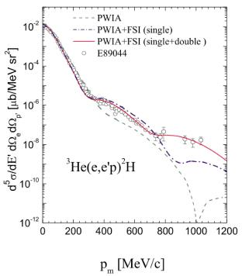
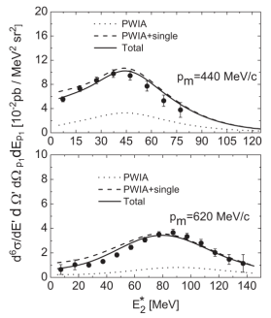
Previous ³He(e,e’p) measurements
³He(e,e’p)d
³He(e,e’p)np
Full
p_{m} = 440 MeV/c
FSI dominant
PWIA
p_{m} = 620 MeV/c
PWIA
p_{m} [MeV/c]
E_{m} [MeV]
Data:
Rvachev et al., PRL94 192302
Benmokhtar et al., PRL94 082305
Calculations:
Ciofi degli Atti and Kaptari, PRL95 052502
Alvioli et al., PRC81 021001
Laget, PLB609 49 (not shown)
Dominated by FSI at large P_{miss}
Not sensitive to n(k)

Slide 6
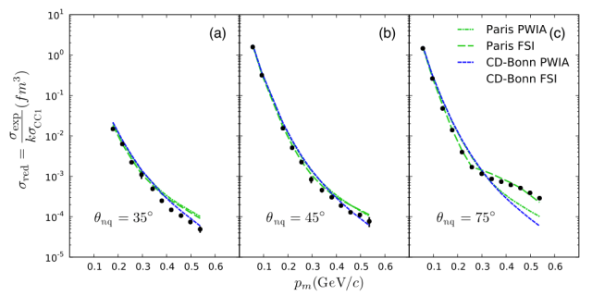
Minimizing FSI:
d(e,e’p)
θ_{nq}= 35º
θ_{nq}= 45º
d(e,e’p)
Full
FSI
75º
³He(e,e’p)np
PWIA
Ratio of FSI to PWIA calculations
0.1
0.5
0.1
0.5
0.1
0.5
p_{miss} = 0.5 GeV/c
P_{miss} (GeV/c)
0.4 GeV/c
➔Choose θ_{rq}< 40º
0.2 GeV/c
θ_{rq}

Slide 7
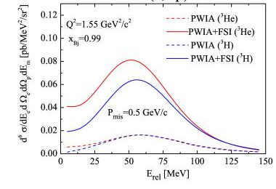
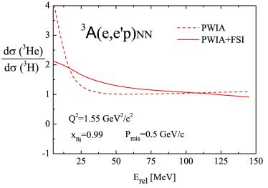
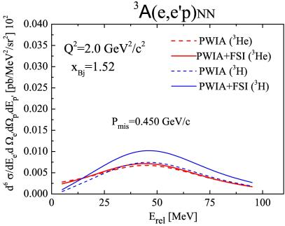
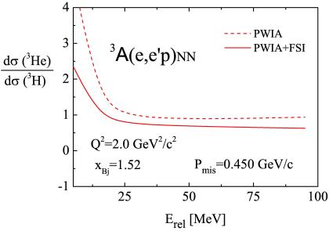
Minimizing FSI: taking ratios at p_{m} = 0.5 GeV/c
Ratio
Full
Full
³He
x = 1
max FSI
PWIA
³H
PWIA
PWIA
x = 1.5
min FSI
³H
Full
³He
L. Kaptari

Slide 8
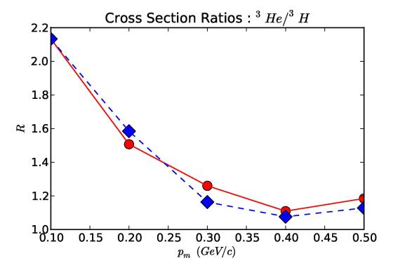
Minimizing FSI: taking ratios
Experimentalkinematics
PWIA
FULL
P_{m} (GeV/c)
Sargsian
Choose θ_{rq} < 40º
Take ratios to cancel residual FSI

Slide 9
Kinematics
E_{beam} = 4.4 GeV
Q² = 2.0 GeV²
I_{beam} = 20 μA
Both HRS
<p_{m}> (MeV/c) | x | E_{e} (GeV) | θ_{e} | p_{p} | θ_{p} | Time (days)
100 | 1.15 | 3.47 | 20.9º | 1.6 | 48.7º | 0.5/0.5
300 | 1.41 | 3.64 | 20.4º | 1.4 | 58.6º | 5/5
Calibrations: 1 day

Slide 10
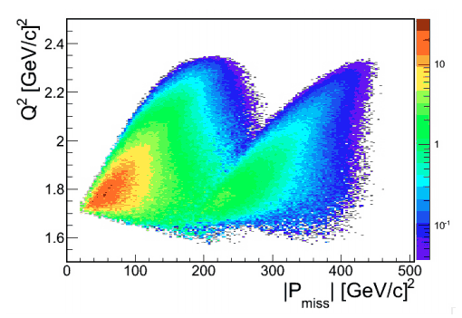
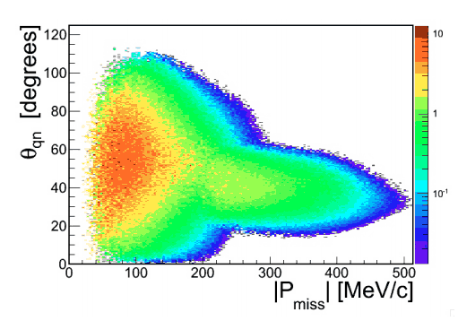
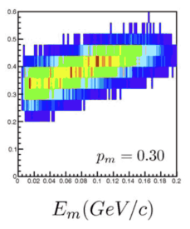
MCEEP Acceptance Simulations

Slide 11
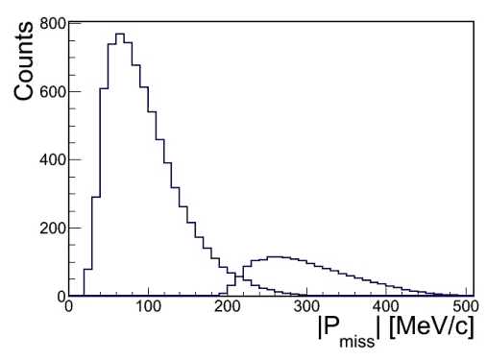
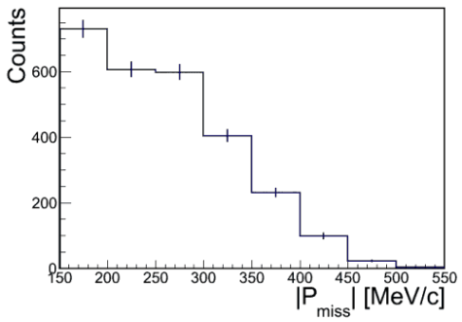
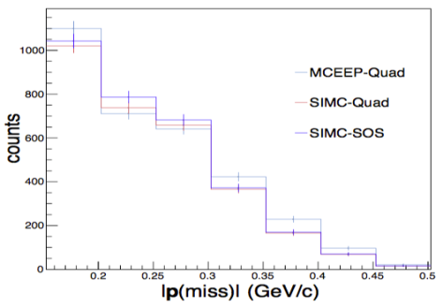
Count Estimates
SIMC:
HRS Q1
MCEEP
SIMC:
SOS Q1
MCEEP

Slide 12
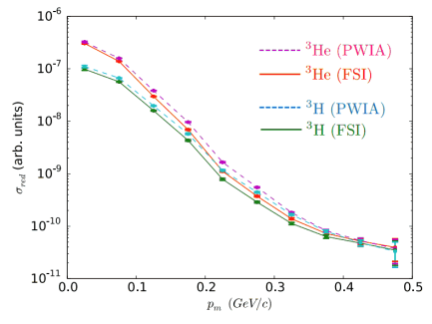
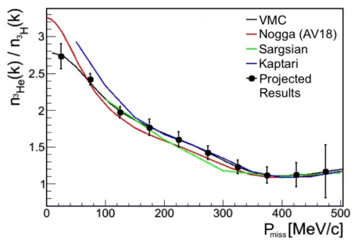
Results
Reduced cross sections
Cross section ratios
P_{miss}
Compare to exact calculations.
First high precision model independent extraction of nuclear momentum distribution ratio

Slide 13
Moving Q1
Counts
x10 for visibility
Nominal
Nominal
Can gain a lot
Optics need study

Slide 14
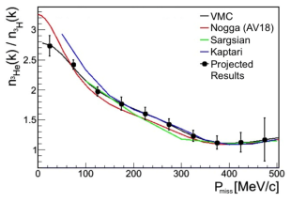

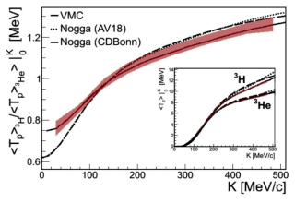
Summary
Unique opportunity to study energy sharing in asymmetric systems
[Implications on the EMC Effect, NuTeV anomaly, Symmetry energy, Neutron Stars, test of nuclear models, and more…]
Ratio
Cross sections
Energy Sharing

