Slide 1
Infrastructure Status for Tritium Experiments
Robin Wines
7 Dec 2015

Slide 2
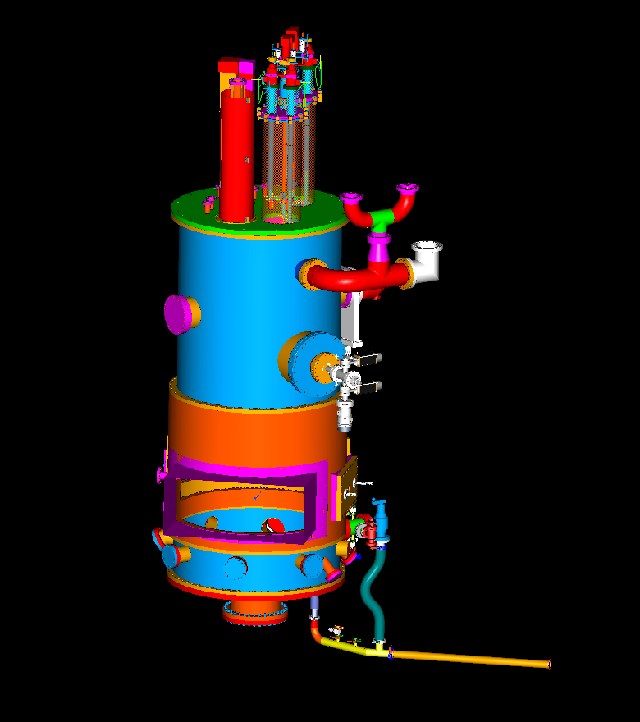
Utilizing Qweak target in model design with addition of exhaust port.
Using Hall A standard scattering chamber with Beryllium window to isolate target from beam line.
Target and chamber modification designs complete.
Presently designing Beryllium window.
Design complete for connection of Savannah River “tent” to chamber.
Qweak target
Be window
Chamber

Slide 3
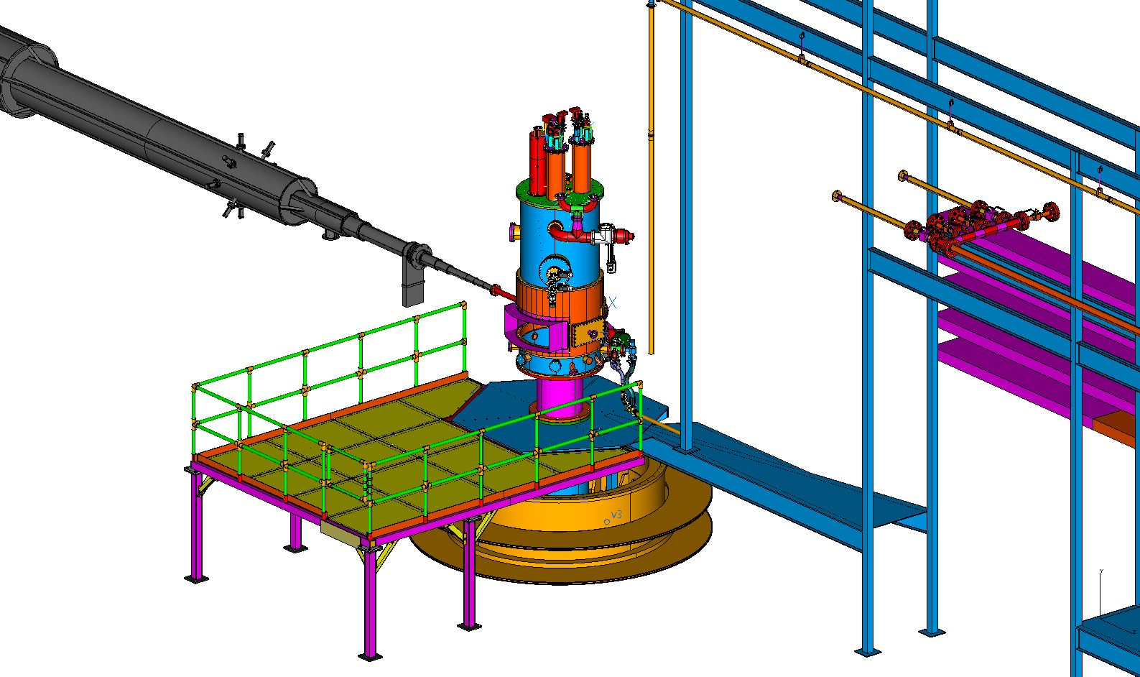
Access platform designed
Designed for both HRS parked at 12.5⁰.
Presently analyzing platform for structural and elevated platform requirements.

Slide 4
Exhaust system routed along platform to smoke removal port in Hall A.
Port to have dual purpose for smoke removal and Tritium exhaust.
Shutter/Damper utilized, specifications defined by Savannah River.
New exhaust fan defined and cost estimate available.

Slide 5
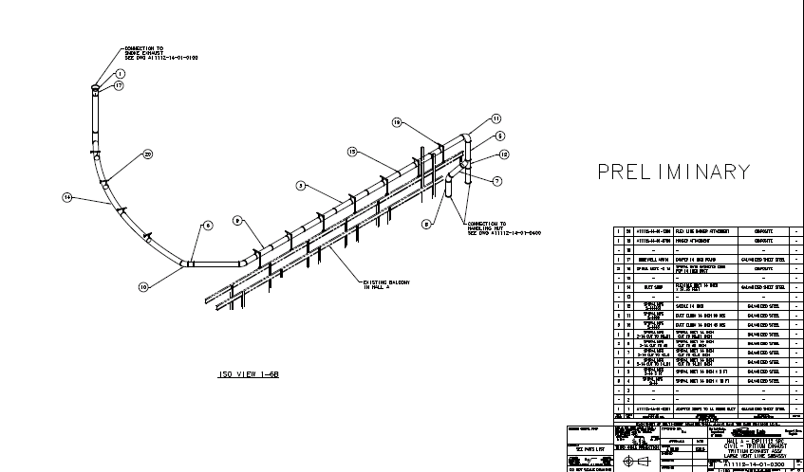
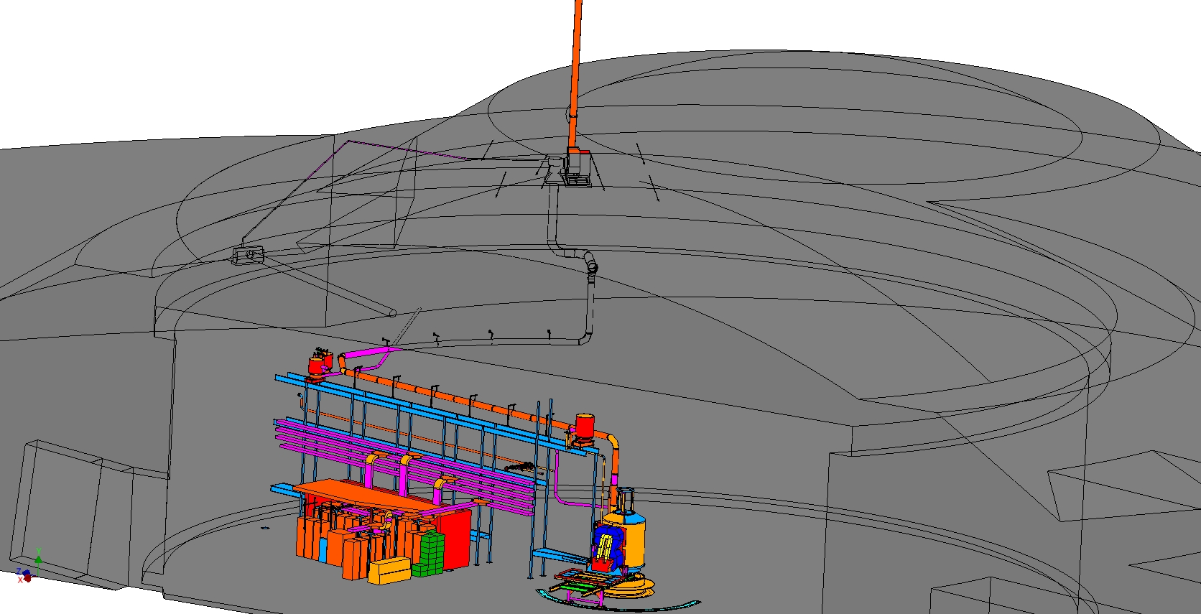
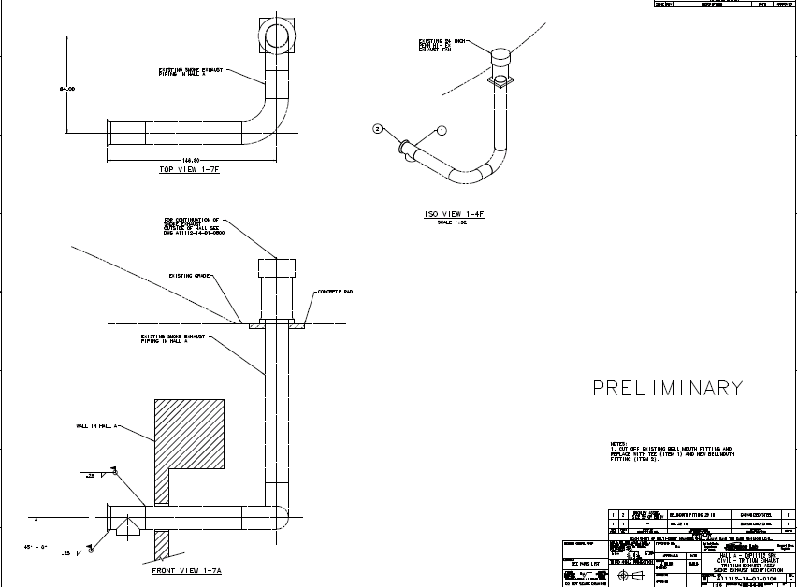
Preliminary drawings complete for Target and HVAC vent lines in Hall.

Slide 6
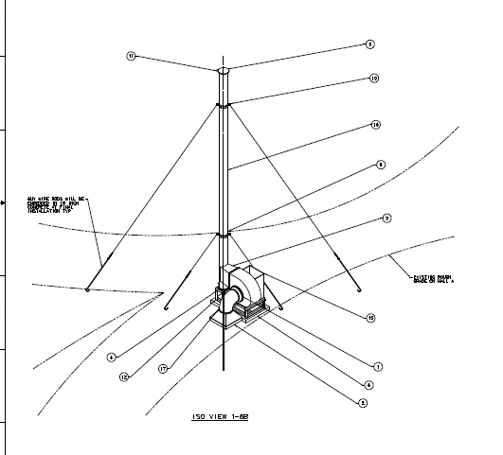
Preliminary drawings complete for Outside Vent Stack.
Calculations to be completed for wind load, etc. Then send to Facilities Management for approval.

