Slide 1
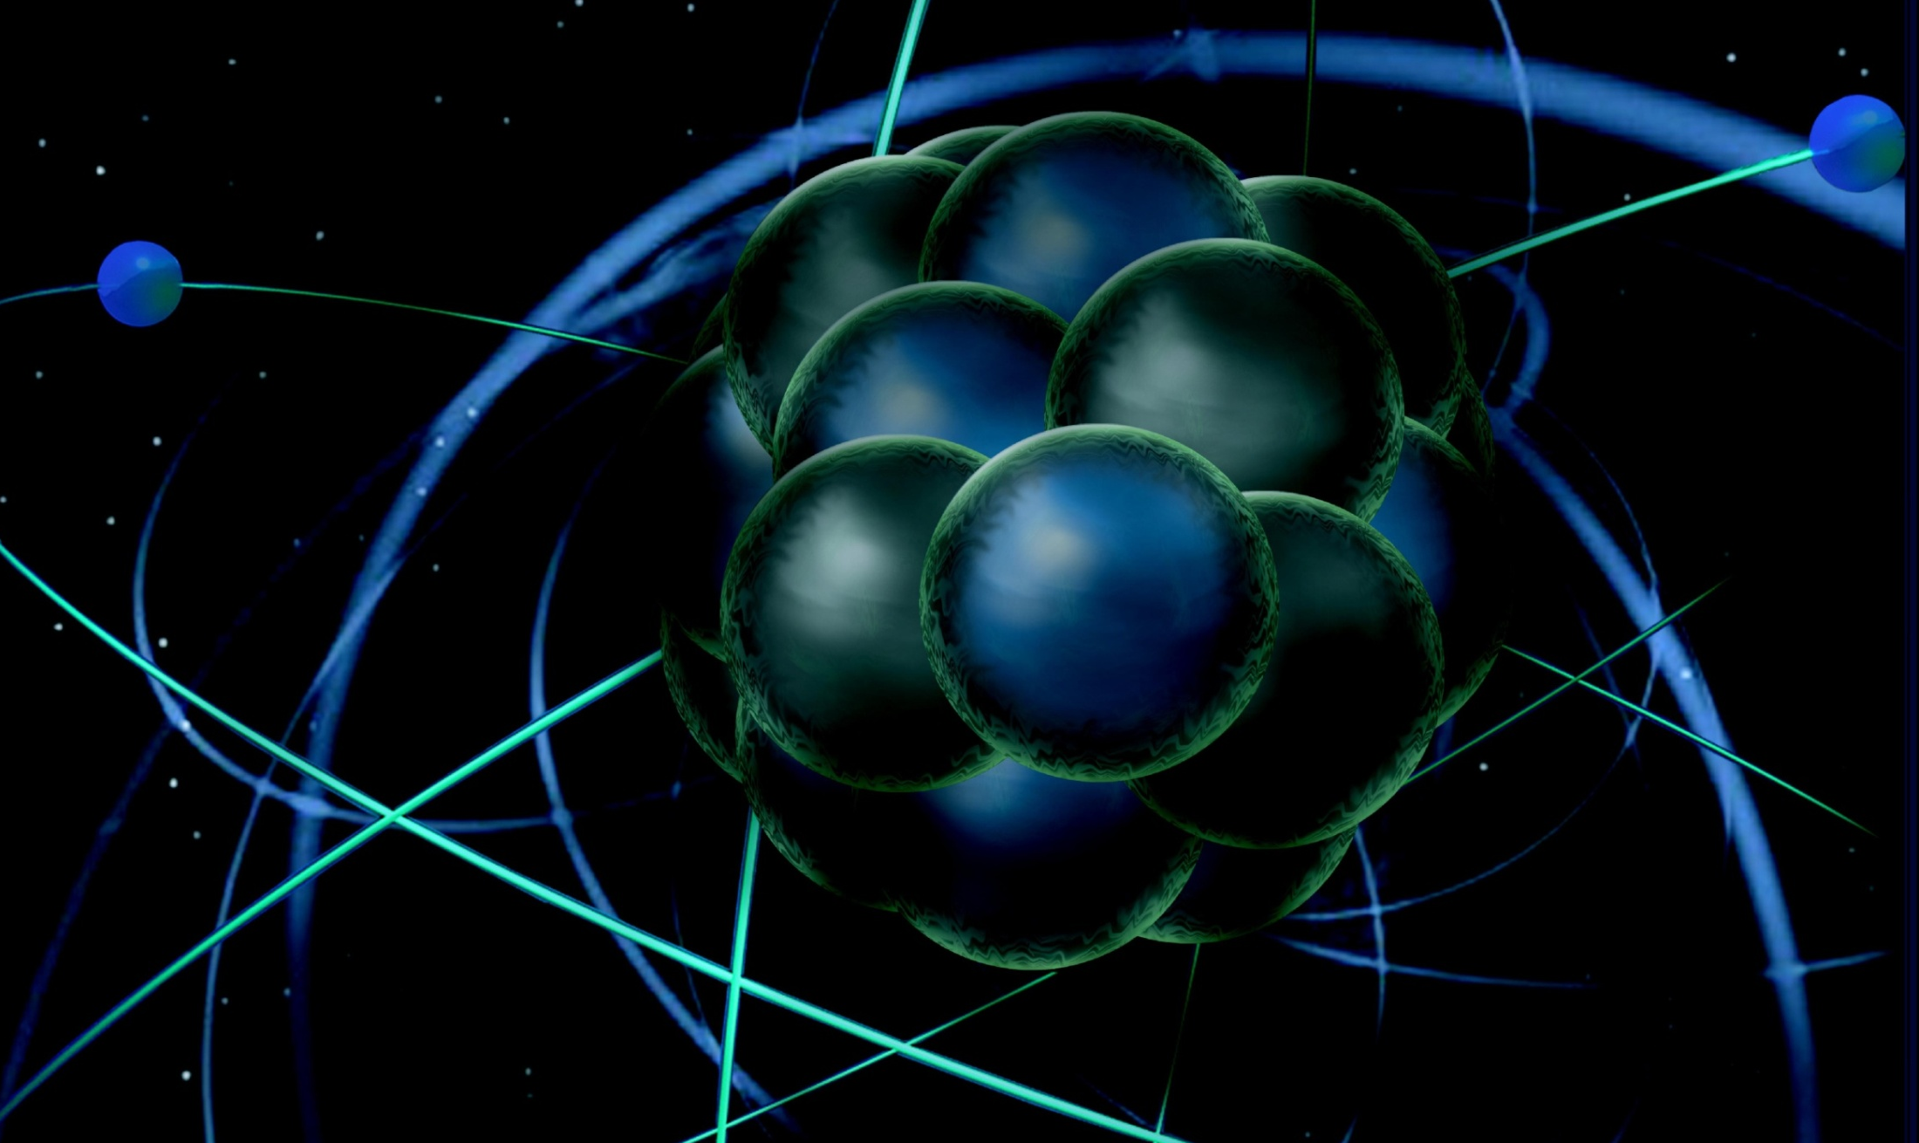
Thomas Jefferson National Accelerator Facility
Medium-Energy Comparative Research Review
June 12, 2013
Rolf Ent (JLab)
DOE MEP Comparative Research Review
June 12, 2013

Slide 2
Outline Jefferson Lab Presentations
Introduction this talk
Organization
Publications and Invited Talks
(Some) Accomplishments – Mainly Technical
Medium-energy Electron Ion Collider
Nucleon Structure Patrizia Rossi
Nuclear Structure/QCD and Nuclei Douglas Higinbotham
SM Tests/BSM Searches Roger Carlini
Rolf Ent, MIT, Feb. 27, 2012

Slide 3
Physics Being Addressed/Goals
QCD and the Structure of Hadrons – study the spectrum and structure of nucleons and mesons as determined by QCD, towards a complete 3D understanding of nucleons and nuclei.
Patrizia Rossi (30 + 15)
Nuclei: From Structure to Exploding Stars- study the (short-range) structure of nuclei as relevant to compressed matter in the universe, and the impact of nuclei on quark/gluon dynamics.
Douglas Higinbotham (15 + 7.5)
In Search of the New Standard Model - use the parity-violating electroweak force as precision tool of Standard Model tests and searches of signature of physics Beyond the Standard Model.
Roger Carlini (15 + 7.5)

Slide 4
Structure of Presentations
With well over 60 scientists in 4 Halls (Hall A, B, C and D) it is impossible to show all research accomplishments by the staff
Often science topics are pursued using the complementarity of the experimental apparatus in the Halls, and thus the science topics of interest of the Hall staff are not necessarily linked to one Hall (for example, the BoNuS experiment in Hall B and subsequent analysis had a substantial Hall C contribution).
We will present based on science topics, not Hall by Hall, whereas the submitted documentation and this talk will hopefully aid to differentiate Hall-by-Hall work.
The presentations follow (mostly) a similar structure for each science sub-topic (like e.g. electromagnetic form factors, short-range nuclear structure):
Subject/physics goal
Example I
(Example II)
Impact Summary
(1-2 Years Outlook and/or 12-GeV Future)
With the pages between parentheses not always included
We hope this structure helps the reviewers to better judge the essential and leading contributions of the staff to the research, given the size of the group and the multiple science sub-topics pursued.

Slide 5
Current Group Members
Laboratory Permanent Staff (Admin): L. Cardman, R. Ent (AD), P. Rossi (Deputy AD).
Term and Other Staff: P. Nadel-Turonski (Isgur Fellow).
Laboratory Permanent Staff (Hall A): A. Camsonne, J.P. Chen, J. Gomez, J. Ole Hansen, D. Higinbotham, C. Keppel (Group Leader), J. LeRose, R. Michaels, S. Nanda, B. Wojtsekhowski.
Post-docs: K. Allada, J. Zhang.
Laboratory Permanent Staff (Hall B): H. Avakian, S. Boiarinov, V. Burkert (Group Leader), D. Carman, A. Deur, L. Elouadrhiri, T. Kageya, V. Kubarovsky, M. Lowry, M. Mestayer, V. Mokeev, E. Pasyuk, A. Puckett, A. Sandorfi, Y. Sharabian, S. Stepanyan, X. Wei, D. Weygand, A. Yegneswaran.
Term and Other Staff: C. Bass, V. Baturin, F.X. Girod, Y. Gotra, A. Puckett, M. Ungaro, V. Ziegler.
Post-docs: K. Park
Laboratory Permanent Staff (Hall C): R. Carlini, S. Covrig, H. Fenker, D. Gaskell, M. Jones, D. Mack, B. Sawatzky, G. Smith, P. Solvignon-Slifer, L. Tang, S. Wood (Group Leader).
Post-docs: S. Malace
Laboratory Permanent Staff (Hall D): E. Chudakov (Group Leader), H. Egiyan, M. Ito, D. Lawrence, L. Pentchev, Y. Qiang, E. Smith, A. Somov, S. Taylor, E. Wolin, B. Zihlmann.
Post-docs:
Joint Staff: E. Brash (Christopher Newport University), R. Fersch (Christopher Newport University), D. Heddle (Christopher Newport University), T. Horn (Catholic University of America), M. Kohl (Hampton University), C. Salgado (Norfolk State University).

Slide 6
Jefferson Lab Group Structure
Staff scientists typically have 25% research time, 75% support for operations.
Their research effort sums up to 15 FTEs.
The latter number is for many people presently reduced with 12-GeV construction ongoing (i.e., they will not add up to 1.0 in Table I)
Staff scientists in Admin have 100% management functions, but do research in evenings and weekends
Staff scientists in Hall D have to date typ. done their research in Halls A/B/C
Postdocs can have up to 100% research time, although they most often do also have small-size support functions.
We have at the moment six joint scientists, that are released for half their teaching duties for research. They often also have a support responsibility at JLab (e.g., Ed Brash is responsible for the Focal Plane Polarimeter in Hall C when in use).
At present 2 joint positions are affiliated with Hall B, 3 with Hall C, and 1 with Hall D
 | Hall A | Hall B | Hall C | Hall D | Post docs | FTE Total
Nucleon Structure | 1.2 | 2.4 | 0.8 | 0.4 | 3.7 | 8.5
Hadron Spectroscopy | 0.1 | 3.0 | 0.1 | 1.2 | 0.3 | 4.7
Nuclear Structure | 0.8 | 0.7 | 1.0 |  | 0 | 2.5
SM Tests/BSM | 0.4 | 0.2 | 0.9 | 0.2 | 0 | 1.7
Postdocs | 2 | 1 | 1
Note: there is a small FTE effort (1.6 FTE) working on technical accomplishments as part of their research, not included here

Slide 7
Funding Support Level by NP for FY10-12 ($K)
 | FY10 $K | FY11 $K | FY12 $K | Notes
Total Salaries, Wages and Fringe Benefits
Permanent Staff (Scientists) | 1952 | 1869 | 1921 | This roughly corresponds to 14 FTEs for about 50 scientists
Term and Other Staff/Post-docs/Graduate Students | 356 | 512 | 505 | About 5 postdocs and the equivalent of 2 FTE term staff
Technical Staff | 193 | 128 | 151 | Includes administrative support
Early Career |  |  | 336 | In FY12 the Early Career Award of Silviu Covrig started ($500K)
Travel | 851 | 900 | 714 | Includes visiting scientist travel
Material and Supplies, Licenses | 44 | 15 | 14
University Support | 867 | 1012 | 935 | Includes joint staff, bridge-faculty positions, and joint postdocs
Other Direct Costs | 182 | 143 | 155
Total Direct | 4445 | 4578 | 4730
Indirect Costs (Overhead) | 1755 | 1917 | 2320
Total | 6200 | 6495 | 7050

Slide 8
Accomplishments/Highlights (01/01/10 – 04/30/13)
Nucleon Structure/Hadron Spectroscopy 13.4 FTEs*
Determined that strange quarks do not play a substantial role in the EM structure of nucleons
Performed a flavor decomposition of nucleon form factors, pointing to differences between up and down quarks
Determined the down to up structure function ratio at large x with reduced uncertainties
Completed initial exploration of 3D structure of nucleons, both for GPDs and TMDs
Evidence for missing excited nucleons included in the 2012 Particle Data Group report
Performed a series of complete photoproduction experiments to pin down the nucleon spectrum with the FROST and the HDIce apparatus
Nuclear Structure/QCD and Nuclei 2.5 FTEs
Found a striking correlation between short-range nuclear structure and parton dynamics
Confirmed the existence of the neutron skin in model-independent manner
SM Tests/BSM Search 1.7 FTEs
Completed the Qweak experiment, with early results constraining new physics to a mass scale of 1.1 TeV, and final results anticipated to a mass scale of 2.3 TeV
Performed an initial measurement and test experiments to search for a heavy photon
DOE Early Career Award – Silviu Covrig
* This number is higher by ~4 as all our postdocs presently fall in this category
Note: not included is an FTE effort (1.6 FTE) working on technical accomplishments as part of their research

Slide 9
Publications, Invited Talks & Awards
Total number of publications as letters (PRL, PL) 35
Total number of publications in other refereed journals 64
Total number of invited talks 212
# of (independent) organizing committees 58 (40)
(semi-local organizing committee or convenors,
does not include international advisory committees)
APS Fellows: 3 in review period
name | year
Harut Avagyan | 2011
Volker Burkert | 2004
Lawrence Cardman | 1986
Jian-Ping Chen | 2008
Latifa Elouadhriri | 2010
Rolf Ent | 2011
Andrew Sandorfi | 1985
Bogdan Wojtsekhowski | 2009

Slide 10
Training the Next Generation of Scientists
Most students come to JLab for experiment preparation, data taking, and (early) data analysis. In numbers, students that are mentored by JLab staff for > 3 months in the 2010-2013 period:
Hall A 28 PhD’s awarded, 15 PhD’s ongoing
3 MSc’s awarded, 2 MSc’s ongoing
Hall B 14 PhD’s awarded, 12 PhDs ongoing
1 MSc awarded
Hall C 5 PhD’s awarded, 16 PhD’s ongoing
Hall D 2 PhD’s awarded
Many of our JLab staff also act as mentors to undergraduate students from DOE’s Science Undergraduate Laboratory Internship and NSF’s Research Experience for Undergraduates programs.
On average there are 50 undergrads per year involved in JLab research.

Slide 11
Postdoc Tracking Information
Included here are only past postdocs of the 2010-2013 period:
Hall A 1 assistant professor (UCairo)
1 staff scientist (ANSL)
1 postdoc (MIT)
Hall B 3 staff scientists (JLab)
1 research professor (ODU)
Hall C 1 assistant professor (CUA)
2 industry (seismic imager, medical scientist)
1 postdoc (UVa)*
Hall D postdoc positions are anticipated to start in FY14
* Staff scientist position offer pending

Slide 12
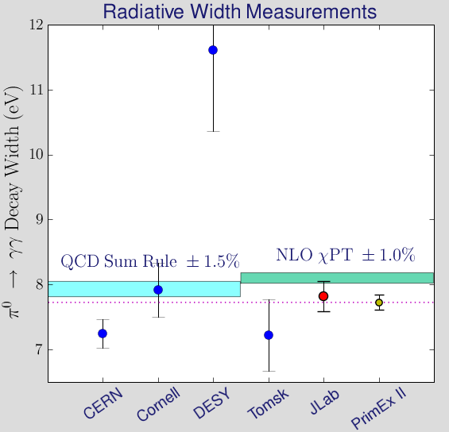
PrimEx
Precision Measurement of π⁰ life time
Chiral anomaly of QCD predicts exact value of decay width.
γ
π⁰
Coordination: Kubarovsky
Beam Line: Pasyuk
E02-103, E08-023
Primakoff effect
Γ(π⁰→γγ) = 7.82eV±0.14±0.17
(2008)
(2002)
Projected uncertainty for PrimEx-II (E08-023) – data taken in Fall 2010.
E02-103
PrimEx I
I. Larin et al., PRL 106, 162303 (2011).

Slide 13
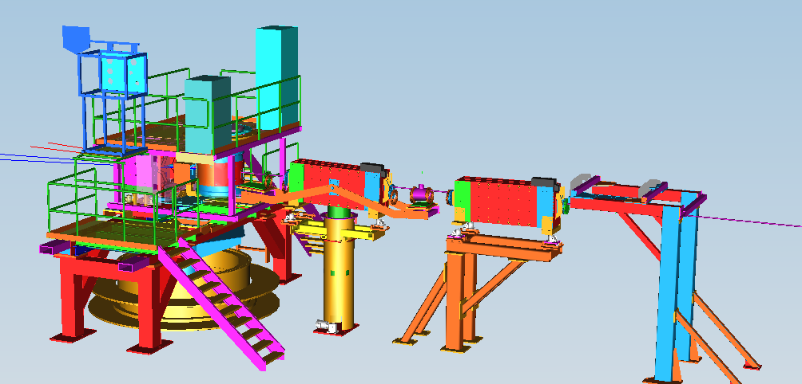
G2p/GEp: recent major large-installation experiment
Spin Polarizability : Major failure (>8σ) of χPT for neutron δ_{LT}. Need g₂ isospin separation to solve.
Hydrogen HyperFine Splitting : Lack of knowledge of g₂ at low Q² is one of the leading uncertainties.
Proton Charge Radius : one of the leading uncertainties in extraction of <R_{p}> from μ−H Lamb shift.
Byproduct: increased DAQ speed/HRS to 7-8 KHz (<30% dead time)
Michaels
Septa
Spokesperson: Chen
Coordinator: Zhang
Chicane
New Beam Diagnostics
(BPM,BCM,Harps,Tungsten Calo)
Local Dump
Polarized Target

Slide 14
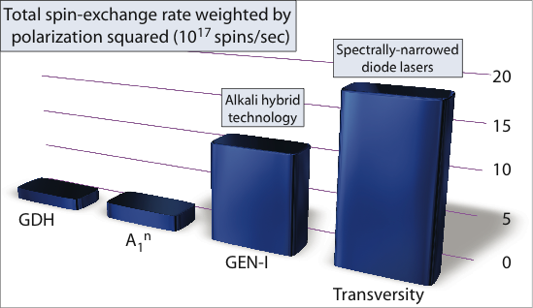
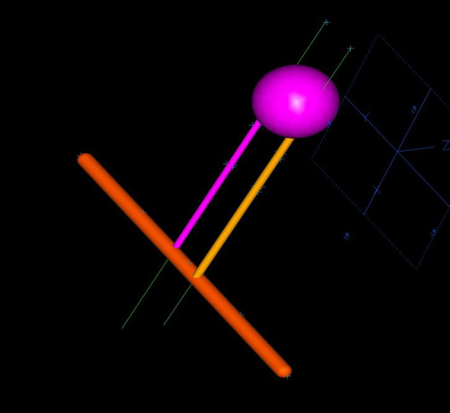
Polarized 3He – Status and Upgrade Plans
Used for 13 experiments to date at JLab
Reached 60% in-beam polarization, 10³⁶ luminosity (world best)
Hybrid (mixed Rb/K) Optical Pumping
Narrow width high power laser
Over 70% polarization without beam
3-d polarization direction
Fast spin slip using RF
Two polarimetry systems (NMR & EPR), 3-5% precision.
Upgrade step I → improve FOM by 2-3
- 40 cm target to reach
~60% polarization with 30 μA
- Cells with convection flow
- Large pumping chamber (3.5” diameter)
- Pulsed NMR,
calibrated with EPR and water NMR
- Measure EPR calibration constant κ₀
- Metal end-windows desirable
Upgrade step II → improve FOM by 2-3
- 60 cm target, ~60% pol. with 60 μA
- Metal end-windows
Recent R&D pogress:
1st convection cell tested
Pulsed NMR working,
studies continue
New laser tested
Design on-going
Figure-of-merit (FOM) →
Project, R&D Leads: Chen, Solvignon

Slide 15
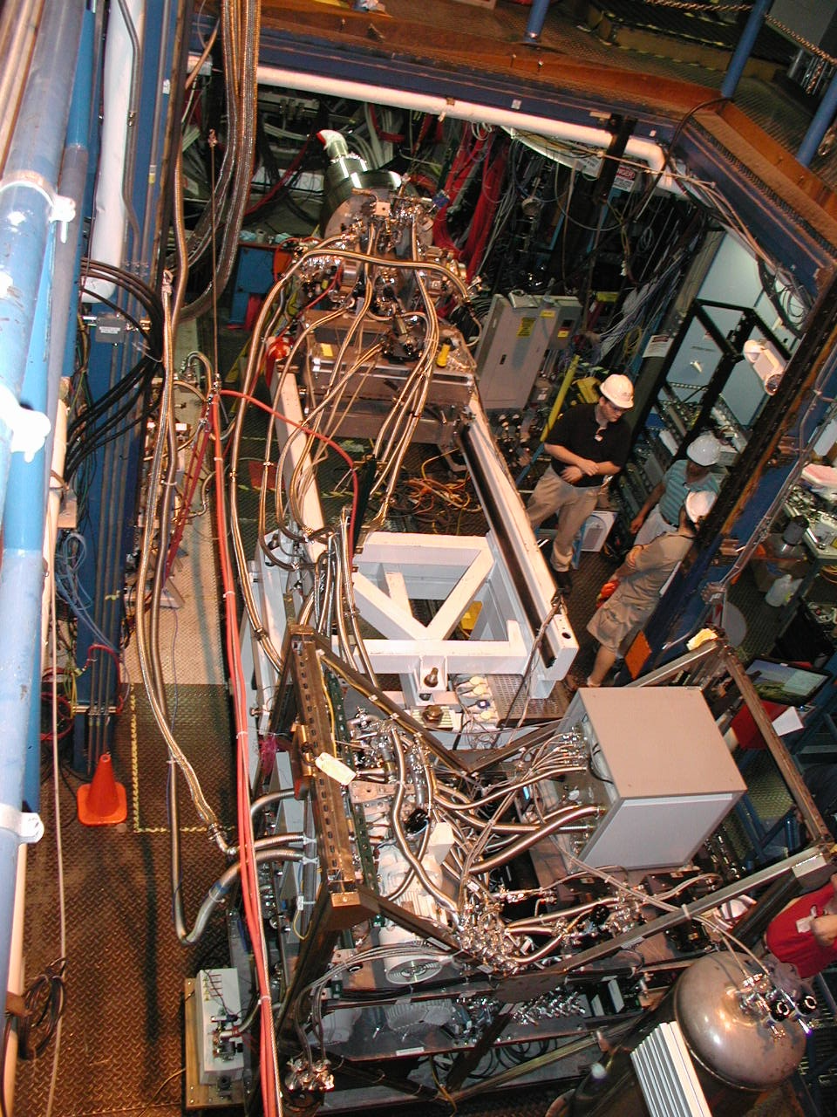
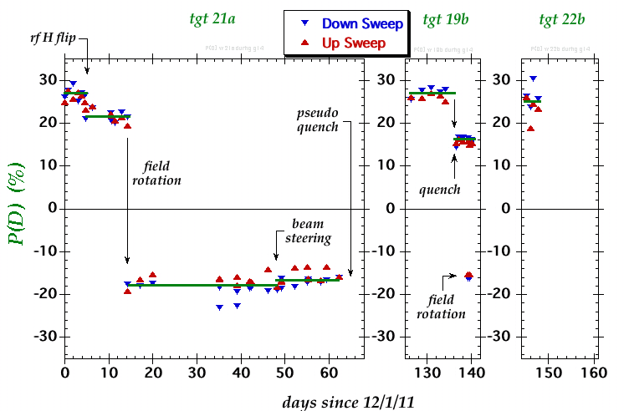
HDIce Polarized Target
2011/2012: HDIce successfully used for complete photoproduction experiments!
g14-HD Spokesperson & Lead Sandorfi
Thermal design, modeling (heat, radiation) Lowry
NMR measurement development Deur
H→D spin transfer, transfer cryostat Wei
Condensing of HD target Kageya
Controls, IBC gas handling Bass
Dilution refrigerator at ~50 mK, and at ~0.9T

Slide 16
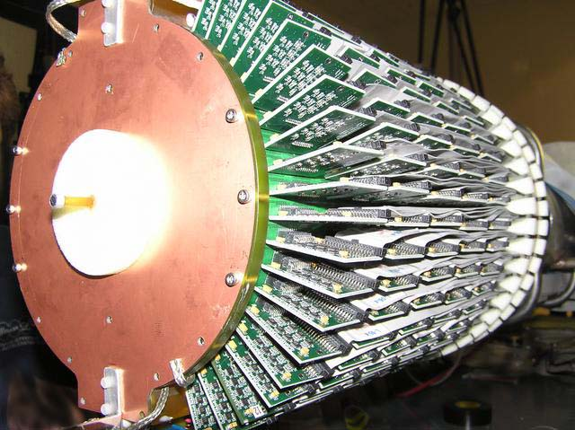
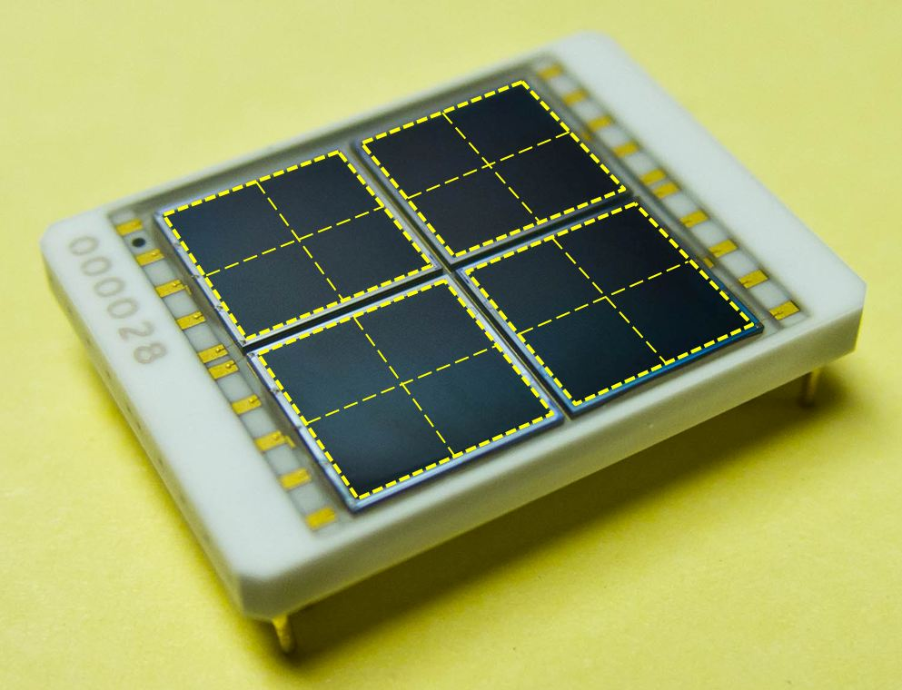
BoNuS & Silicon PM development
Qiang, Smith, Somov + other Hall D staff
Silicon photo multiplier is a novel photo detector with many desirable features
First planned use of SiPMs in large-scale nuclear or high-energy physics experiment
Performance including radiation hardness, time resolution and dead time measured
Further radiation hardness R&D for EIC in collaboration with Hamamatsu
BoNuS: radial TPC with 1st use of GEMs w. curvature (Fenker)
Measured down to 2.6 MeV proton spectators following e-d scattering (Fenker, Keppel)
BoNuS improvements in later experiment - materials and electronics (Stepanyan)
50 μm
12 mm
Hamamatsu
4×4 Array of
3×3 mm² SiPMs

Slide 17
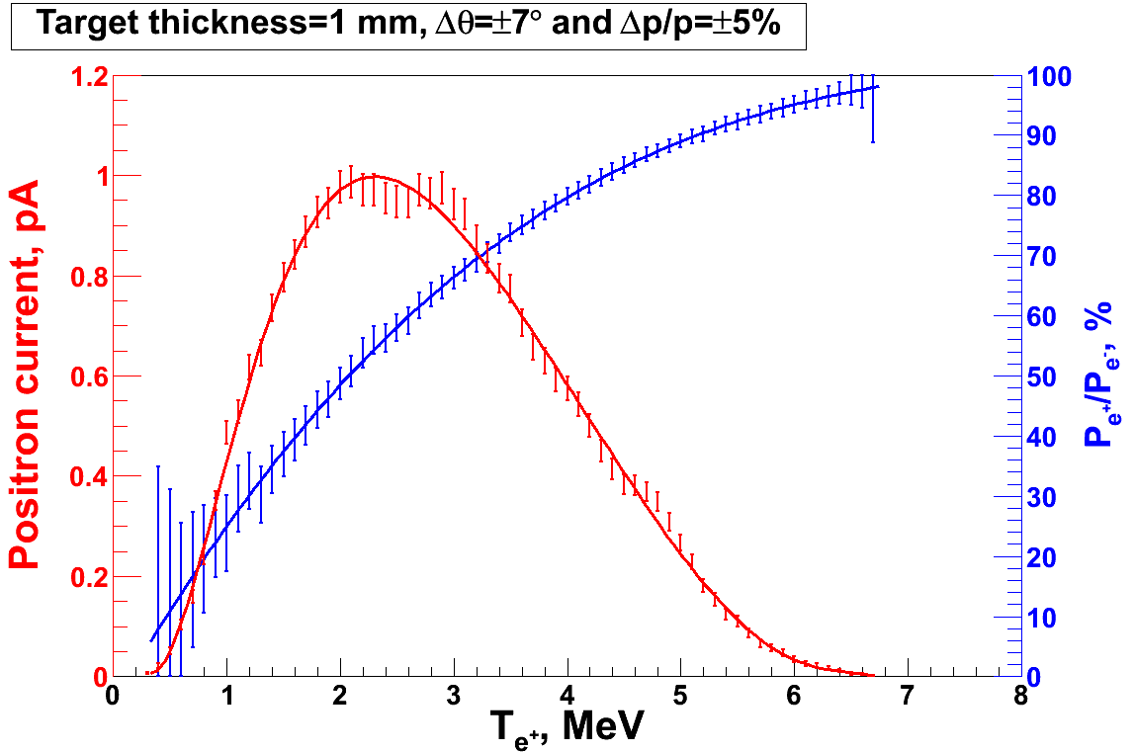
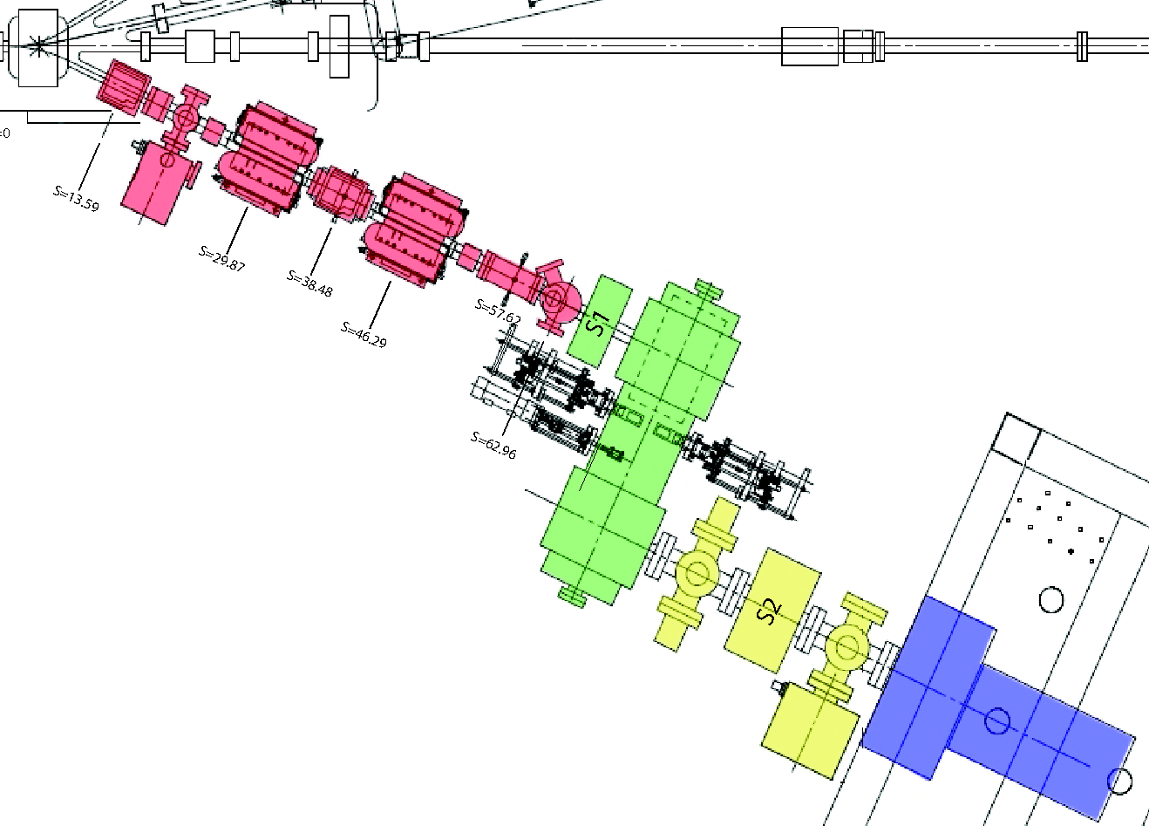
A proof of principle experiment (PEPPo):
Polarized Electrons to Polarized Positrons
Example Simulation
Polarized Bremsstrahlung and pair production
T= 6.3MeV
I_{e} = 1 µA
T₁ = 1 mm
PEPPo
PEPPo goal: Demonstrate producing polarized e⁺ from polarized e⁻ beam in the 3-6 MeV/c range
Production
Targets
(0.1-1mm W)
Status: Successfully measured the long. polarization transfer of 8 MeV e⁻ to e⁺. Asymmetries point to a high degree of polarization in the resulting collected e⁺ beam.
e⁻ Driver: CEBAF injector polarized electron beam
e⁺ Collection: solenoid & combined function spectrometer
e⁺ Diagnostic: coincidence annihilation detectors and 2-D profile monitor
e⁺ Detection: Compton transmission polarimeter
Polarimeter Target
Major contributions to concept and DAQ/measurement:
Cardman, Camsonne, Michaels

Slide 18
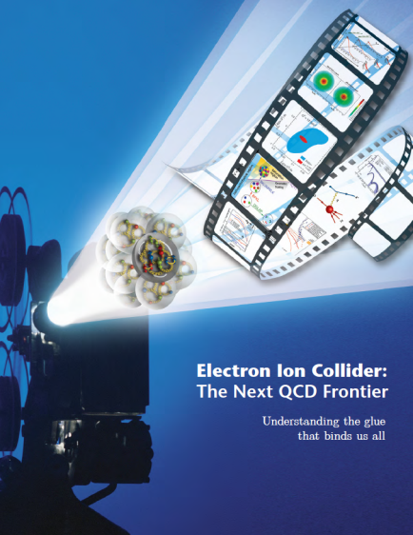
EIC White Paper & MEIC Design Report
WP Steering Committee: Horn
Authors: Nadel-Turonski, Ent
“… was impressed by the outstanding quality of the present MEIC design”
“The report is an excellent integrated discussion of all aspects of the MEIC concept.” (JSA Science Council 08//29/12)
EIC white paper
Posted: arXiv:1212.17010 (v2)
Posted: arXiv:1209.0757

Slide 19
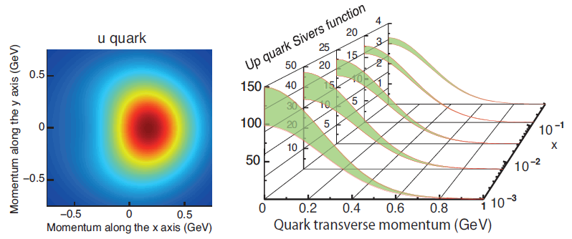
MEIC Science and Conceptual Design
TMD & GPD imaging science developed (Chen, Horn, Ent)
Integrated detector & interaction region developed
(Nadel-Turonski, Ent, Horn)
DIRC R&D (Nadel-Turonski)

Slide 20
Jefferson Lab Introduction - Summary
Active research component of JLab staff scientists balancing support duties and highly-visible research, covering four main areas:
Nucleon structure (including hadron spectroscopy)
Nuclear structure/QCD and nuclei
Standard Model tests/Beyond the Standard Model Searches
Technical accomplishments
Group structure organized around four groups/Halls, with Hall D group still ramping up and concentrating on Hall D construction efforts
JLab staff scientists are more often than not spokesperson of experiments, or play a well-recognized role in coordination or analysis within the collaborations.
Research topics have been spearheaded by JLab staff, with follow-up at international facilities such as COMPASS/CERN (flavor dependence of average transverse momentum widths) and MESA/Mainz (DarkLight and Qweak).
Typical presence of users to staff on site is ratio of 3:1, with roughly one of each 3 users representing the international user community.
Large education component of multiple students in highly collaborative nature with user community
Visible and first-ever technical developments, such as the development of a radial TPC based on GEMs, the use of Silicon PMs, a world record high-power cryogenic target, and polarized HDIce and 3He targets.

Slide 21
Evaluation Criteria
1. Assess the significance and merit of the group’s research, in the context of present and emerging research directions within nuclear physics.
2. Assess the group’s future prospects for achieving scientific excellence, based on its past achievements and the vigor and focus of the group members.
3. Assess the scientific productivity of each group, including any specific strengths and weaknesses.
4. Evaluate the impact of the group’s scientific research effort nationally and internationally.
5. Assess the effectiveness of the group in training the next generation of scientists.
6. Identify particular strengths of each group, such as scientific leadership, technical leadership, development of innovative concepts or instruments, maintenance of unusual skills, or crucial inputs into collaborative efforts.

Slide 22
Jefferson Lab – Medium Energy Comparative Research Review Summary
JLab staff scientists provide both leadership and support for outstanding and innovative research in hadronic physics, nuclear structure/QCD and nuclei physics, and the search for physics beyond the Standard Model.
Based on both the past achievements of these scientists and the exciting upcoming 12 GeV research directions, the prospects for continuing this leadership and defining research directions (such as for EIC) are outstanding.
JLab staff has exhibited a healthy scientific productivity in terms of refereed and contributed papers, as also independently evidenced by an Early Career Award and three recent APS Fellowships.
JLab staff is highly recognized worldwide as topical experts and initiators of research lines, as evidenced by the amount of invited talks and (semi-local) organization of international workshops and conferences.
JLab staff scientists act as local mentors to multiple Ph.D. and M.Sc. Students during their stay at JLab, in close collaboration with university supervisors. Per year, also on average 50 undergrads participate in research.
JLab staff has made visible and first-ever technical developments, such as the development of a radial TPC based on GEMs, the use of Silicon PMs, a world record high-power cryogenic target, and polarized HDIce and 3He targets.

Slide 23
Qweak world record target & improved polarimetry
See Roger Carlini’s presentation

