Slide 1
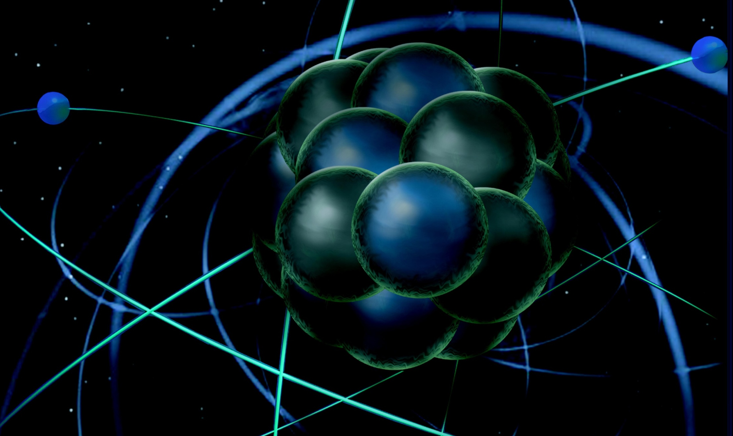
Thomas Jefferson National Accelerator Facility
Medium-Energy Comparative Research Review
Nuclear Structure/QCD and Nuclei
Nucleons in the Nucleus
Douglas Higinbotham (JLab)
DOE MEP Comparative Research Review
12 June 2013

Slide 2
Physics Topics
Short Range Correlations (SRC)
Learning about the short range part of the nucleon-nucleon potential by probing nucleons as they come close together in the nucleus.
EMC Effect
Understanding the modification of nucleons in the nucleus in deep inelastic kinematics.
SRC and EMC Together
Experimental evidence of a link between SRC and EMC effects.
PREX Neutron Skin Measurement
Learning about the equation of state of neutron rich matter.

Slide 3
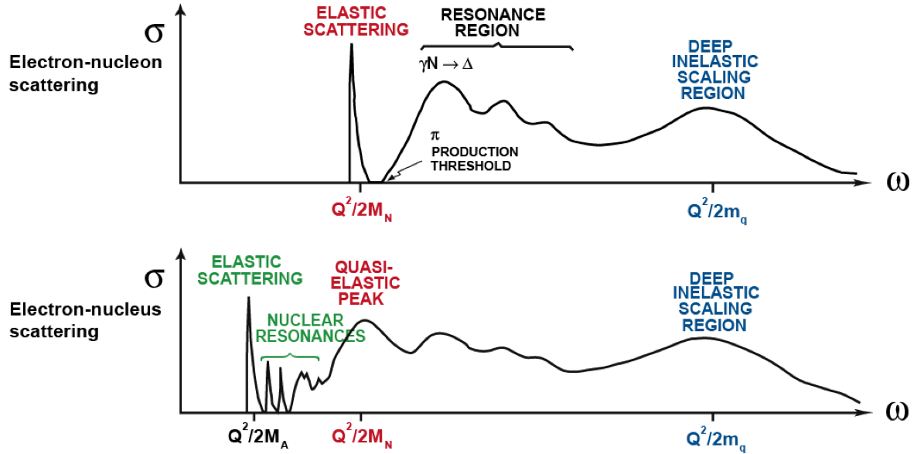
Electron Scattering from Nucleons in the Nucleus
x_{B} = Q²/2mω
x_{B} > 1
x_{B} = 1
x_{B} < 1

Slide 4
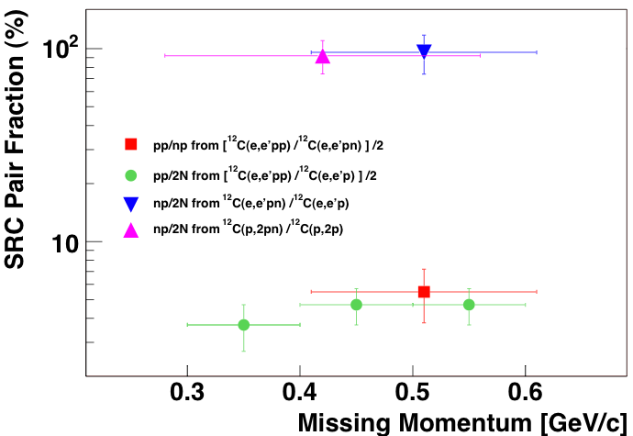
Kinematics To Observe Short-Range Correlations
R. Subedi*, D. Higinbotham, S. Wood et al., Science 320 (2008) 1476. (100+ inspire citations)
* co-advised by D. Higinbotham and John Watson (Kent State University)
J. Arrington, D. Higinbotham, G. Rosner, and M. Sargasian, Prog.Part.Nucl.Phys. 67 (2012) 898.
x_{B} > 1 , Q² = 1.5 [GeV/c]² and missing momentum greater then Fermi momentum

Slide 5
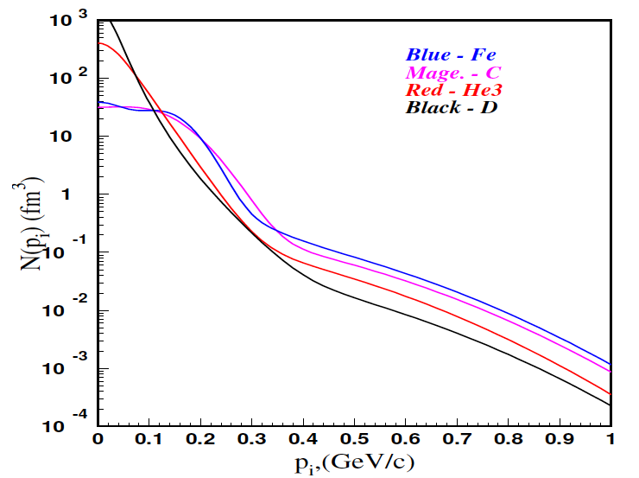
Measuring Correlations via (e,e’) Ratios
N. Fomin, D. Gaskell, et al., Phys. Rev. Lett. 108 (2012) 092502.
C. Atti and S. Simula, Phys. Rev. C 53 (1996) 1689.
Magnitude of the plateaus proportional to the probability finding pairs in the nucleus.
Consistent with the idea that the functional form of these pairs is the same in all nuclei.

Slide 6
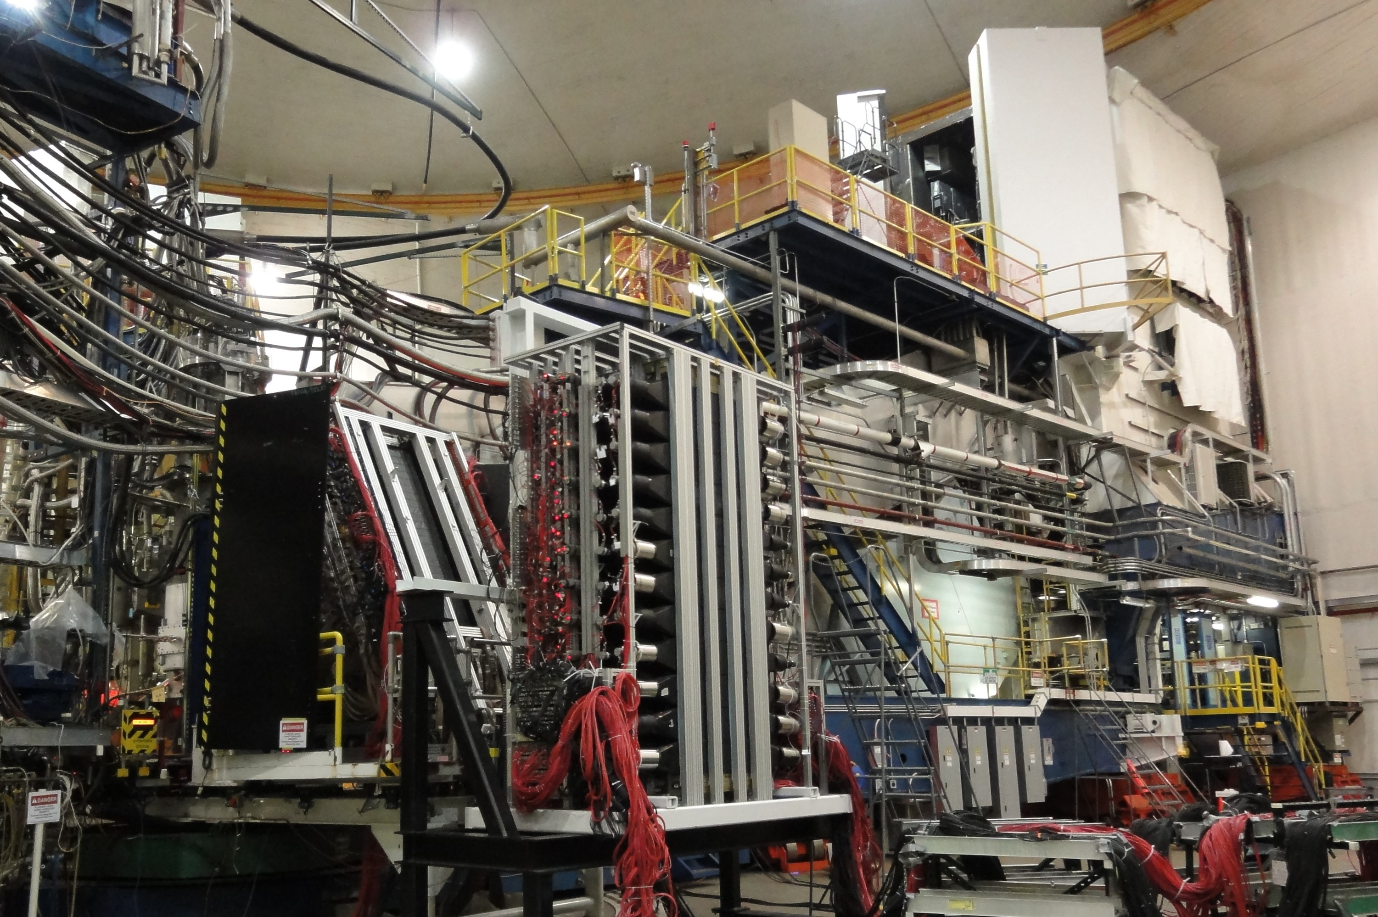
SRC Analysis in Progress
E07-006: SRC 2nd Generation (e,e’pN) Completed In 2011
D. Higinbotham, S. Gilad, J. Watson & S. Wood Spokespersons
E08-014: SRC (e,e’) x>1 data on ³He, ⁴He, ⁴⁰Ca, & ⁴⁸Ca Completed In 2011
J. Arrington, D. Day, D. Higinbotham and P. Solvignon Spokespersons
HRS
BigBite
Neutron Detector
Along with standard HRS, Ph.D. Students and an international collaboration setup BigBite and Neutron Detector for the 2011 run.
Provides students hands-on experience with scintillators, Cherenkovs, wire-chambers, DAQ and in the future GEM Detectors.

Slide 7
EMC (European Muon Collaboration) Effect
EMC effect is simply the fact the ratio of DIS (e,e’) cross sections is not one.
J.J. Aubert et al. PLB 123 (1983) 275.
Simple Parton Counting Expects One
MANY Theory Explanations
Conclusions from previous data
Q²-independent
Universal x-dependence (shape)
Magnitude varies with A
Average Nuclear Density Effect
New Jefferson Lab data (shown)
¹²C/D same as previous results.
J. Seely et al., PRL 103 (2009) 202301.

Slide 8
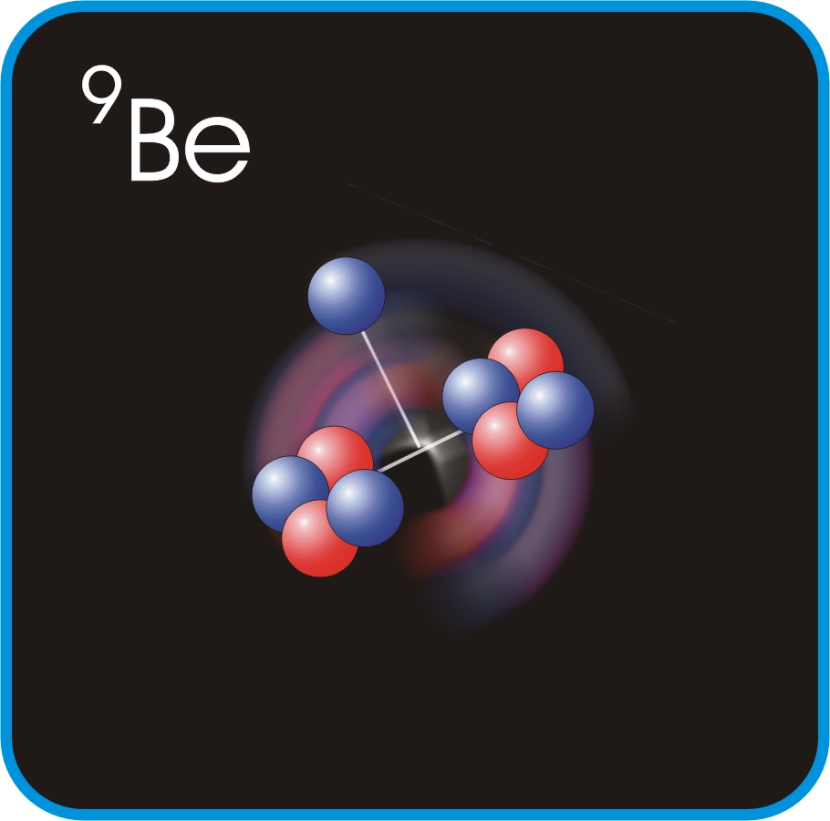
New Insight On The EMC Effect Data
J. Seely, D. Gaskell, et al., Phys, Rev. Lett. 103 (2009) 202301.
Plot shows slope of ratio σA/σD at EMC region.
EMC effect correlated with local density not average density.

Slide 9
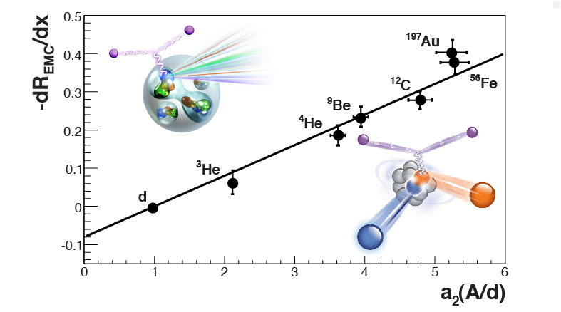
Experimental SRC and EMC Correlation
L. Weinstein, E. Piasetzky, D. Higinbotham and J. Gomez, O. Hen, R. Shneor, Phys. Rev. Lett. 106 (2011) 052301.
J. Arrington, A. Daniel, D. Day, N. Fomin, D. Gaskell, P. Solvignon, Phys. Rev. C 86 (2012) 065204
SRC Plateaus (A/d)
The data shows that EMC effect slopes are proportional to the SRC plateaus.

Slide 10
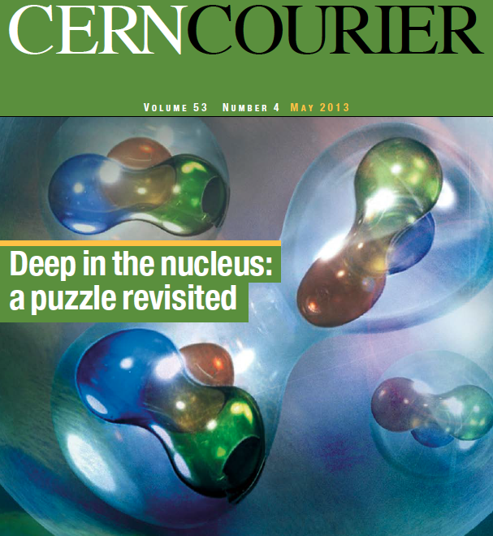
Impacts of SRC & EMC Research
Understanding nucleons in the nucleus is important high energy subfields that want to use nuclear targets to understand nucleons. (e.g. neutrons from ³He or D)
Topic of recent INT workshop with invited talks from R. Ent, D. Gaskell, H. Avakian, S. Wood, D. Higinbotham, C. Keppel, and P. Solvignon.
Review article on the topic accepted for publication in Int. J. Mod. Phys. E by O. Hen, D. Higinbotham, G. Miller and L. Weinstein.
Physics Topic was last month’s cover story in the CERN Courier which was authored by D. Higinbotham, G. Miller, Or Hen, and K. Rith.

Slide 11
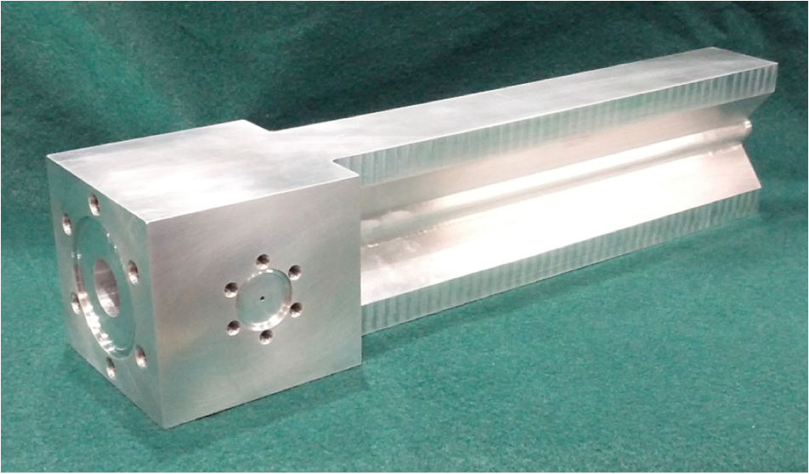
Upcoming EMC & SRC Experiments
E12-10-103 & E12-11-112 plans ³He & ³H (e,e’) SRC & EMC Measurements
D. Higinbotham and P. Solvignon
E12-10-008 & E12-06-105 plans a survey of nuclei (such as ⁴⁰Ca & ⁴⁸Ca)
Exact list being optimized, but goal is to cover EMC x < 1 and SRC x > 1 for each nucleus
D. Gaskell and P. Solvignon
E12-11-107 will use a Large Acceptance Device (LAD) to tag recoiling nuclei
Goal to directly show if the cause of the EMC effect is due to SRC pairings
S. Wood
Tritium Target Cell Machined From Block Of Aluminum

Slide 12
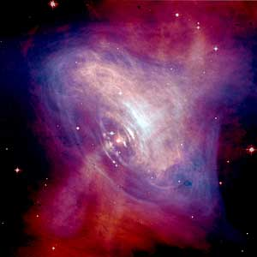
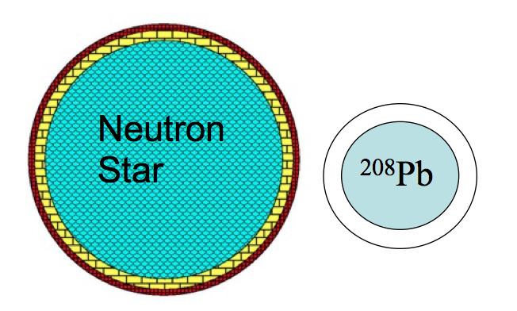
Understanding Neutron Stars with Measurements on Earth
At the center of the crab nebula is a neutron star with a 28-30km diameter.
Neutron star has a solid crust (yellow) and a liquid core (blue).
The lead nucleus a neutron skin.
Both the neutron skin and neutron star crust are made out of neutron rich matter at similar densities.
Common unknown is the equation of state (EOS).
By making elastic scattering measurements on lead to determine its parity violating asymmetry, the neutron skin radius can be determined and the EOS can be constrained.
femtometers
kilometers

Slide 13
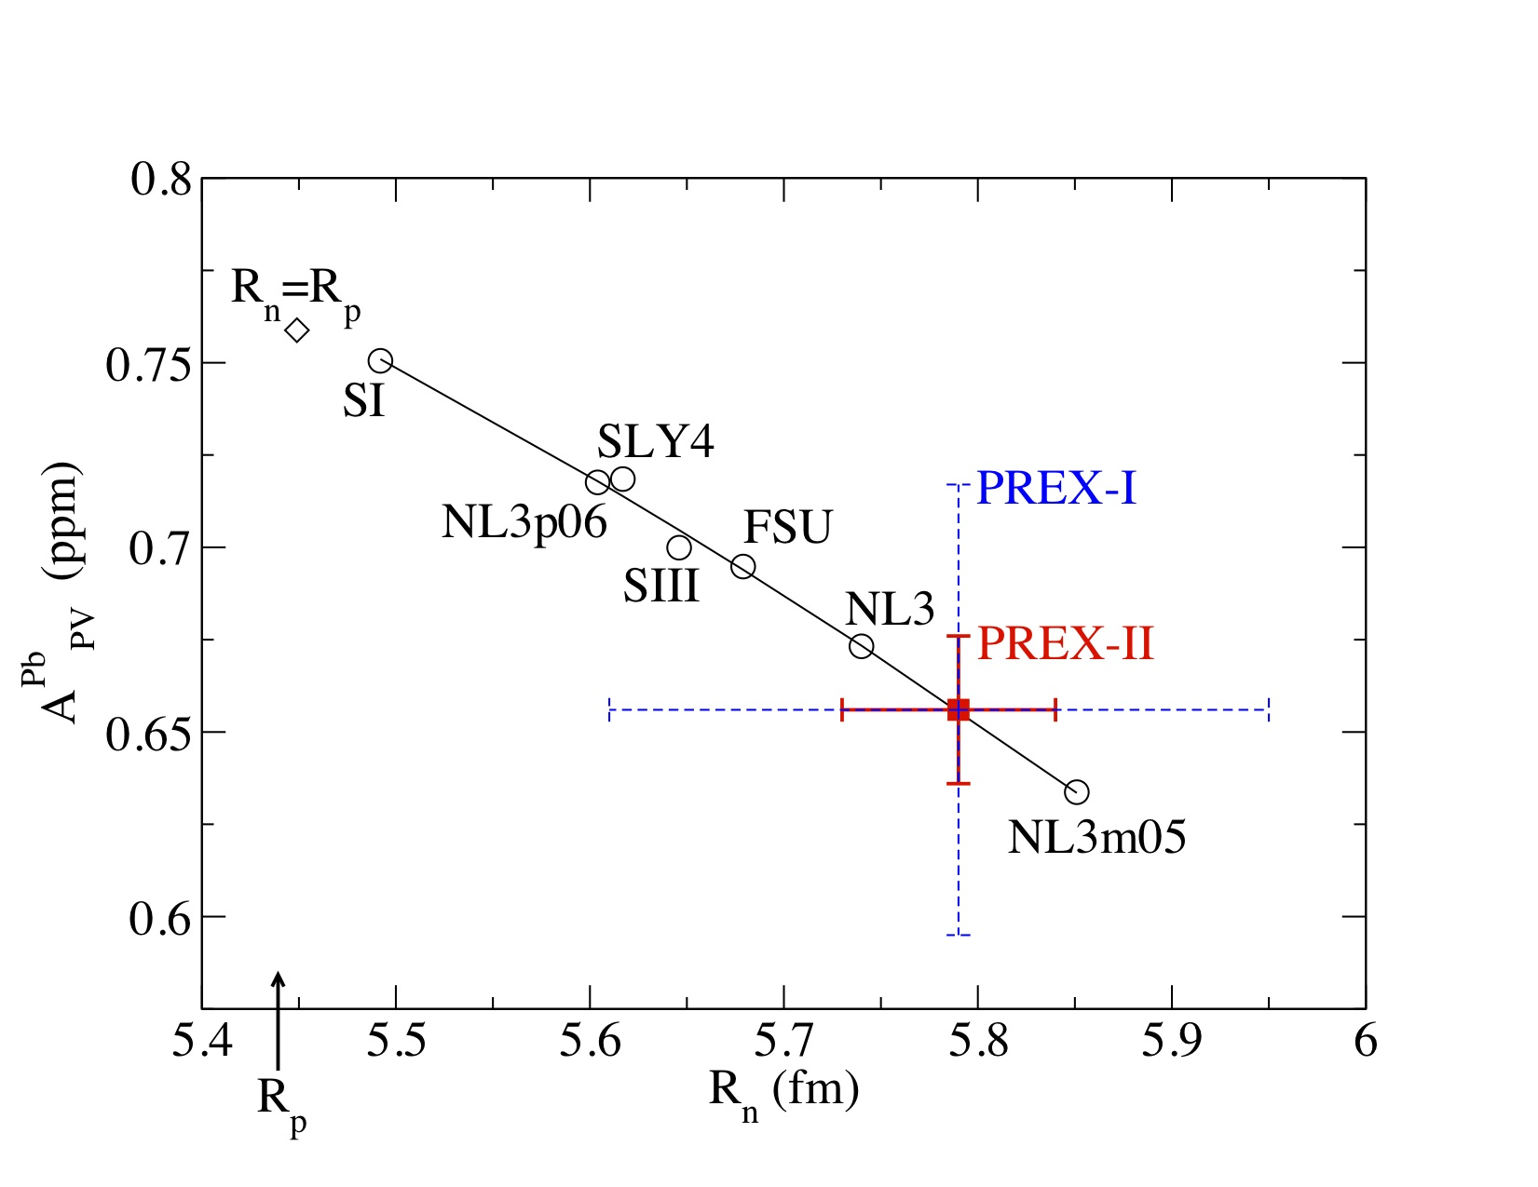
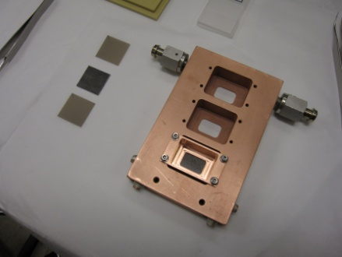
Determination of the Neutron Radius of Lead
S. Abrahamyan, R. Michaels, K. Paschke* et. al., Phys. Rev. Lett. 108 (2012) 112502.
* Bridge with the University of Virginia at the time of the experiment.
Require special target design to keep the lead foils from melting in high power beam.
Data definitely shows Rn > Rp in lead and already constrains possible EOS.
PREX-I has laid the ground work for a PREX-II measurement plan for the 12GeV CEBAF.

Slide 14
Summary
After decades of work at numerous labs, Jefferson Lab scientists have realized the goal of clearly probing short-range correlations.
David Gaskell, Douglas Higinbotham, Patricia Solvignon, and Steve Wood
New data from Jefferson Lab on the EMC effect has created a paradigm shift from EMC being an A-dependent effect to a local density effect.
David Gaskell, Simona Malace (postdoc), and Patricia Solvignon
An experimental link between EMC and short-range correlations has been observed and generated considerable interest; including a cover story of the CERN Courier and INT workshop.
Douglas Higinbotham, Javier Gomez, and Rolf Ent
The lab’s parity violation expertise (see R. Carlini’s talk) has been used to measure the neutron skin of lead.
Bob Michaels and Kent Paschke (bridge position with Univ. of Virginia)

