Slide 1

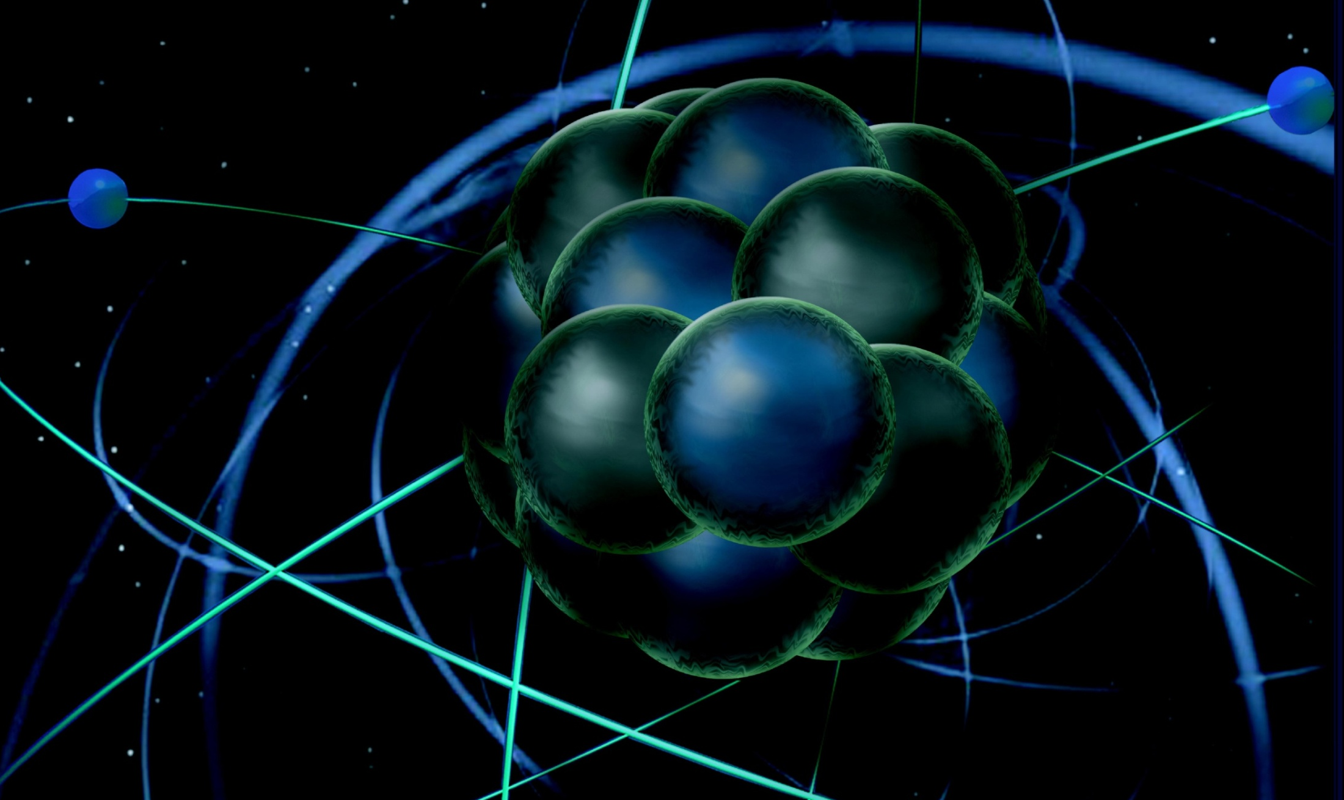
The Structure of the Nucleon
June 12, 2013
Patrizia Rossi (JLab)
DOE MEP Comparative Research Review
June 12, 2013

Slide 2
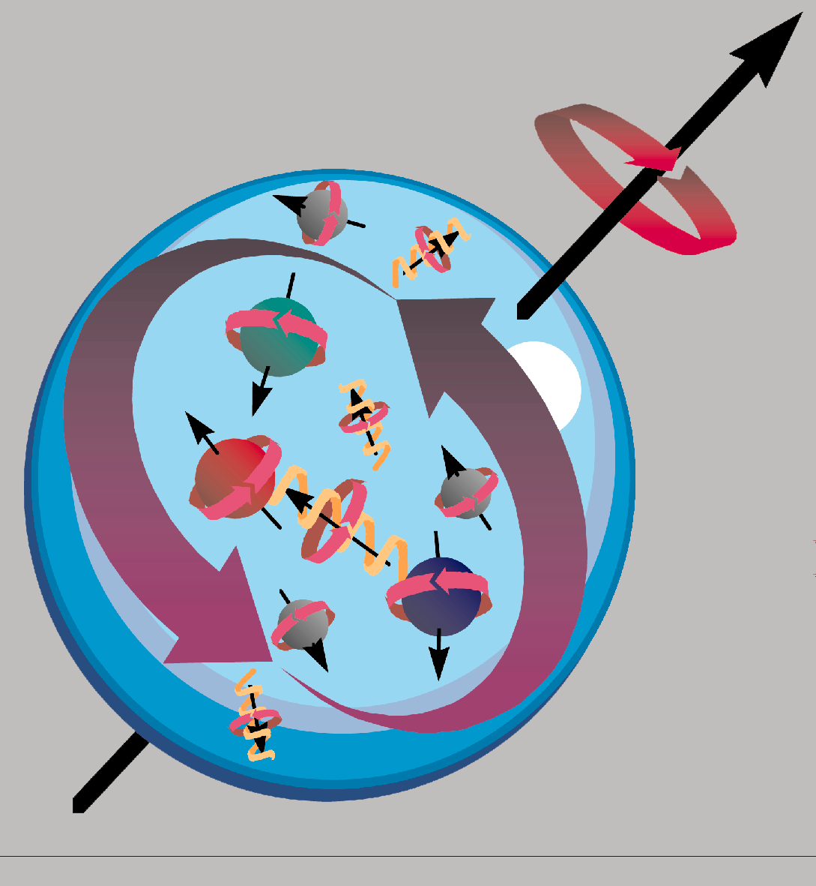
The nucleon: a complex object
nucleon
form
factors
3D
parton distributions: GPD & TMD
1D parton distributions
nucleon
resonances

Slide 3
Nucleon e.m. Form Factors
Fundamental quantities describing the distribution of charge (G_{E}) and magnetization (G_{M}) in the nucleon
Necessary ingredients as input for the descriptions of ALL processes where nucleons are involved
    QCD test
    connection with GPDs
    determination of the strange FF
    ■ QE scattering
    …
Extensively measured in the last fifty years but far from their full understanding

Slide 4
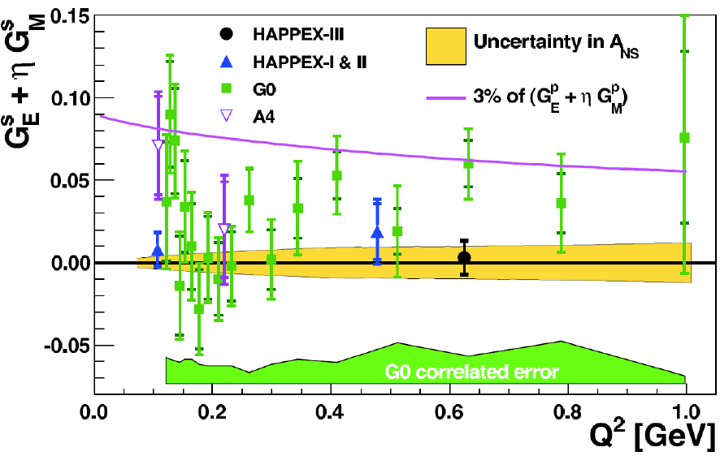
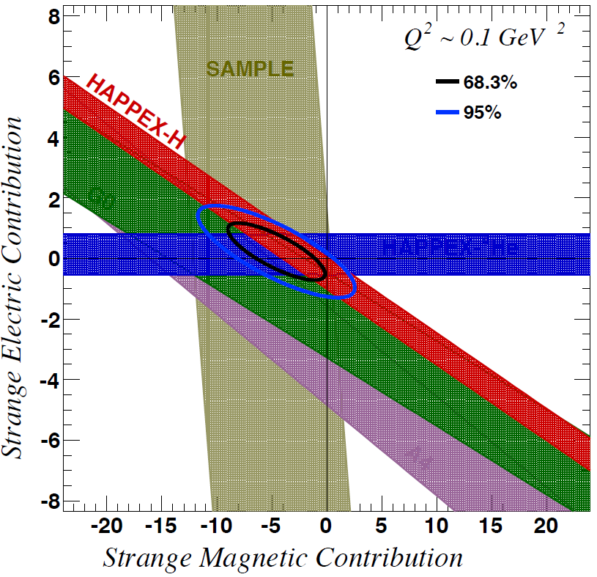
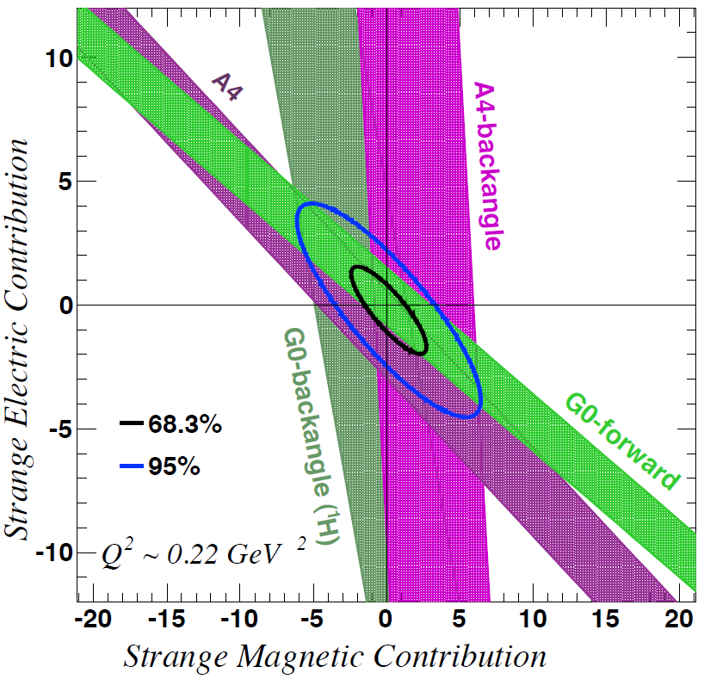
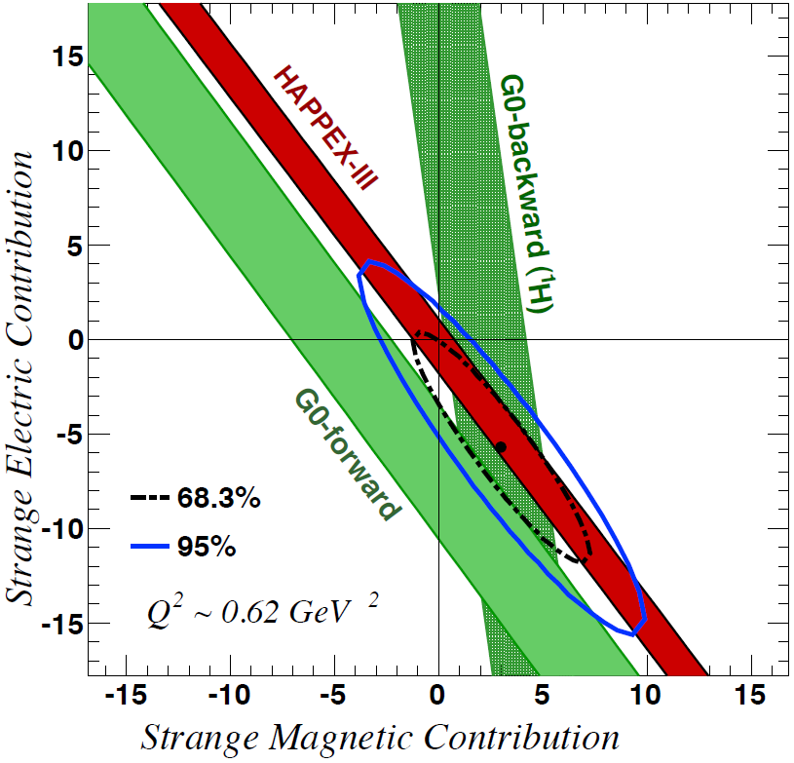
Strangeness Contribution to Nucleon Form Factors
Purple line represents 3% of the proton form factors
→ strange quarks do not play a substantial role in the long-range e.m. structure of nucleons
HAPPEx-3: PRL 108 (2012) 102001
G0-Backward: PRL 104 (2010) 012001
Michaels, Smith

Slide 5
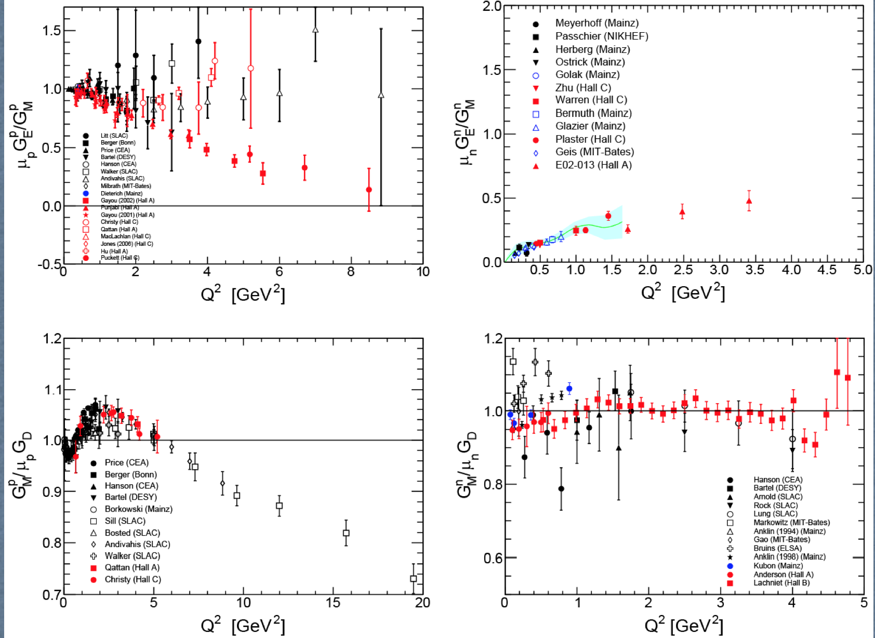
Flavor Decomposition of the Nucleon FFs
PRL 106 252003(2011)
Cates, de Jager, Riordan, Wojtsekhowski
PRL 104, 242301 (2010)
Brash, Jones, Puckett, Wojtsekhowski]
G0-Backward: PRL 104 (2010) 012001
G. Smith
PRL 104 242301(2010)
PRL 105 262302(2010)
Brash, Jones, Puckett, Wojtsekhowski
Very different behavior for u & d quarks suggests apparent scaling in proton F₂/F₁ may be accidental

Slide 6
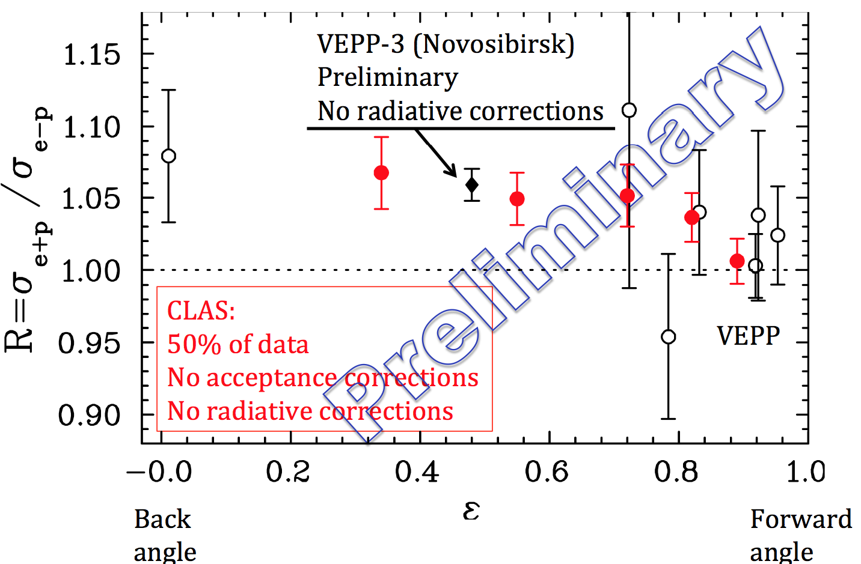
Two Photon Exchange Contribution
Comparison to world data at Q² >1
Jones, Kohl, Pentchev, Stepanyan
Preliminary results are consistent with two-photon exchange explaining the difference between polarization-transfer versus unpolarized G_{E}^{p}/G_{M}^{p} results

Slide 7
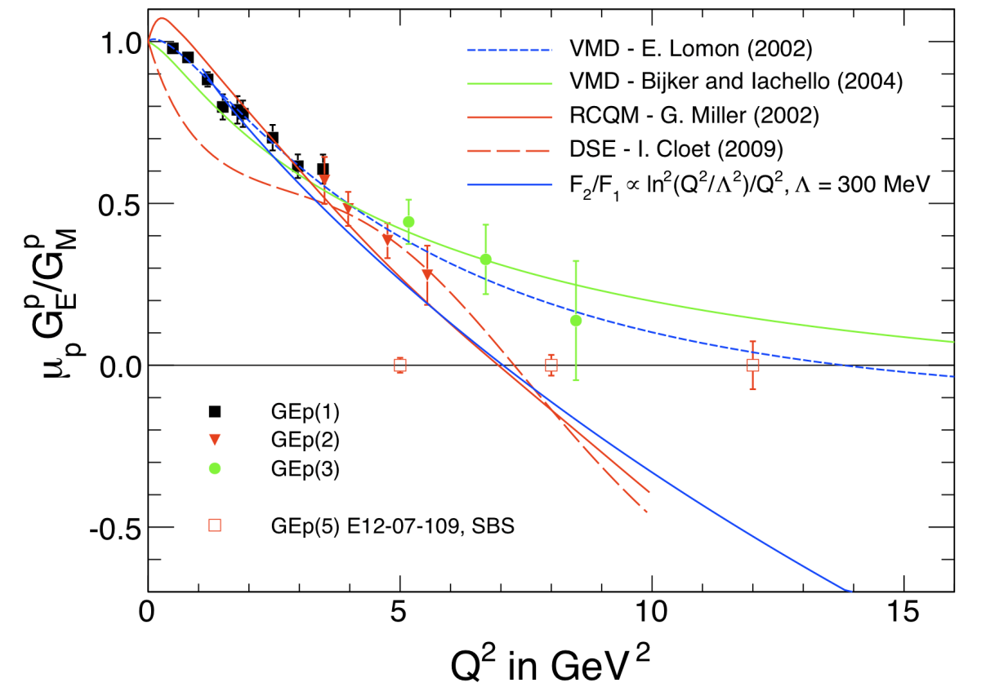
Form Factors Measurements: IMPACT
Distribution of charge and magnetization in the proton re-written ➔Theoretical models revised inferring the importance of relativistic effects and quark orbital angular momentum.
The modest role of the strange quark sea in combination with proton and neutron data allowed for the first time a quark flavor separation of proton and neutron form factors in terms of up and down quark contributions
Proton and neutron form factors measurement at high Q² with the 12 GeV beam will constrain theoretical models - 6 experiments approved

Slide 8
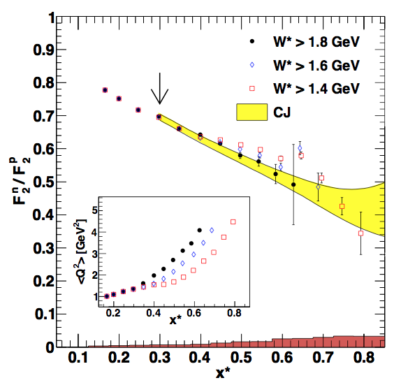
1D Parton Distributions
Long-standing puzzle in hadronic physics: behavior of the ratio of d to u quark PDFs in the proton in the limit x → 1
First model-independent measurement of F₂^{n}/F₂^{p} & F₂^{n}
F₂^{n}/F₂^{p} ratio by tagging almost unbound neutrons using detection of low momentum protons in radial TPC
Approved experiment at Jlab 12 GeV will reach x=0.82
PRL 108 142001(2012)
Fenker, Keppel

Slide 9
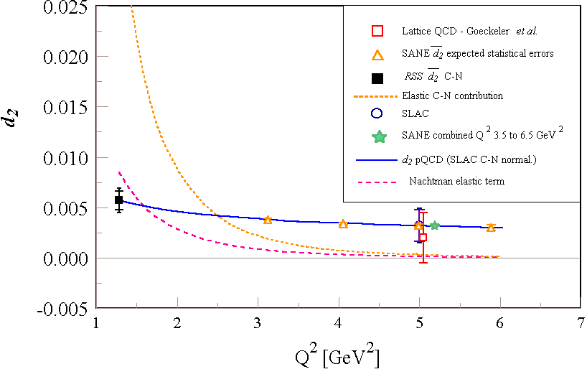
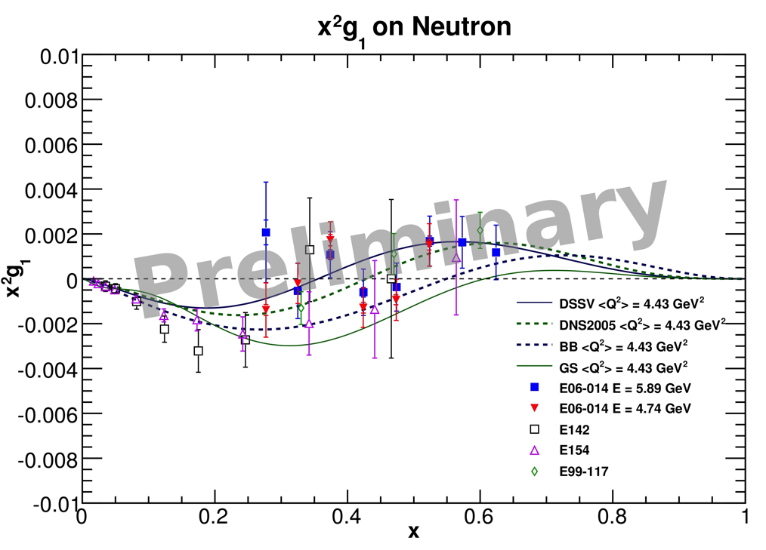
d₂^{n} / d₂^{p}
Clean probe of twist-3 physics (quark-gluon correlations)
Color polarizabilities χ_{E},χ_{B} are linear combination of d₂ and f₂
Provide a benchmark test of Lattice QCD at high Q²
x²g₁^{n} (d₂^{n} integrand)
Chen, Jones
Measurements, still preliminary, remain consistent with the Burkhardt-Cottingham sum rule.
d₂^{p} and d₂^{n} will be extracted and directly compared with lattice QCD computations.

Slide 10

1D Parton Distributions: IMPACT
Jefferson Lab high x data is now being used in CTEQ and other global fitting efforts to improve knowledge of parton distribution functions in the valence regime – as well as to address QCD-associated uncertainties in neutrino, LHC, and other experiments
New CTEQ-JLab “CJ” (Keppel) and JLab Angular Momentum “JAM” (Sawatsky, Chen) theory and experiment collaborations formed to address specific issues associated with extractions of unpolarized (CJ) and polarized (JAM) pdf in the valence regime
F₂^{n}/F₂^{p} from BoNuS is textbook physics!

Slide 11
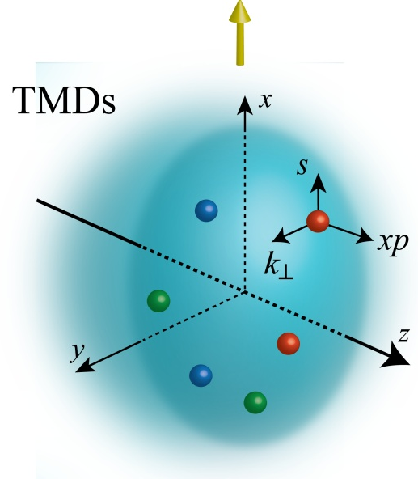
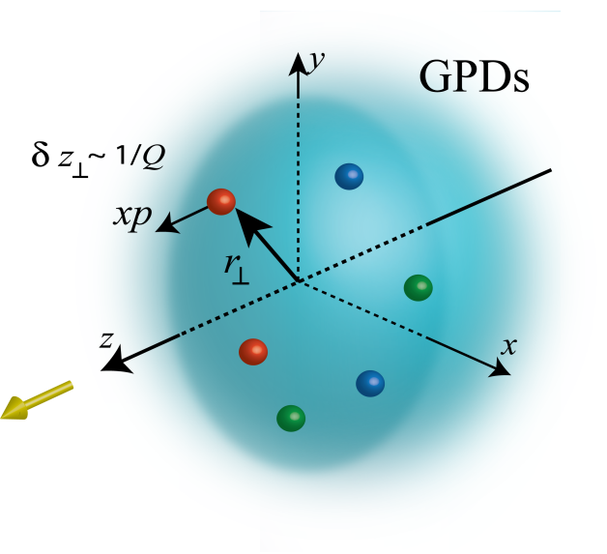
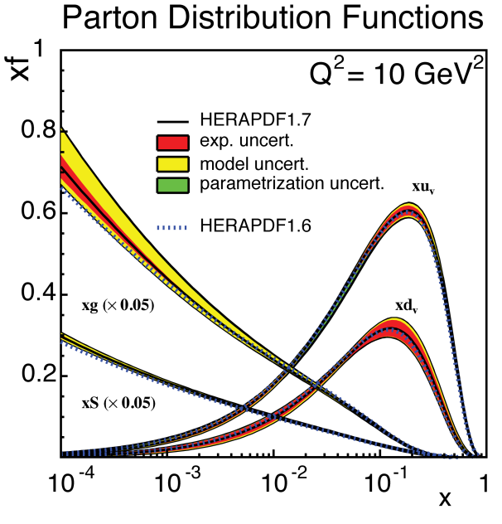
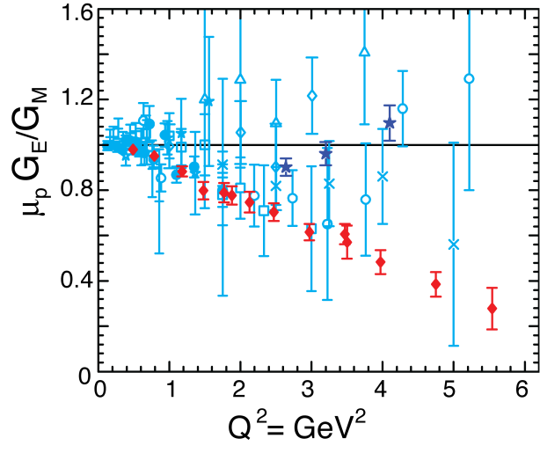
Unified View of the Nucleon Structure
W_{p}^{u}(x,k_{T},r ) Wigner distributions
6D Dist.
d³r
d²k_{T} dr_{z}
TMD f₁^{u}(x,k_{T}), .. h₁^{u}(x,k_{T})‏
GPDs/IPDs
3D imaging
dx &
Fourier Transformation
d²k_{T}
d²r_{T}
Form Factors
G_{E}(Q²),
G_{M}(Q²)‏
PDFs
f₁^{u}(x), .. h₁^{u}(x)‏
1D
11

Slide 12
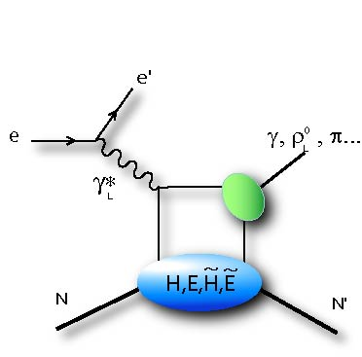
3D Parton Distributions: GPD
Q²
Longitudinal momentum fraction x at transverse location b
At leading twist eight GPDs whose extraction is possible ony through models/parameterizations ➔ needs data in a large kinematic domain of x_{B}, t, Q²
t
DVCS most clean process to access GPDs
Polarized beam, unpolarized target:
Unpolarized beam, longitudinal target:
Unpolarized beam, transverse target:
H(ξ,t)
~
H(ξ,t)
E(ξ,t)

Slide 13
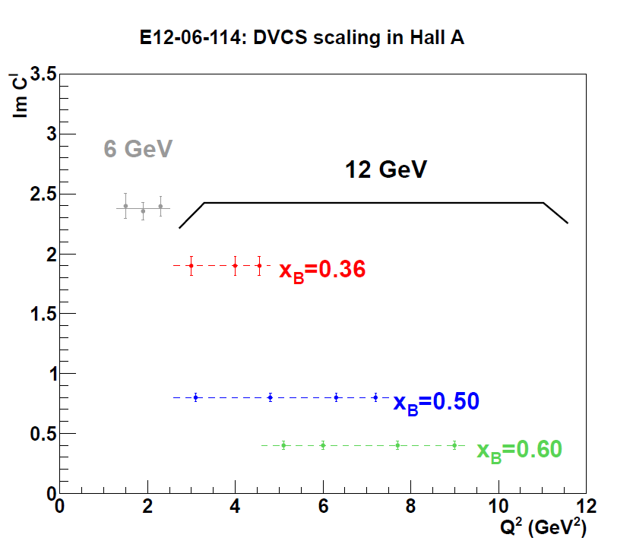
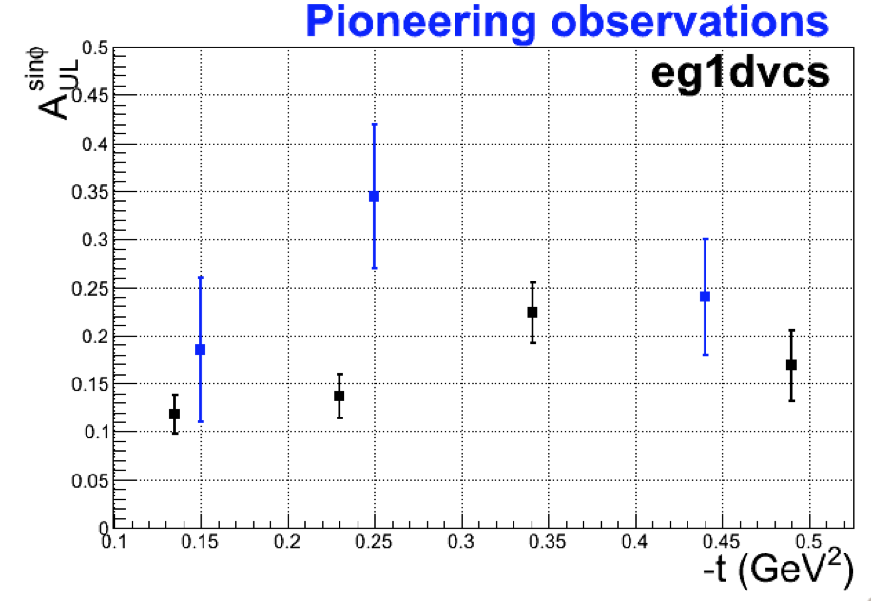
3D Parton Distributions: GPDs
Preliminary
Hall A:
strong indication of handbag dominance
Hall B:
very large data set provides constraints on GPD models on a very large kinematic domain
PRC 83 025201 (2011)
Burkert, Camsonne, Elouadhriri, Girod

Slide 14
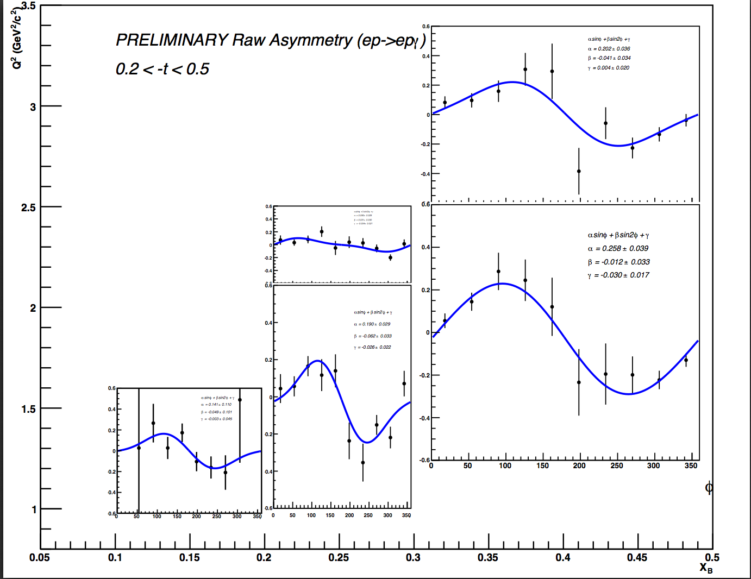
3D Parton Distributions: GPDs
Preliminary
Hall A:
strong indication of handbag dominance
Hall B:
very large data set provides constraints on GPD models on a very large kinematic domain
PRC 83 025201 (2011)
Burkert, Camsonne, Elouadhriri, Girod

Slide 15
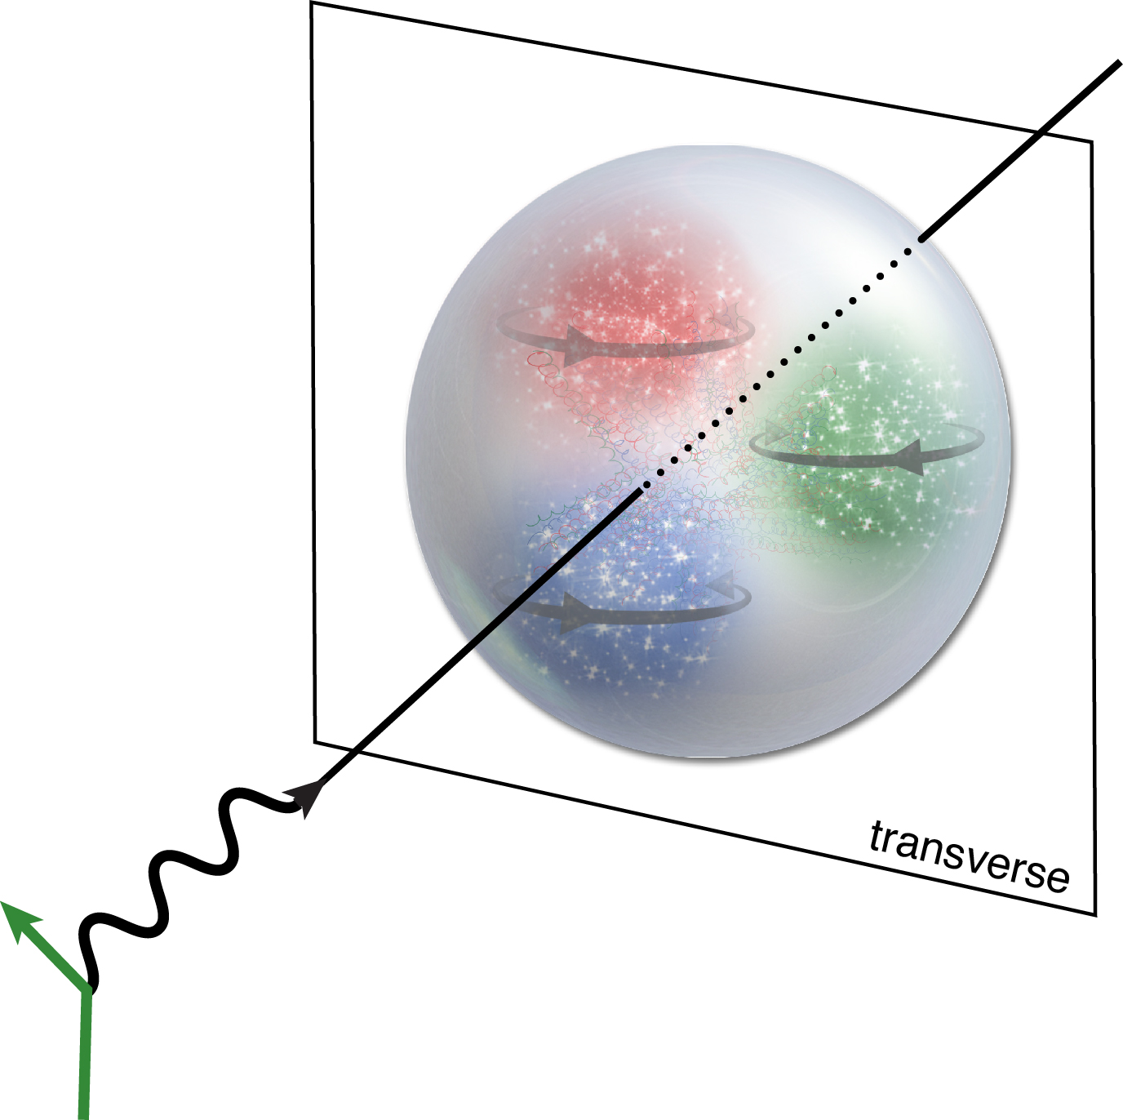
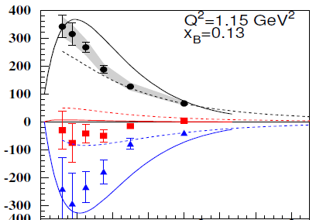

Role of Transversity GPDs
Cross section vs t → σ_{T} parametrized employing transversity GPDs
The measurement shows that the position of the quark depends on how the spin is pointing:
transversely spinning quarks with their spin up tend to gather in the left half of the proton - as seen by the incoming electron - whereas transversely spinning quarks pointing down gather in the right half
[Goloskokov Kroll(2011)]
[Goldstein et al.(2011)]
PRL 109 112001 (2012)
Avakian, Kubarovsky

Slide 16
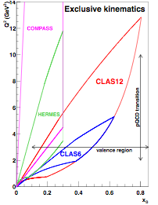
GPD in DVCS exp. @ 12 GeV (Hall A & B)
The feasibility of high luminosity exclusive measurements in complementary high precision (Hall-A) and large acceptance (CLAS) spectrometers has been demonstrated.
Several approaches investigate GPD extraction methods from data
Ground prepared for a wide program @ 12 GeV
N-Pol.
Sensitivity to GPDs
Exp. @ 12 GeV
U
~
E12-06-114: proton (A)
E12-06-119: proton (B)
E12-11-003: neutron (B)
H, H, E
~
L
H, H, E
E12-06-119: proton NH3 (B)
T
E, H
E12-12-010: proton HD (B)

Slide 17


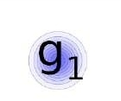
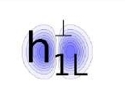

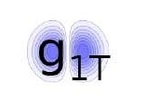
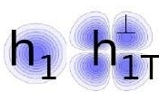
3D Parton Distributions: TMDs
Access orbital motion of quarks
➔ contribution to the proton’s spin
Observables: Azimuthal asymmetries due to correlations of spin q/n and transverse momentum of quarks
quark polarization
U
L
T
T
U
f₁
h₁
Boer-Mulders
nucleon polarization
g_{1L}
T
L
h_{1L}
helicity
worm-gear
Two major asymmetries:
Sivers: effect in distribution funct.
Collins: effect in fragmentation funct.
TMDs Accessible through Semi-Inclusive Reactions (SIDIS)
T
,
T
T
f_{1T}
g_{1T}
h₁
h_{1T}
Sivers
worm-gear
transversity
pretzelosity

Slide 18
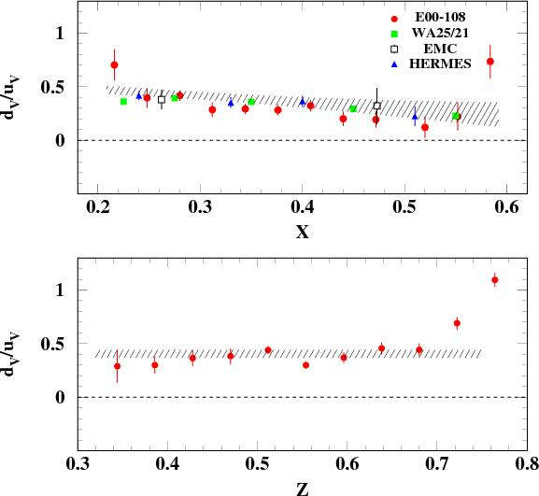
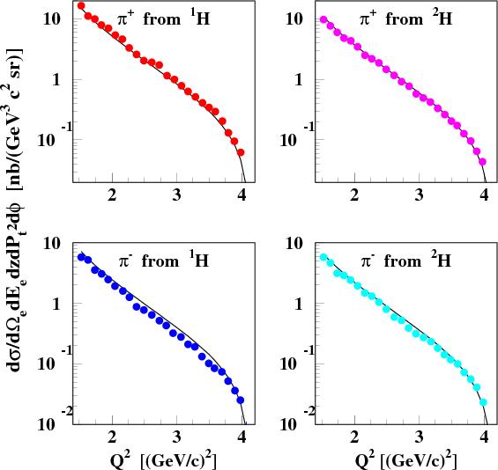
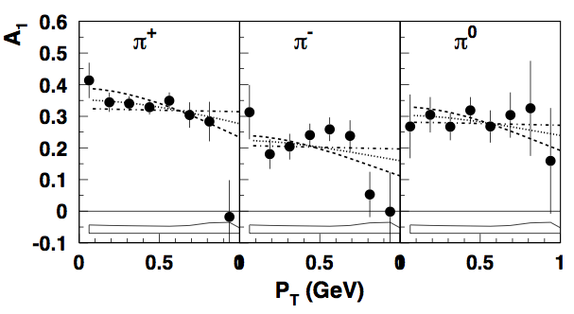
3D Parton Distributions: TMDs
Q² [(GeV/c)²]
Agreement with the parton model expectation
PRL 105 262002 (2010)
PRC 85 015202 (2012)
Avakian, Ent, Gaskell, Rossi
Different width of TMDs of quarks with different flavor and polarizations

Slide 19
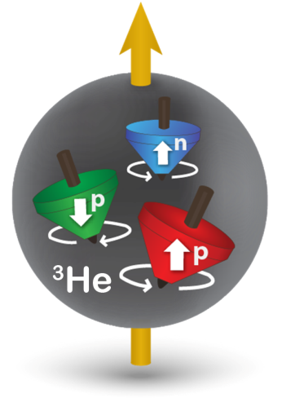
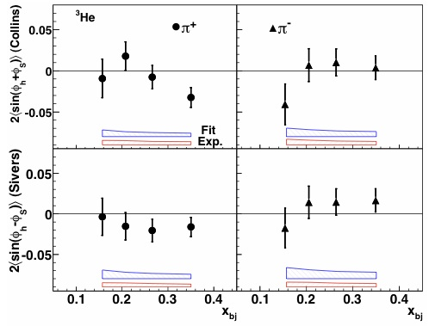
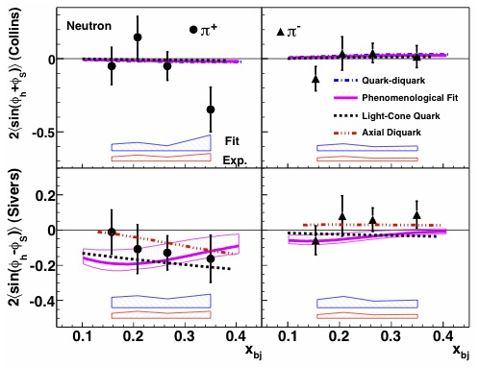
3D Parton Distributions: TMDs
Target:
(transversely) polarized ³He ~ polarized neutron
PRL 107 072003 (2011)
PRL 108 052001 (2012) Chen, Allada
1st measurements of 3He (neutron) single-spin asymmetries
³He
^{neutron}
Collins small, largely compatible to 0; Sivers negative (?) for π⁺, zero for π⁻
Inaugural American Physical Society Dissertation Award in Hadronic Physics:
Jin Huang for his thesis, "Measurement of Double Spin Asymmetries in Charged Pion Production from Deep Inelastic Scattering on a Transversely Polarized 3He Target”

Slide 20
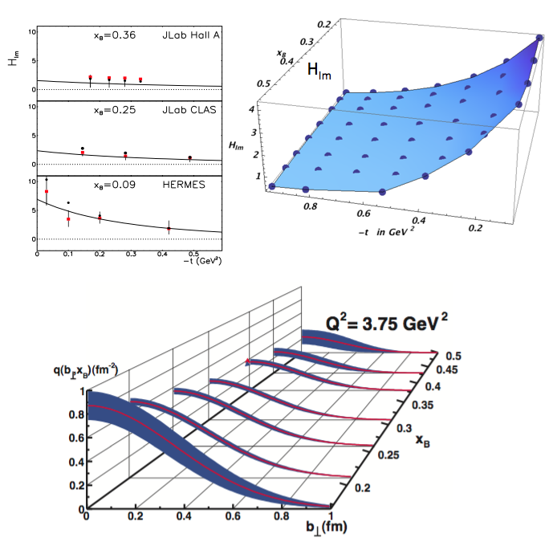
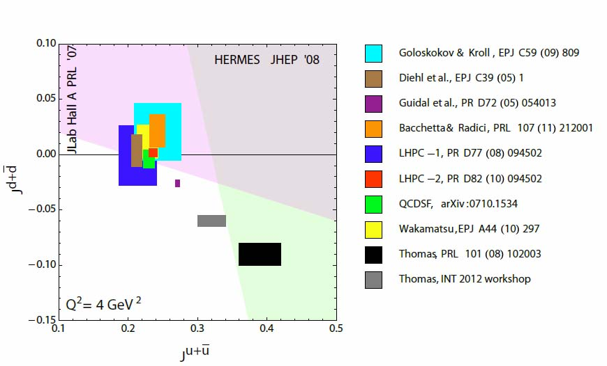
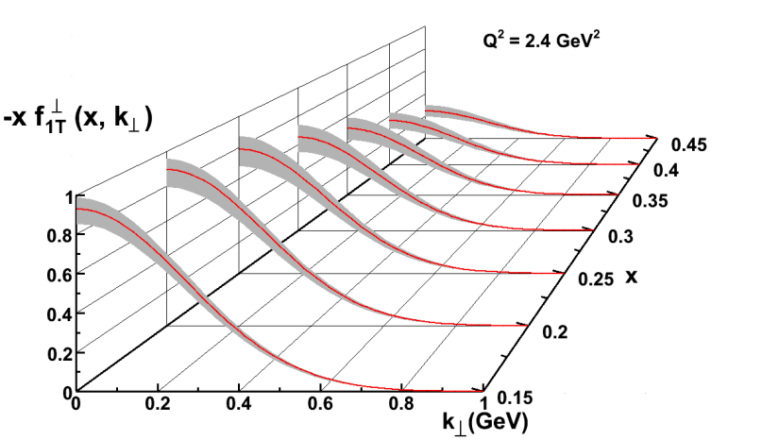
3D Parton Distributions: IMPACT
Access to quark orbital angular momentum
Access to the nucleon 3D view
Transverse Spatial Imaging
≈30% ≈zero
Transverse momentum space

Slide 21
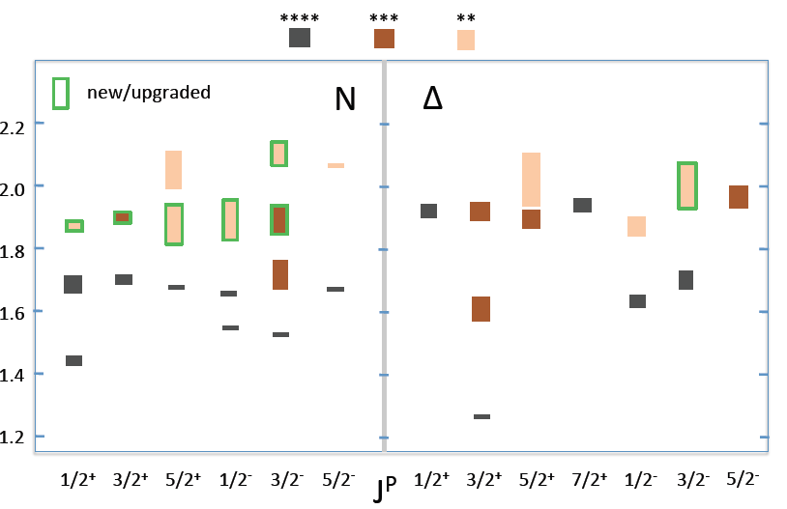
N/Δ spectrum in PDG 2012
Projected new states constrained largely from meson photoproduction
Bonn-Gatchina coupled-channel analysis
EPJ A48, 15 (2012)
Burkert. Mokeev, Pasyuk
The analysis of nearly all new CLAS photoproduction data led to the inclusion into the Review of Particle Properties, 2012 edition, several state for which there is now either new or improved evidence
Notes:
The analysis of these and other data sets led to the inclusion into the Review of Particle Properties, 2012 edition, several state for which there is now either new or improved evidence. These are shown by the bars with green frames. The brown color shades show the strength of the evidence assigned by the PDG. It is also interesting to note that 5 of these candidates states occupy a narrow band of only 150MeV width centered around 1900MeV.

Slide 22
Electromagnetic & hadronic decays
New CLAS results in PDG 2012
Baryons | Γ(Σ⁺γ)/Γ(Σπ) | Γ(Λγ)/Γ(Λπ) | Unit | CLAS data entry in PDG
Σ(1385) |  | 1.42±0.12 +0.11/-0.07 | 10⁻² | 2012 Keller et al.
Σ⁺(1385) | 5.98±1.11 +0.27/-0.61 |  | 10⁻² | 2012 Keller et al.
Mesons | Live time 10⁻¹⁷ s | Channel | CLAS data entry in PDG
π⁰(135) | 8.32±0.15±0.17 | Primakoff | 2012 Larin et al.
PRIMEX results and e.m. couplings from the Σ(1385) radiative decays

Slide 23
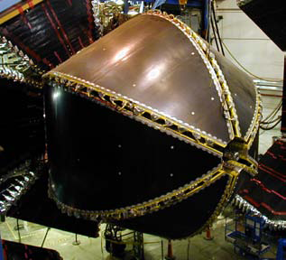
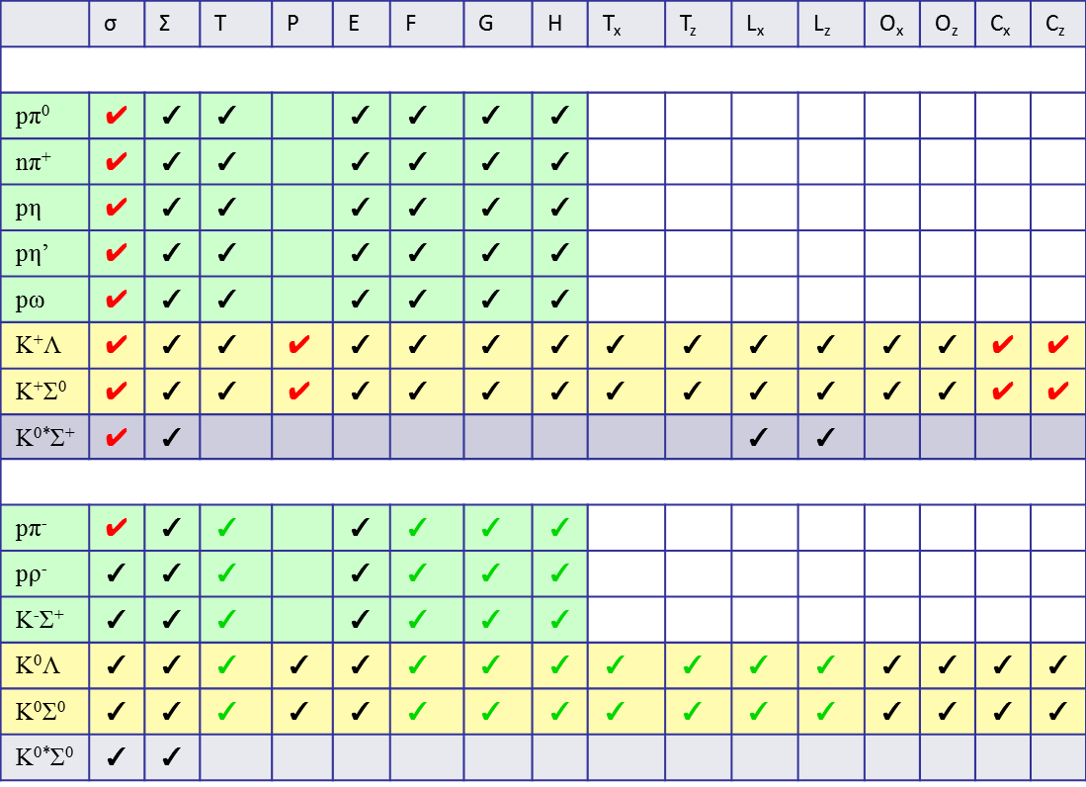
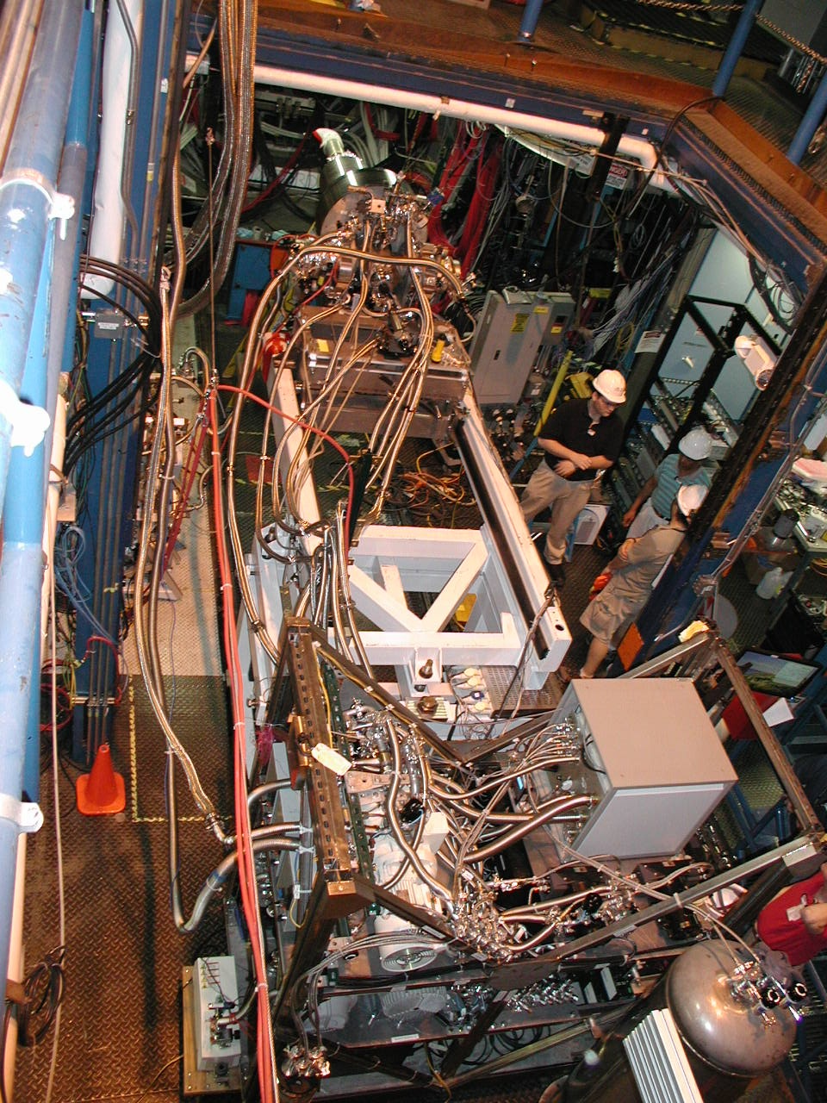
Single Meson Production on Protons & Neutrons
✔ - published ✔ - acquired ✔ -acquired HDIce
2011/2012: HDIce successfully used for complete photoproduction experiments!
Proton targets
Data taking completed
With g9b-FROST
Neutron targets
2011/2012 g14-HD run
Bass, Deur, Kageya, Lowry, Sandorfi, Wei

Slide 24
Meson Spectroscopy: the future
Excited
Gluon Field
Quarks
Hybrid Meson
like
Exotic
like
Gluonic excitation (and parallel quark spins) lead to exotic J^{PC}

Slide 25
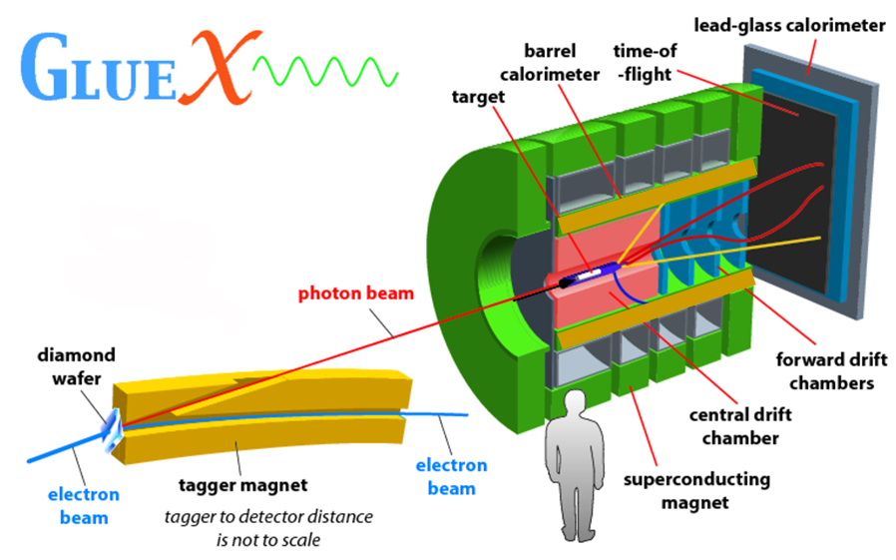
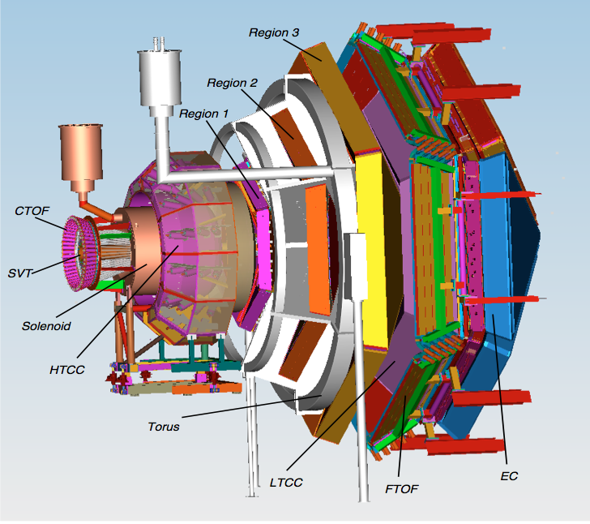
Search for Exotics
JLab 12 GeV: Complementary meson production program
GlueX in Hall D
CLAS12 in Hall B
Real 9 GeV photon beam (~10⁸ γ/s) high statistics
High degree of linear polarization aids PWA
Hermetic detector high/flat acceptance
high multiplicity final states
Quasi-real photoproduction high statistics
(Electroproduction at tiny Q²)
High degree of linear polarization
Near hermetic detector
New world database of meson photoproduction events with systematic cross-check between two detectors

Slide 26
The structure of the nucleon - summary
JLab staff scientists play a major role in carrying out fundamental measurements to study the innermost structure of the nucleon:
- Form Factors
- 1D Parton Distribution Functions
- Three-Dimensional Parton Distribution Functions (GPD, TMD)
- Baryon and Meson Resonances
This is evidenced by the considerable scientific productivity in terms of published papers and participation to workshop and conferences.
JLab staff scientists are recognized, within the US and internationally, pioneers in the studies of the 3D view of the nucleon structure as evidenced also by recent APS Fellowships.
JLab staff scientists have outstanding leadership in the 12 GeV program being co-spokesperson of almost all the approved experiments.
JLab staff scientists have fruitful and longstanding collaboration with a large and vibrant international scientific community.
Notes:
Outstanding leadership

