Slide 1
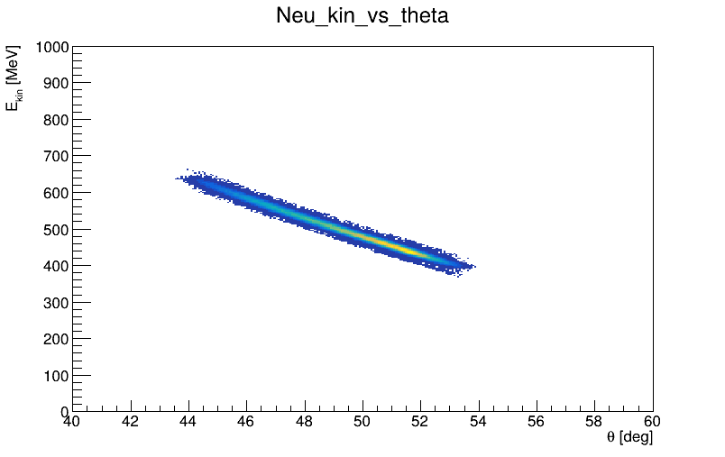
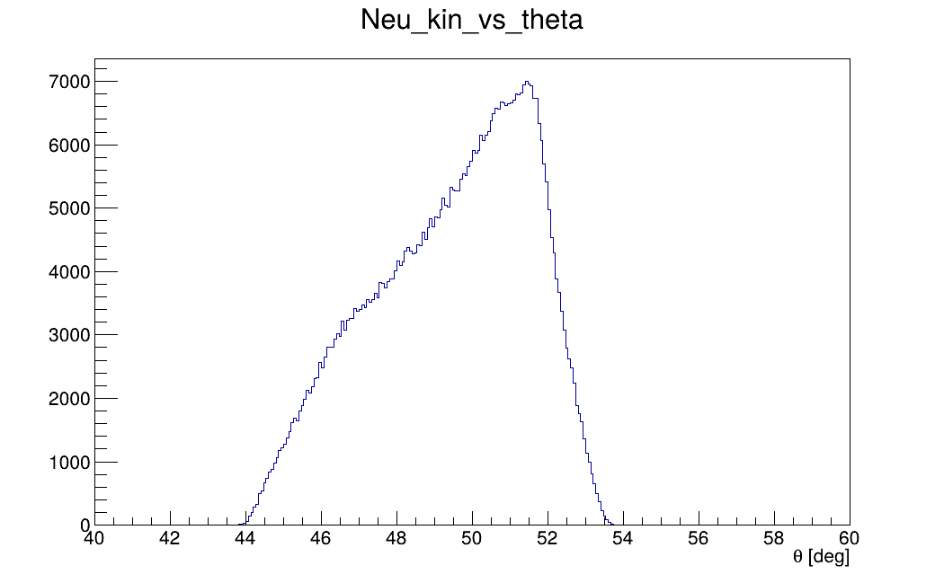
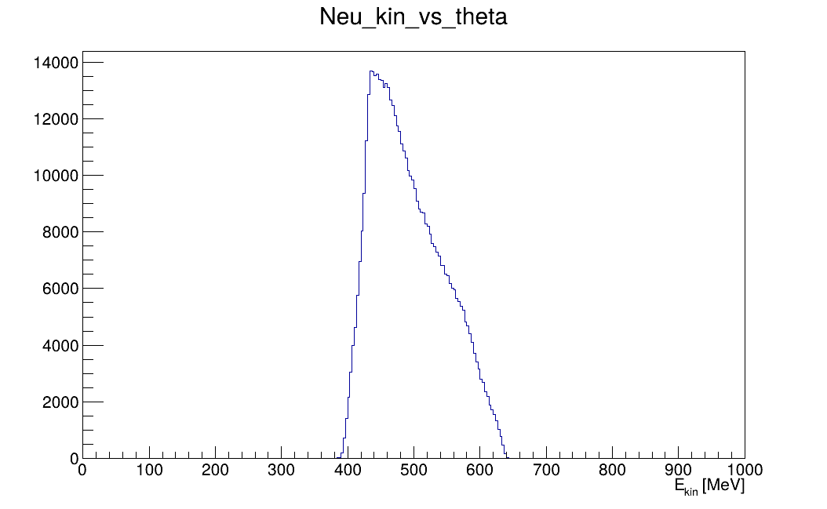
Incident Neutron Information
Neutron arm centered at 48 deg
For a constant threshold, there will be a strong angular dependency on the efficiency
Introduce an angle-dependent threshold:
Theta in deg, returned value in GeV
Threshold set at 48 deg, with +5 MeV at 44 deg, and -5MeV at 54deg
$$−2.592×{10}^{−3}×θ+(threshold+48×2.592×{10}^{−3})$$
Projection to x-axis
Projection to y-axis

Slide 2
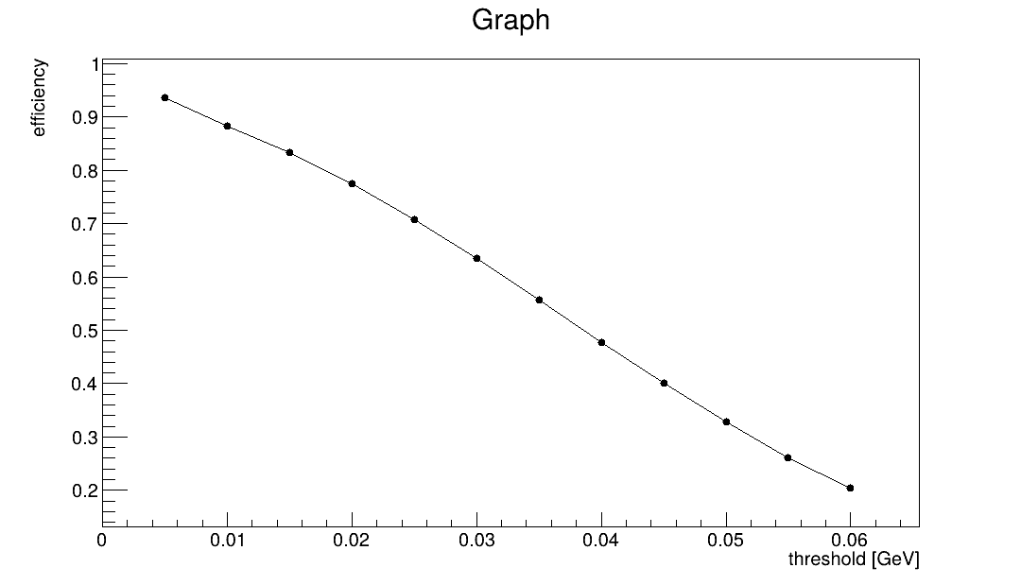
NCal efficiency vs threshold

Slide 3
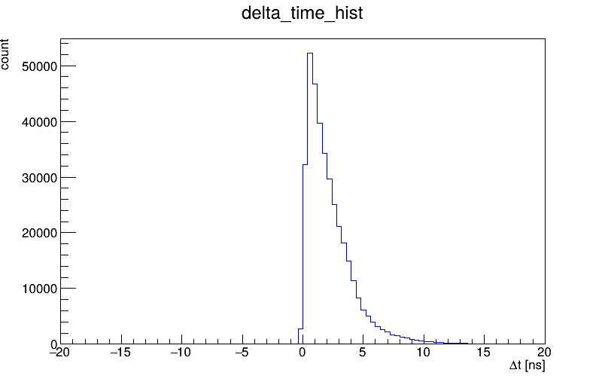
NCal time distribution
$∆t$ is the time difference between:
Signal starting time in the Ncal module that has the highest Edep in scintillators
The expected arrival time assuming:
elastic kinematics
Ncal recon position
track starting from center of target
One can cut $0ns<∆t<10ns$ or $0ns<∆t<5ns$

Slide 4
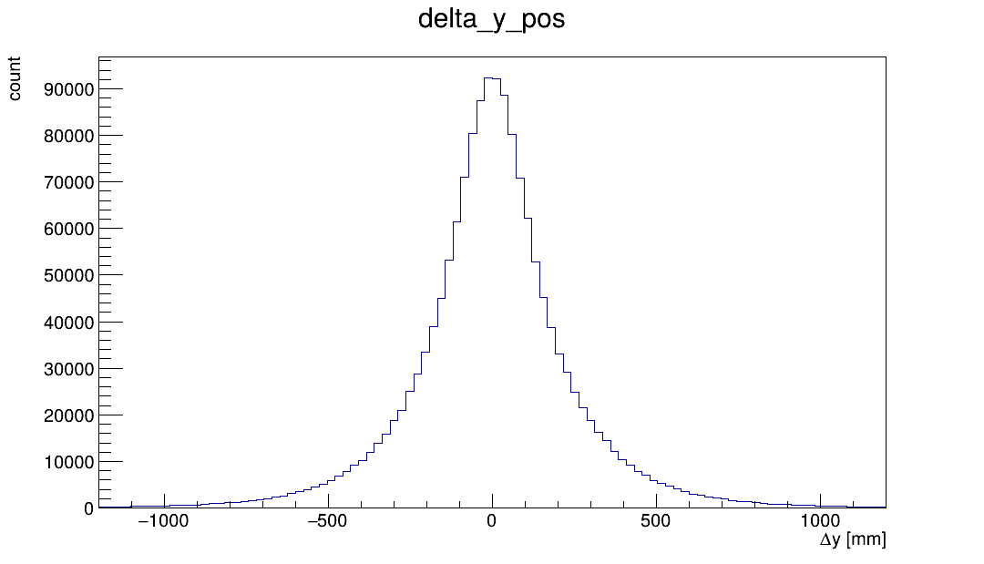
TOF Matching Condition
After passing the NCal threshold and time cut, check TOF fired modules
Calculating the difference between NCal recon y position, and y position of fired TOF module centers
TOF fire condition is edep in a tof module larger than 3 MeV
Right plot has a very large tail, but many of them could come from back scattering or slow processes

Slide 5
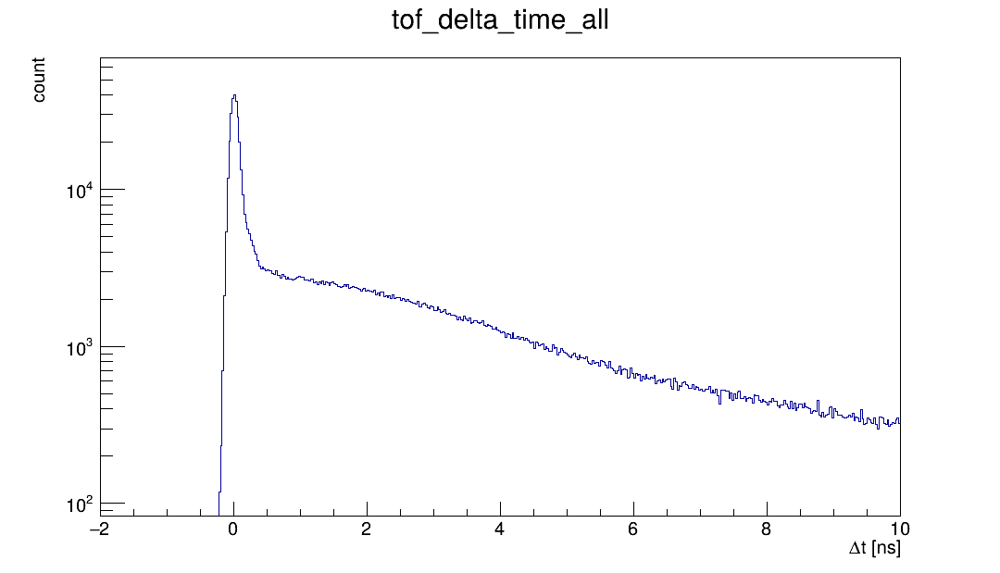
TOF Matching Condition
After passing the NCal threshold and time cut, check TOF fired modules
Calculating the difference between NCal recon y position, and y position of fired TOF module centers
TOF fire condition is edep in a tof module larger than 3 MeV
Right plot has a very large tail, but many of them could come from back scattering or slow processes
$∆t$ is the time difference between:
Signal starting time in a tof module
Expected time assuming, elastic condition, track from target center, and position reconstructed by tof (with 1cm reso. in x)

Slide 6
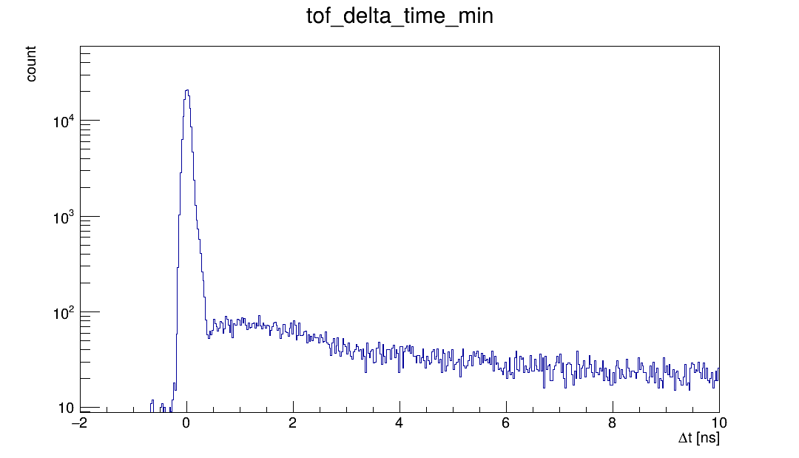
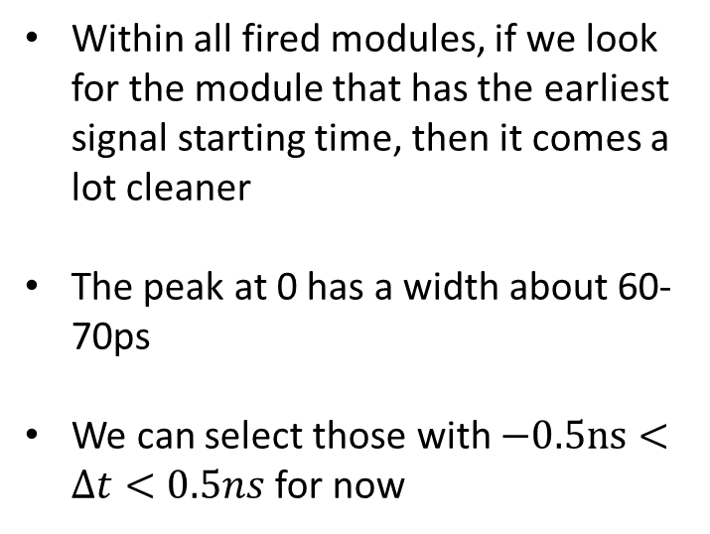
TOF Matching Condition
Within all fired modules, if we look for the module that has the earliest signal starting time, then it comes a lot cleaner
The peak at 0 has a width about 60-70ps
We can select those with $−0.5ns<∆t<0.5ns$ for now
$∆t$ is the time difference between:
Signal starting time in a tof module
Expected time assuming, elastic condition, track from target center, and position reconstructed by tof (with 1cm reso. in x)

Slide 7
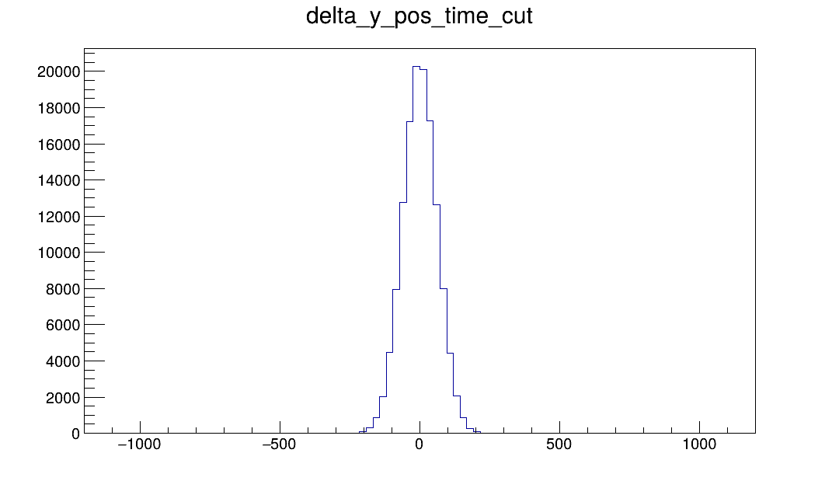
TOF Matching Condition
Once applying the $−0.5ns<∆t<0.5ns$, one sees that the y pos of fired modules become a lot closer to the Ncal reconstructed position
One can search for +/- 5 tof modules around the Ncal reconstructed hit position

Slide 8
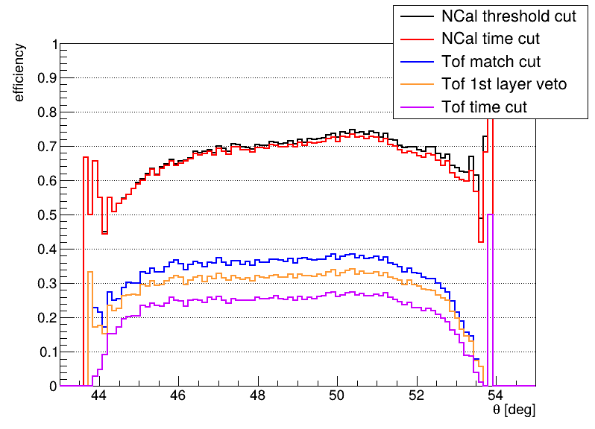
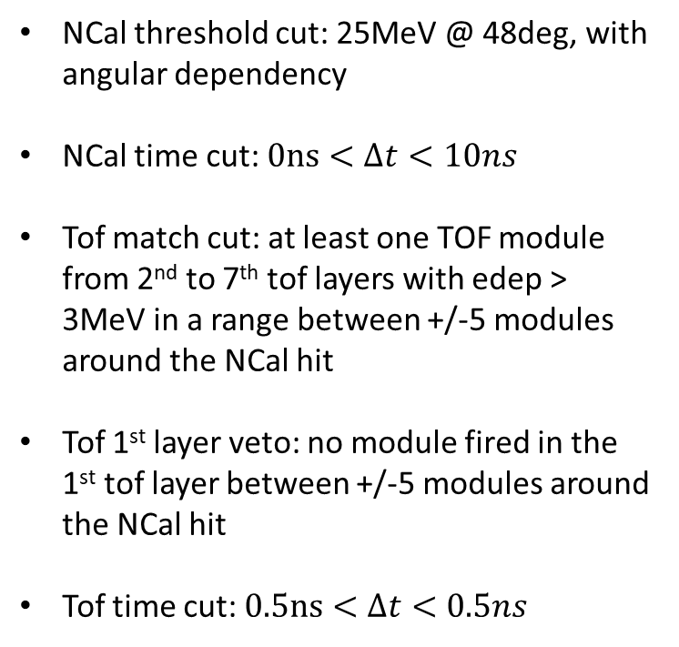
Neutron arm efficiency
NCal threshold cut: 25MeV @ 48deg, with angular dependency
NCal time cut: $0ns<∆t<10ns$
Tof match cut: at least one TOF module from 2nd to 7th tof layers with edep > 3MeV in a range between +/-5 modules around the NCal hit
Tof 1st layer veto: no module fired in the 1st tof layer between +/-5 modules around the NCal hit
Tof time cut: $0.5ns<∆t<0.5ns$

Slide 9
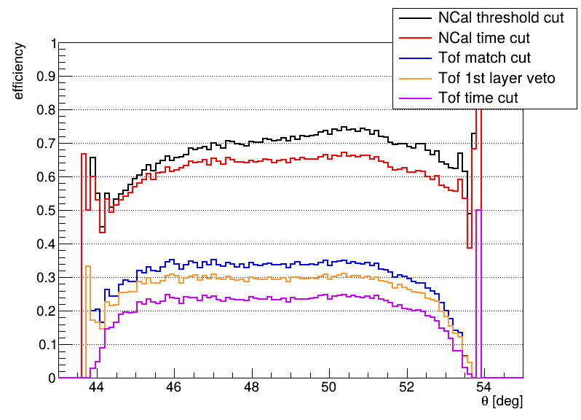
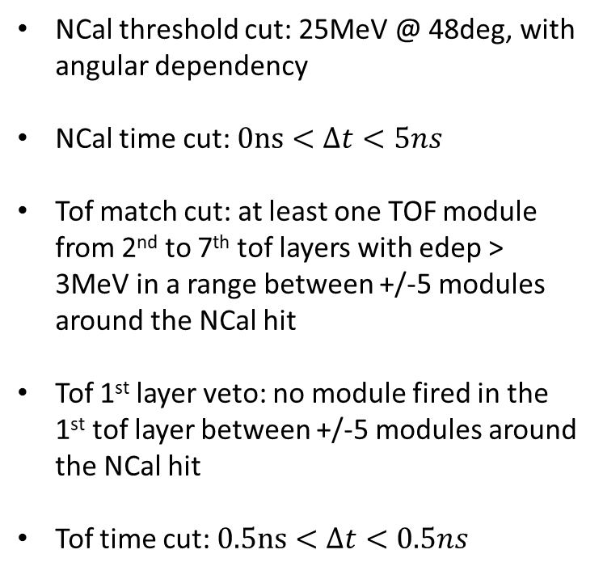
Neutron arm efficiency
NCal threshold cut: 25MeV @ 48deg, with angular dependency
NCal time cut: $0ns<∆t<5ns$
Tof match cut: at least one TOF module from 2nd to 7th tof layers with edep > 3MeV in a range between +/-5 modules around the NCal hit
Tof 1st layer veto: no module fired in the 1st tof layer between +/-5 modules around the NCal hit
Tof time cut: $0.5ns<∆t<0.5ns$

